Slide 1
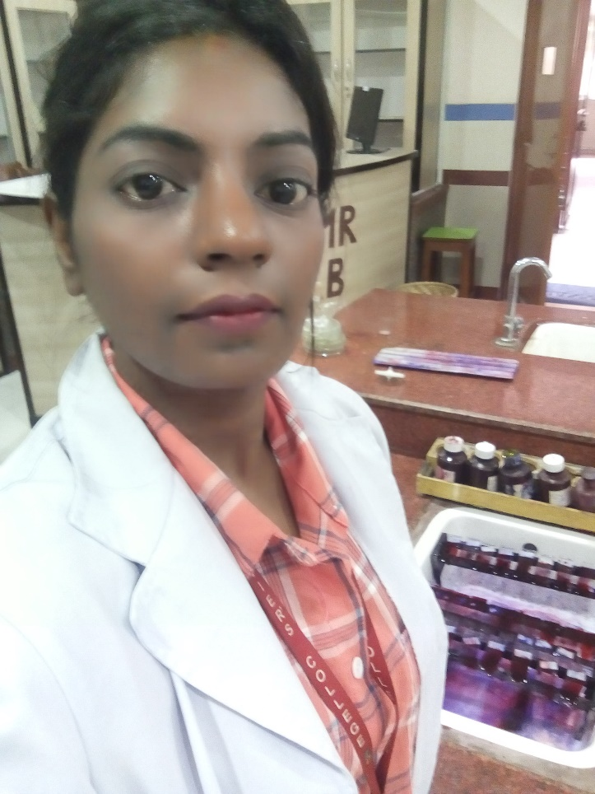
National disease concerns
Presented by- SANJU SAH
St. Xavier’s College, Maitighar, Kathmandu
MS.C Microbiology Department

Slide 2
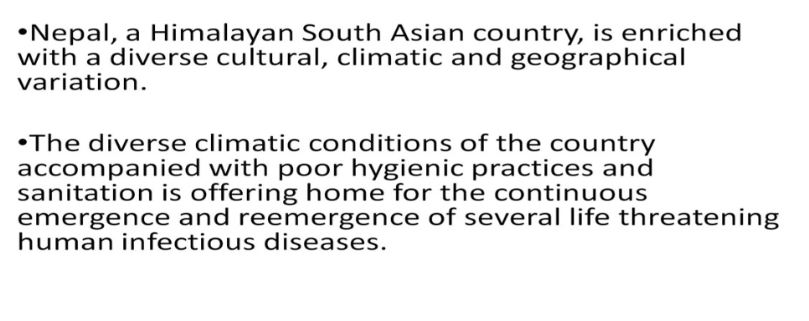

Slide 3
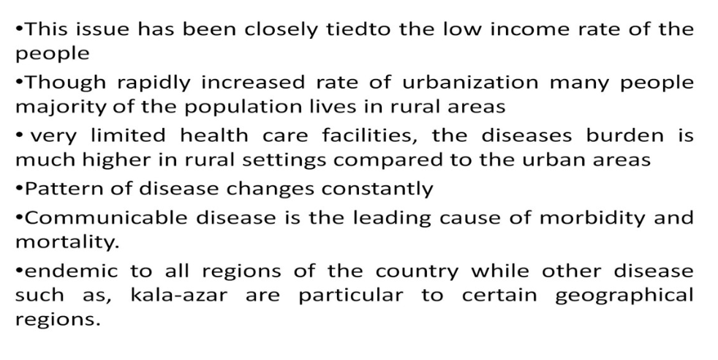

Slide 4
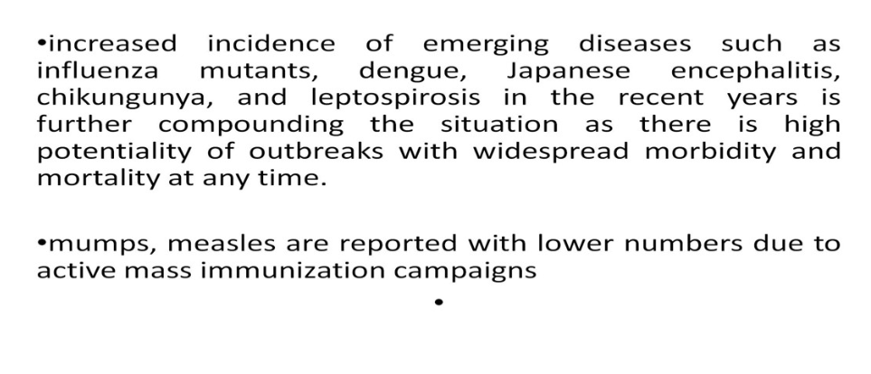

Slide 5
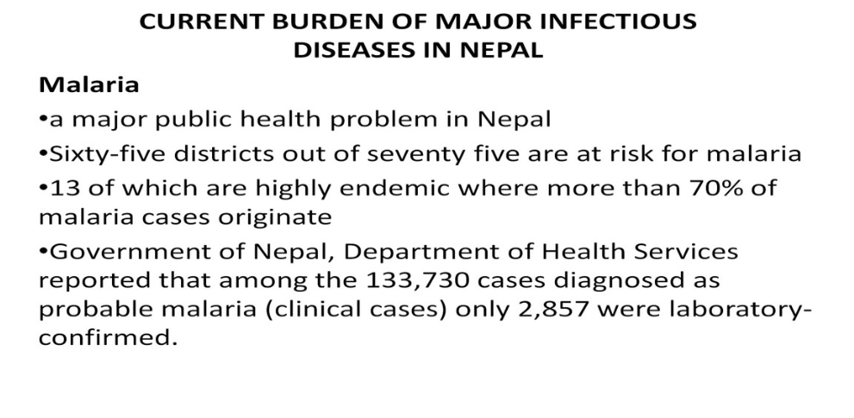

Slide 6
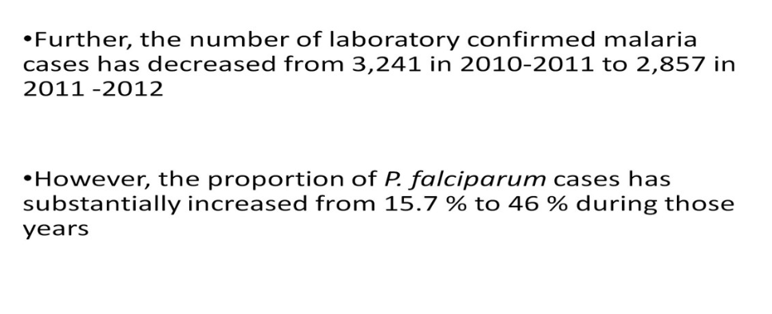

Slide 7
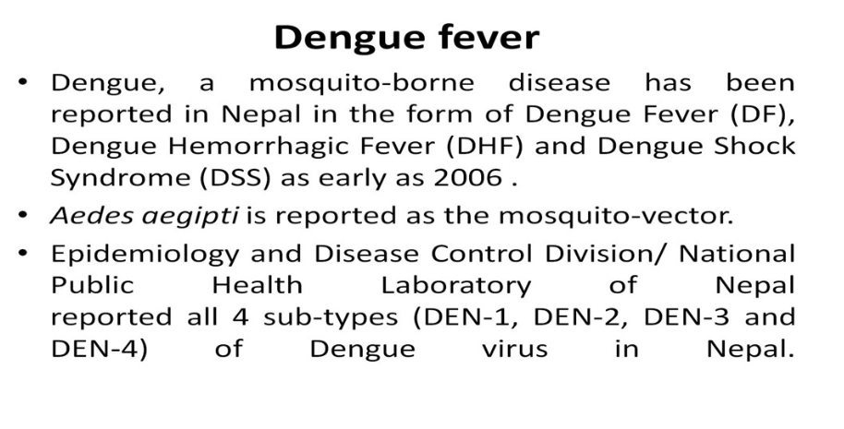

Slide 8
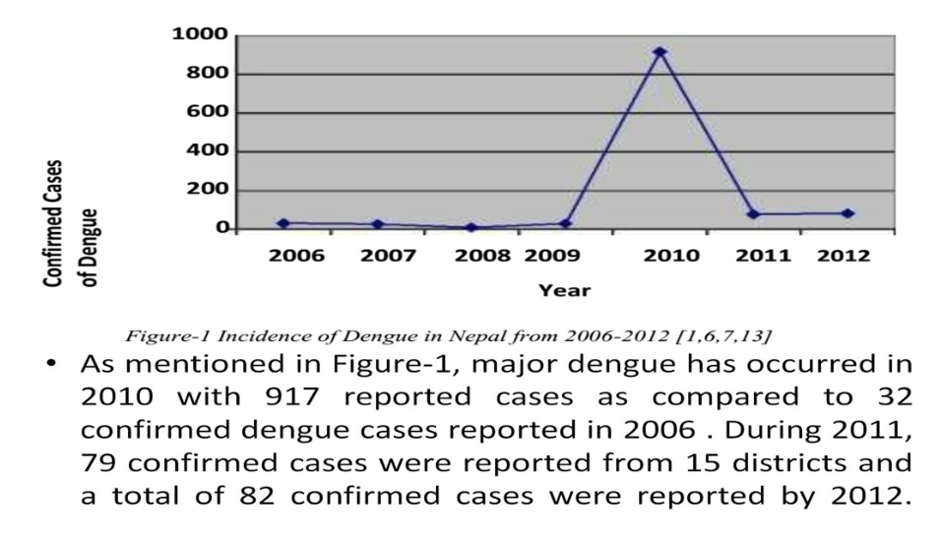

Slide 10
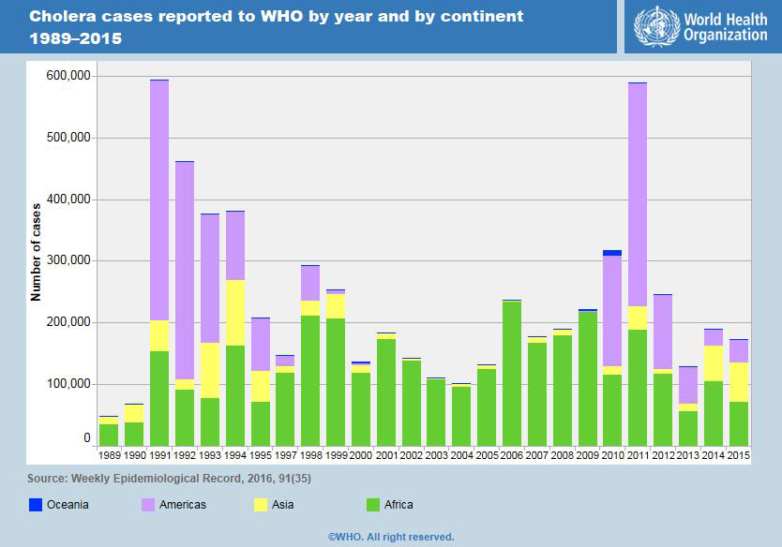

Slide 11
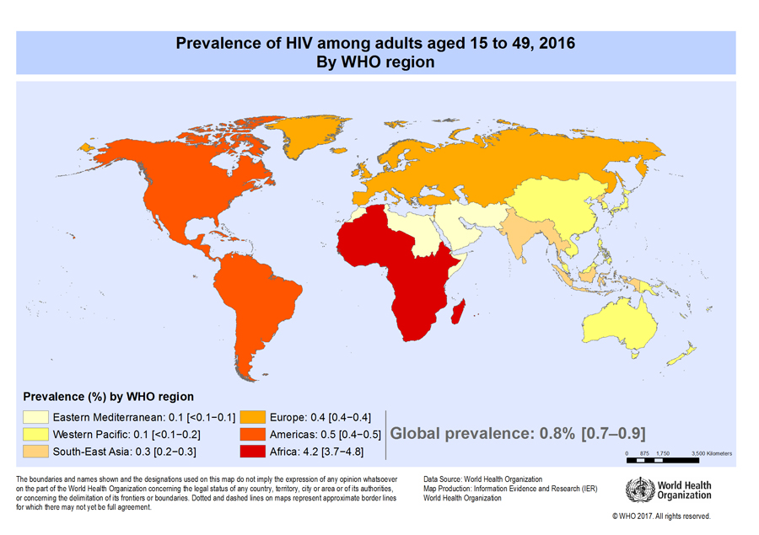

Slide 12
NEPAL : DIARRHOEAL DISEASES
Deaths % rate world rank
6,160 3.89 28.82 47
According to the latest WHO data published in may 2014 Diarrhoeal diseases Deaths in Nepal reached 6,160 or 3.89% of total deaths. The age adjusted Death Rate is 28.82 per 100,000 of population ranks Nepal #47 in the world

Slide 13
Nepal : HIV/AIDS
Deaths % rate world rank
4,066 2.56 17.52 57
According to the latest WHO data published in may 2014 HIV/AIDS Deaths in Nepal reached 4,066 or 2.56% of total deaths. The age adjusted Death Rate is 17.52 per 100,000 of population ranks Nepal #57 in the world

Slide 14
NEPAL : INFLUENZA AND PNEUMONIA
Deaths % RATE WORLD RANK
13,106 8.27 63.82 55
According to the latest WHO data published in may 2014 Influenza and Pneumonia Deaths in Nepal reached 13,106 or 8.27% of total deaths. The age adjusted Death Rate is 63.82 per 100,000 of population ranks Nepal #55 in the world.

Slide 15
Causes of death
Age standardized death rate per 100,000 of population
Causes of death rate world rank
measles 7.26 6

Slide 16
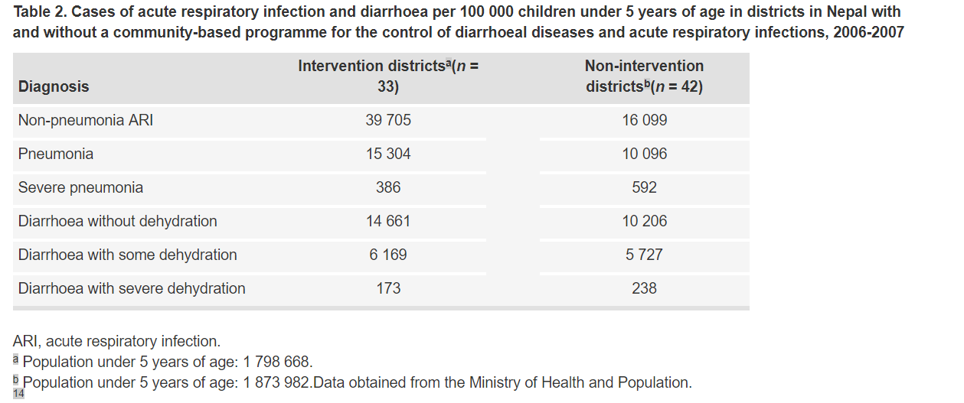

Slide 17
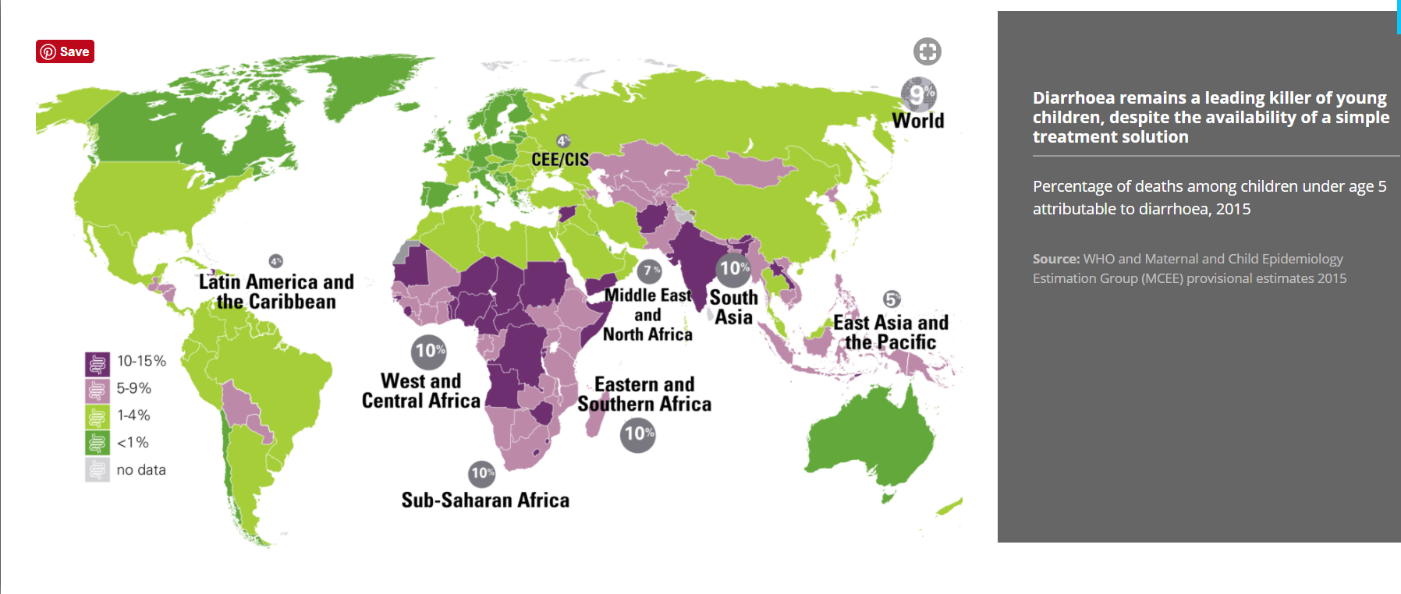

Slide 18
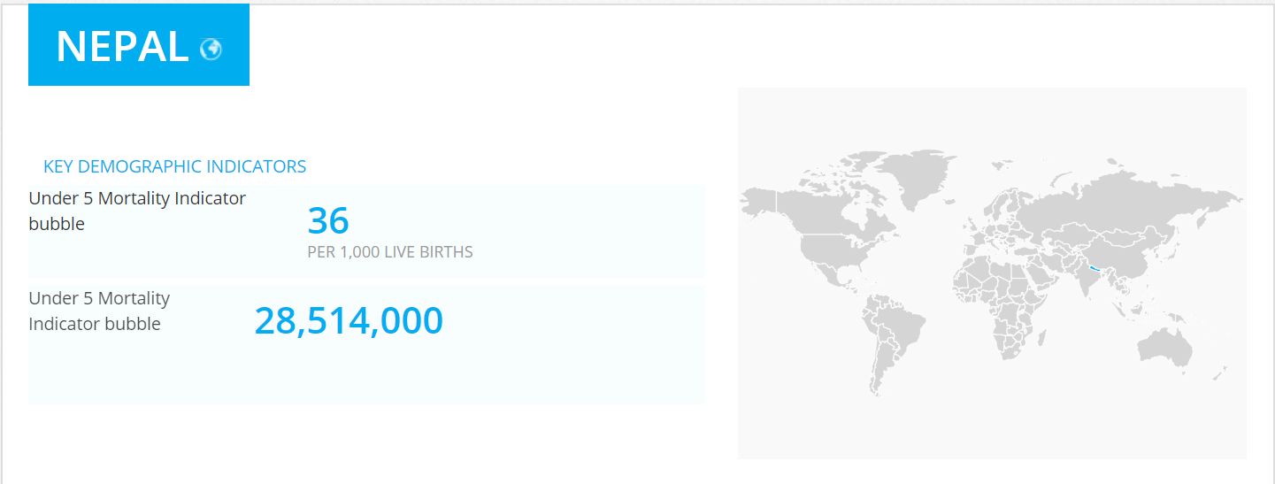

Slide 19
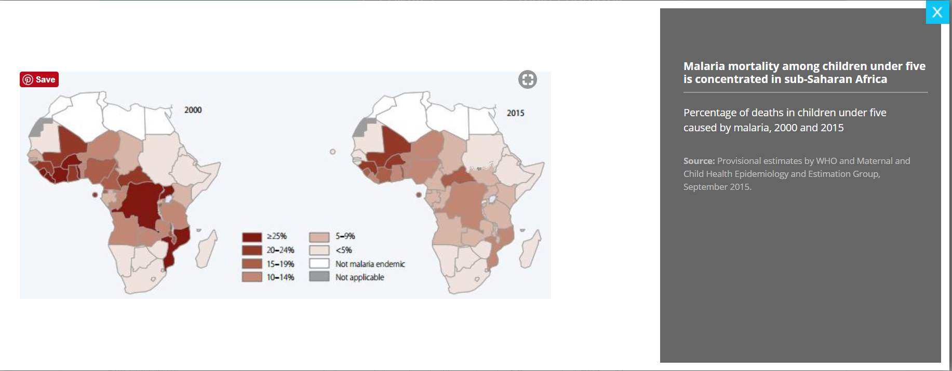

Slide 20
In 2015, there were 214 million malaria cases that led to 438,000 deaths. Of these about 80 per cent were children under five years of age. This translates into a daily toll of more than 800 children under age 5. Most of these deaths occurred in sub-Saharan Africa. However, progress in reducing malaria mortality among children has been encouraging. Since 2000, mortality rates among children under-five have fallen by 65 per cent. An estimated 5.9 million child deaths have been averted.
Malaria is an urgent public health priority. Malaria and the costs of treatment trap families in a cycle of illness, suffering and poverty. Today, 3.2 billion (almost half of the world population) are at risk. Since 2000 malaria has cost sub-Saharan Africa US$ 300 million each year for case management alone and it is estimated to cost up to 1.3 per cent of GDP in Africa

Slide 21
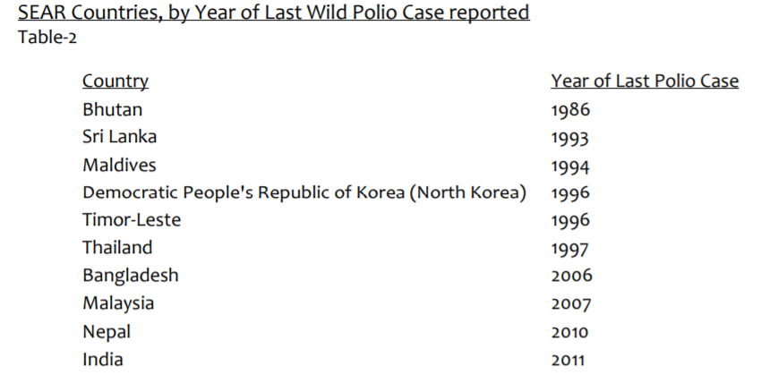

Slide 22
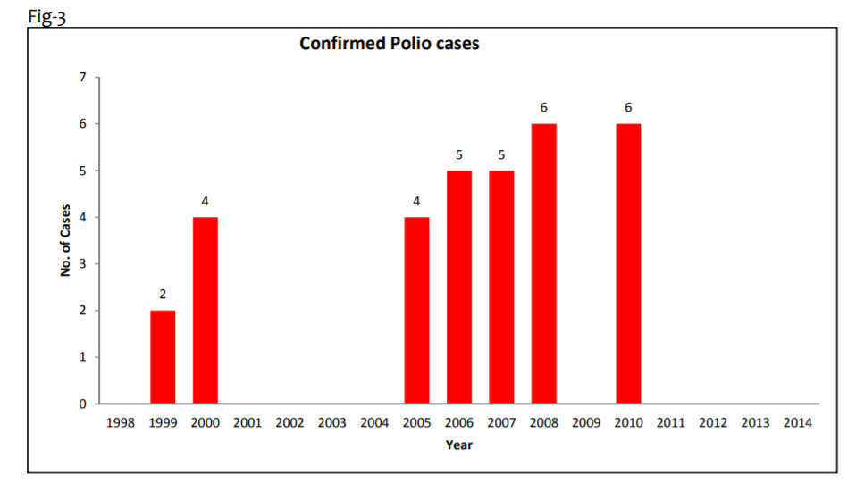

Slide 23
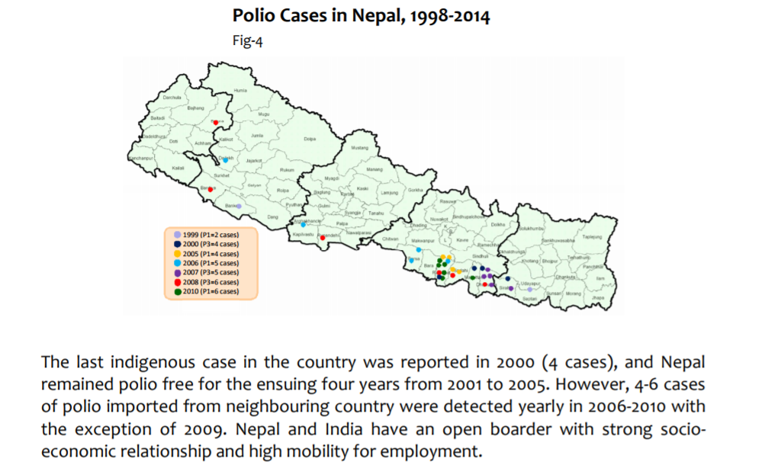

Slide 24
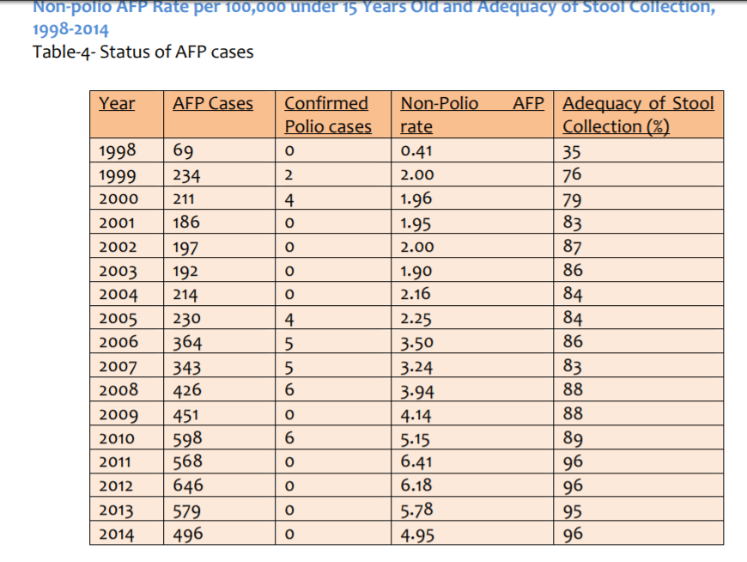

Slide 25
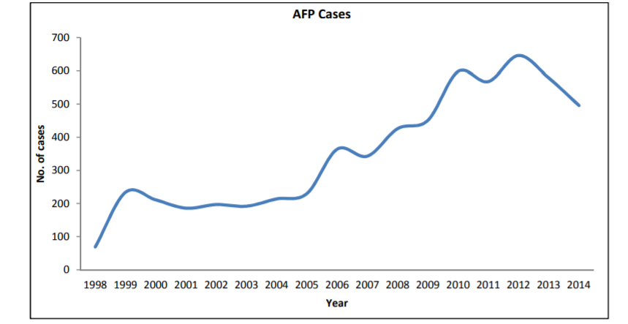

Slide 26
The polio eradication programme in Nepal has transitioned from focusing solely on polio to working on preventing other vaccine-preventable diseases. This transition has shown how staff and assets from an eradication programme can both strengthen a country’s immunization system and reduce disease incidence. Several factors contributed to this successful transition, including the eradication programme’s ability to collaborate with EPI, international technical agencies and donors; the level of support received from donors for the expanded activities; and the eradication programme’s well-trained, highly capable and motivated staff. Nepal’s immunization system has benefited from external assistance. For example, Gavi has funded 60–70% of the costs of vaccine purchases in the country. The total vaccine cost in 2014 was approximately 6.5 million United States dollars. The immunization system has also been strengthened by the January 2016 enactment of the national immunization law that requires that the government allocate adequate funding for immunizations and establishes a fund for collecting national private sector donations for support of EPI.

Slide 27
Other countries have also enlisted their polio eradication programmes in their work on other diseases. For example, in 2007, Bangladesh and India initiated surveillance of Japanese encephalitis with the aid of polio surveillance officers.14 In Nigeria, polio staff and their organizational experience were used to quickly end an outbreak of Ebola virus disease in 2014.15 The possibility that polio may be eradicated in the next few years suggests that staff and assets currently funded by the Global Polio Eradication Initiative may increasingly become available in other areas. Countries should carefully manage the transition from polio eradication to other immunization and public health priorities to ensure that they effectively use valuable experience and assets from the Global Polio Eradication Initiative after the initiative ends.

Slide 28
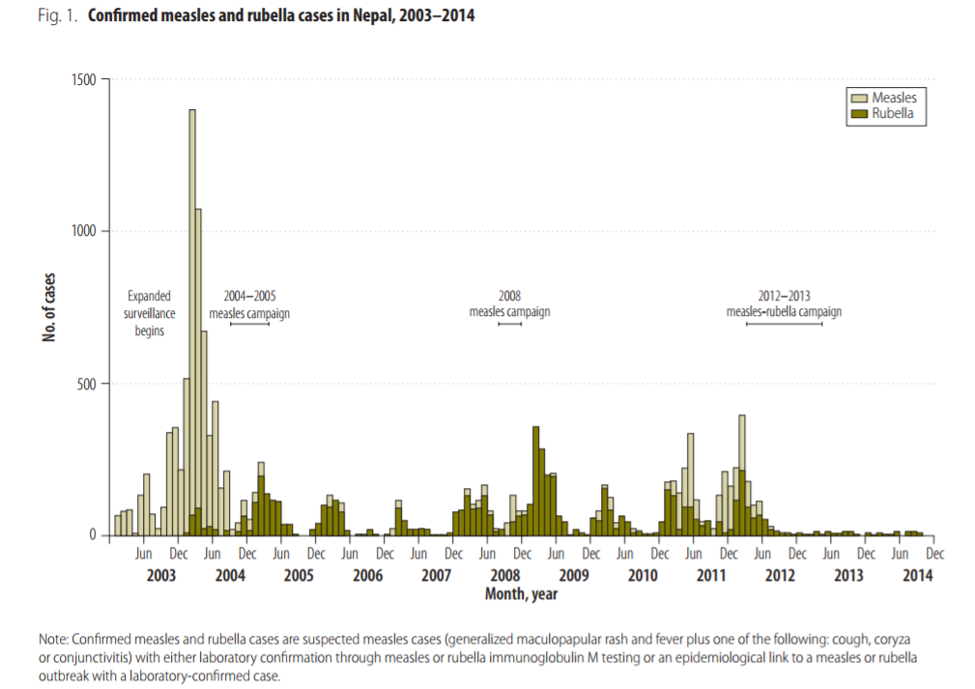

Slide 29
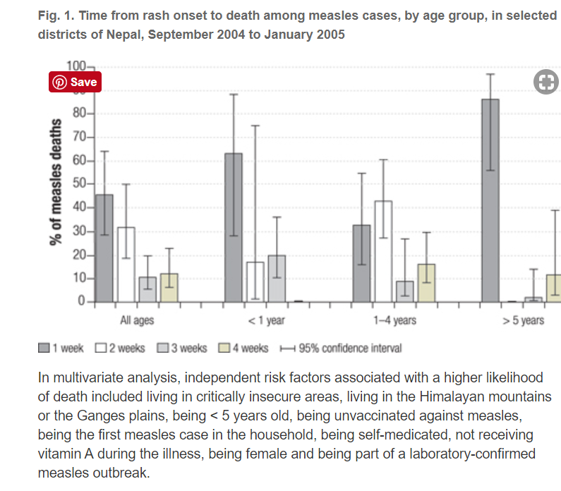

Slide 30
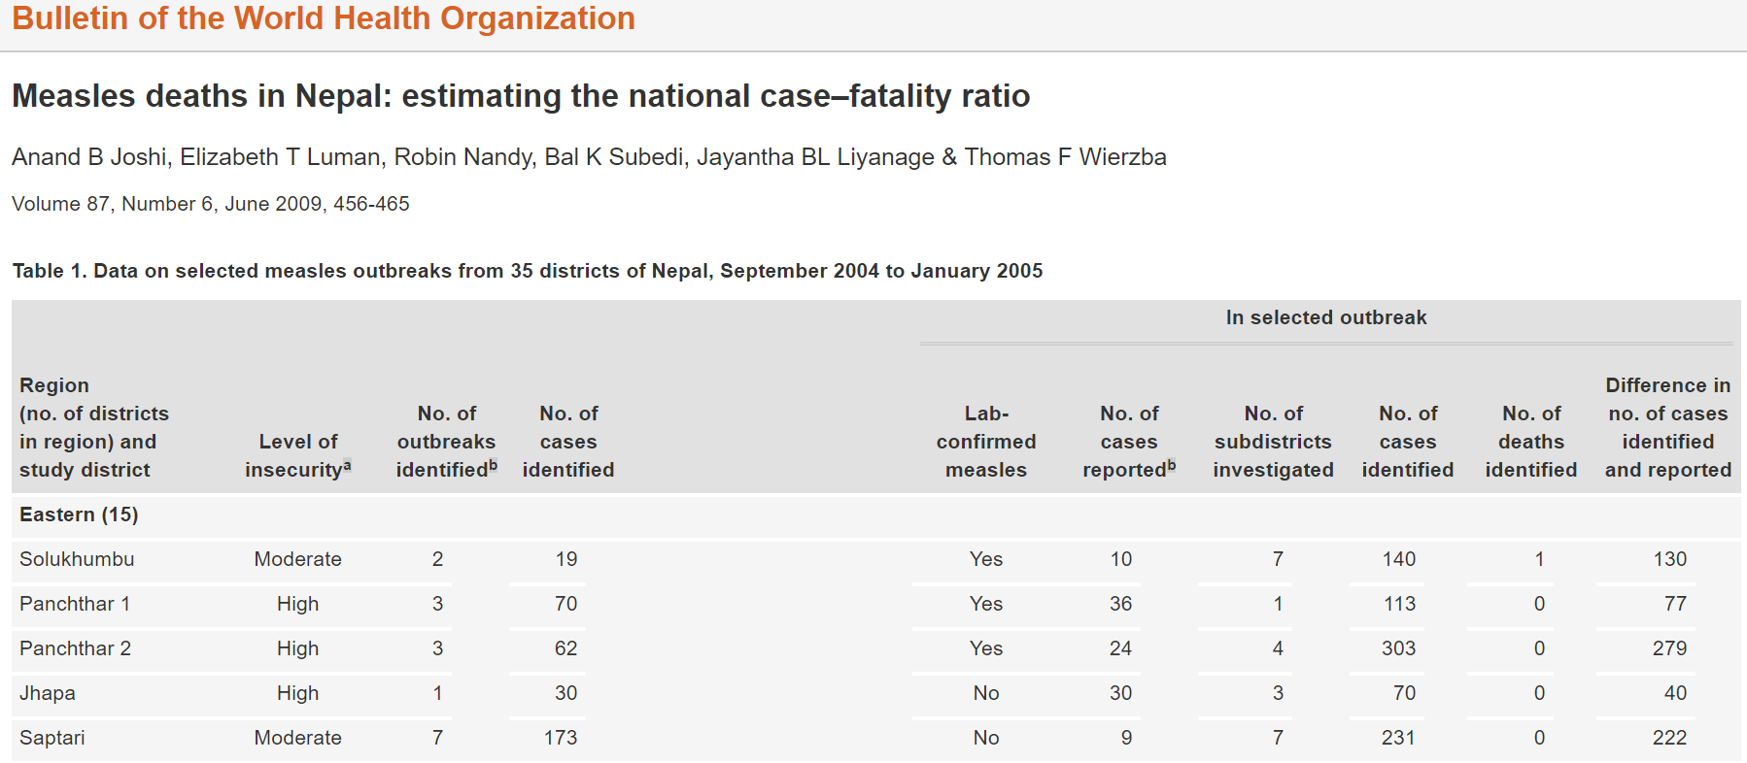

Slide 31
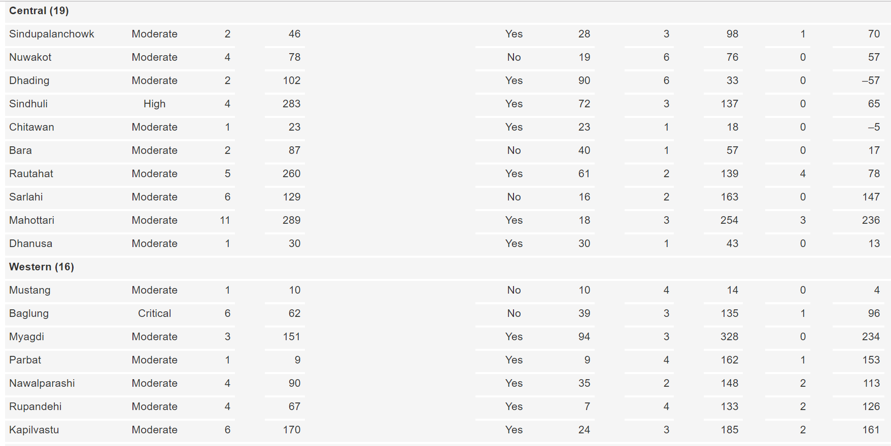

Slide 32
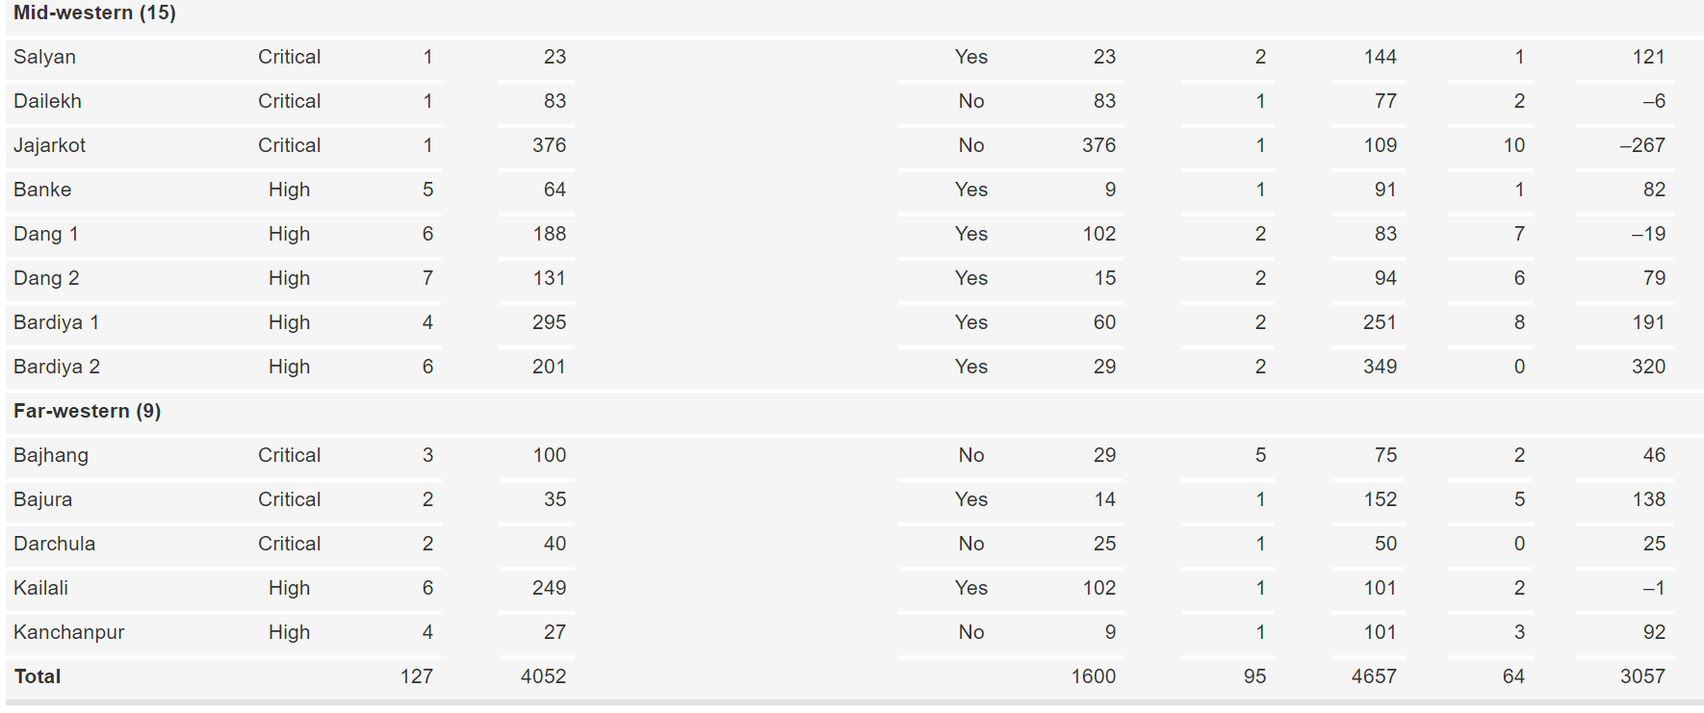

Slide 33
Japanese Encephalitis
The first outbreak of JE in Nepal was reported in 1978 from the Terai district of Rupendehi.
Since then, JE infection has been reported in animal reservoirs and in humans throughout the Terai region
an outbreak of JE in Kathmandu valley in the hill region was confirmed in 1997
a 2006 study reported JE endemicity in Kathmandu Valley
In recent years, the Ministry of Health and Population in Nepal has introduced public health interventions, including mass immunization campaigns, for JE prevention in these known JE-endemic areas

Slide 34
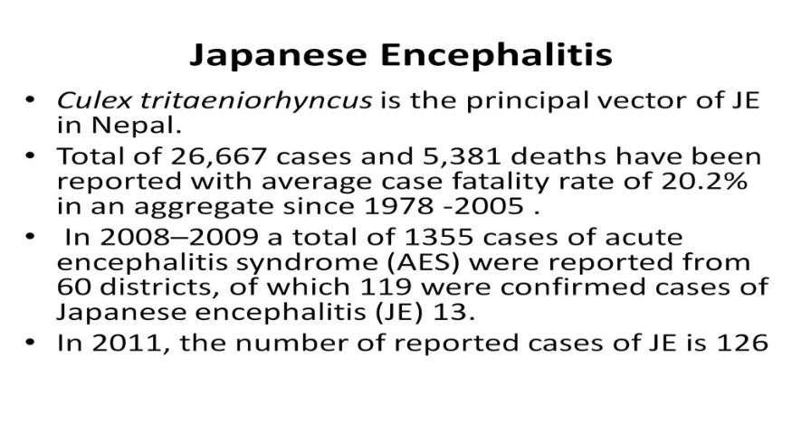

Slide 35
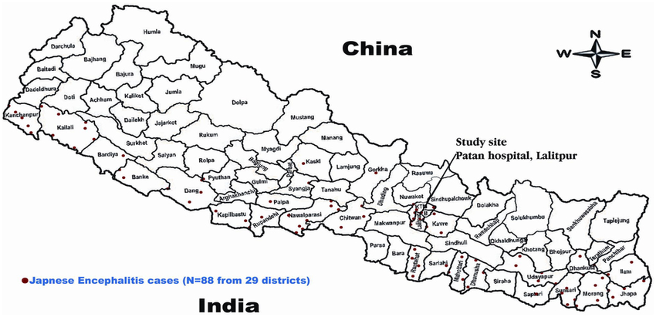

Slide 36
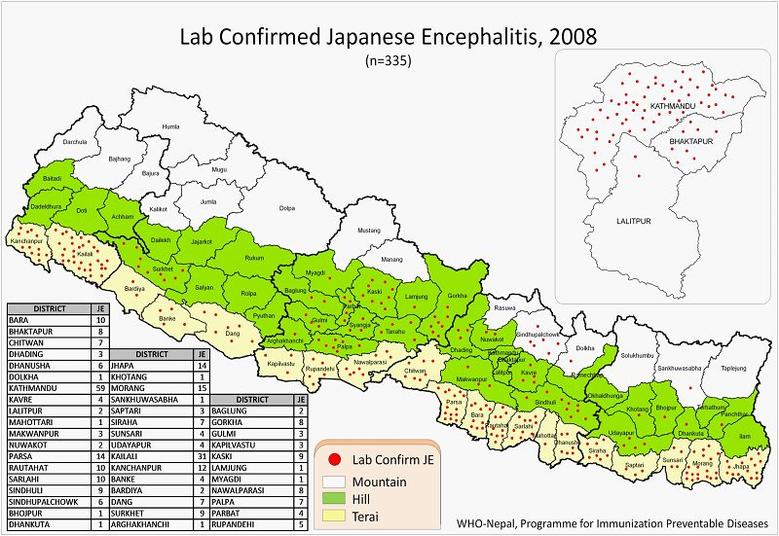

Slide 37
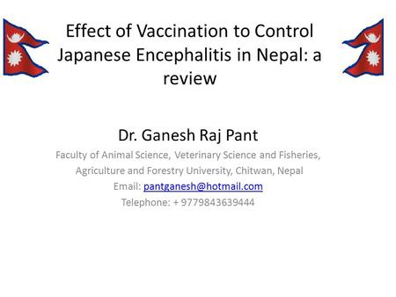

Slide 38
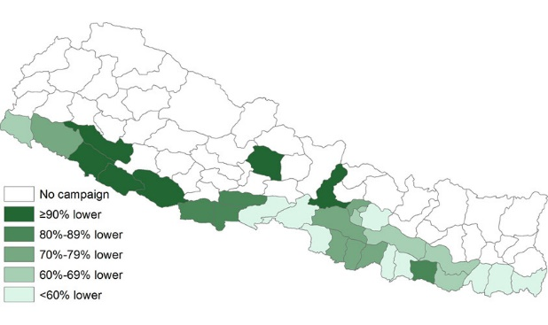

Slide 39
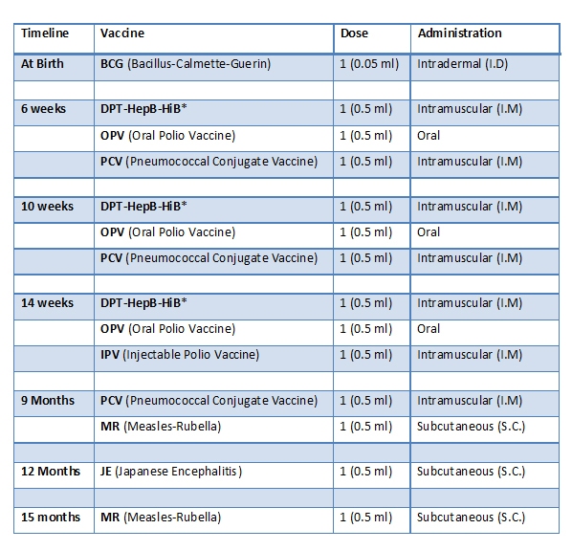

Slide 40
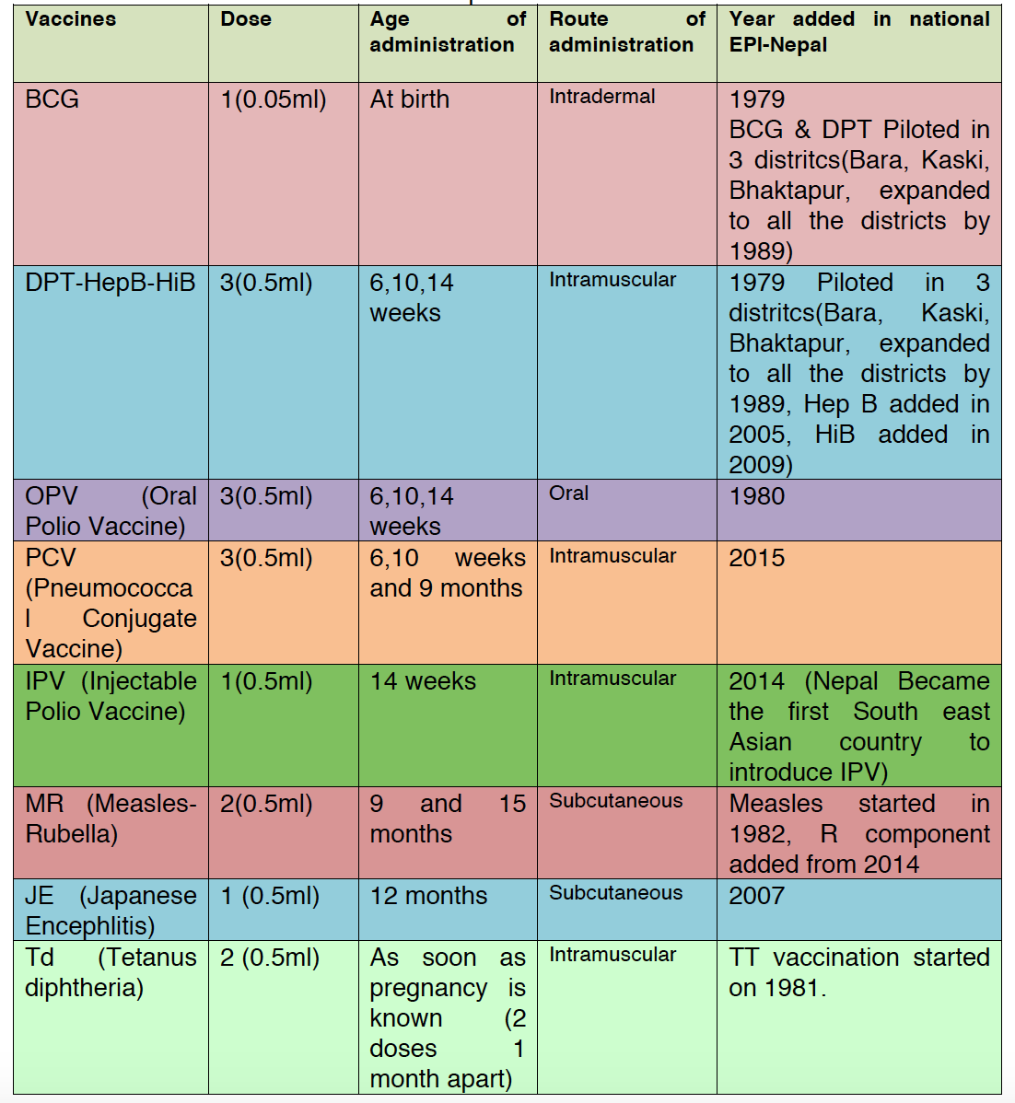

Slide 41
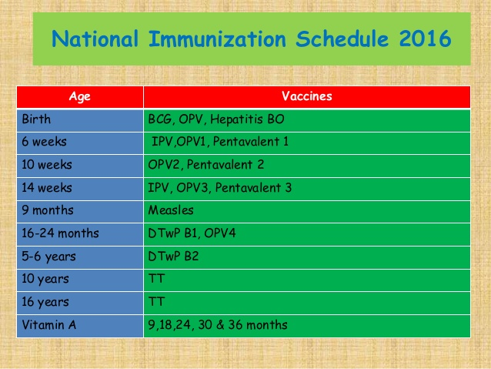

Slide 42
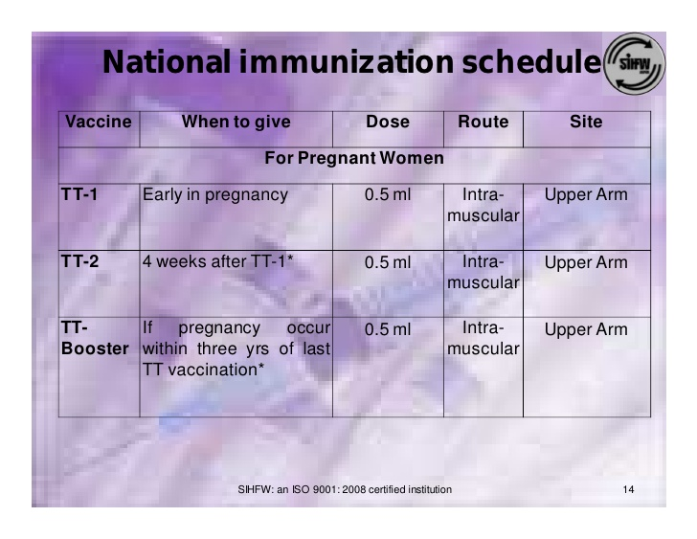

Slide 43
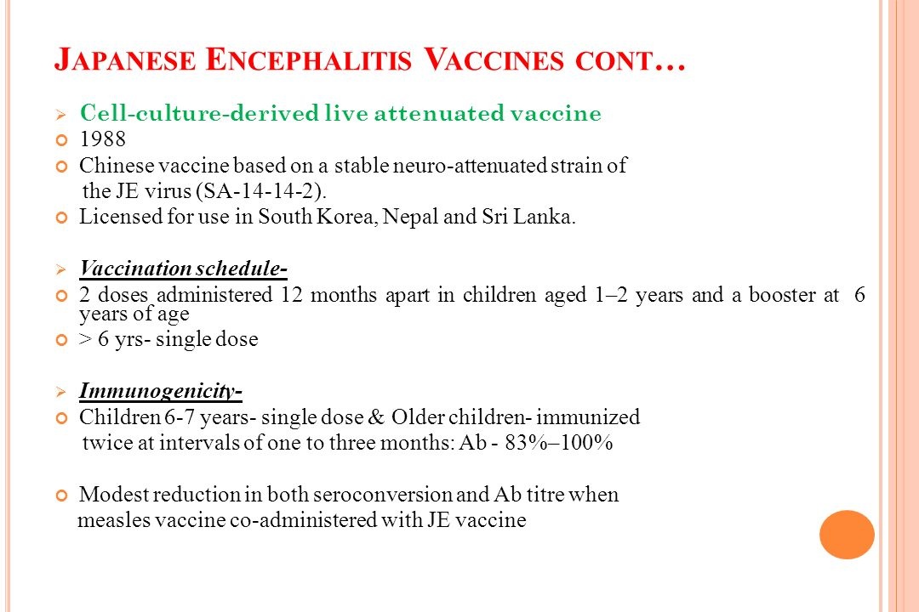

Slide 44
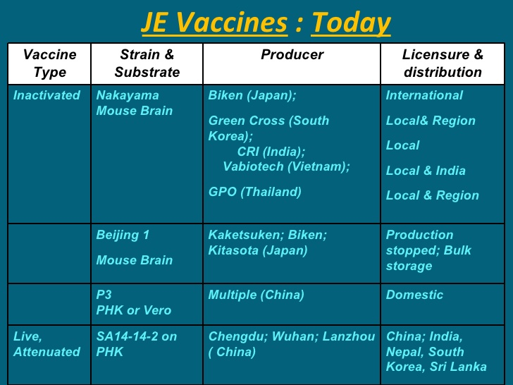

Slide 45
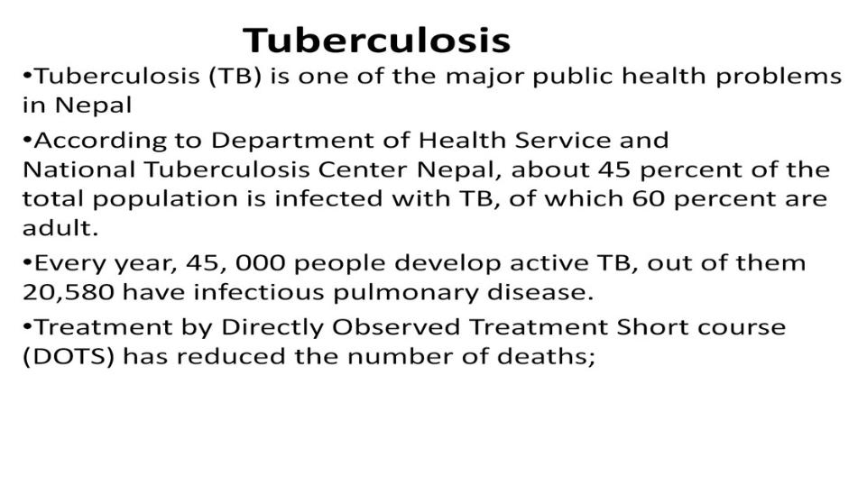

Slide 46
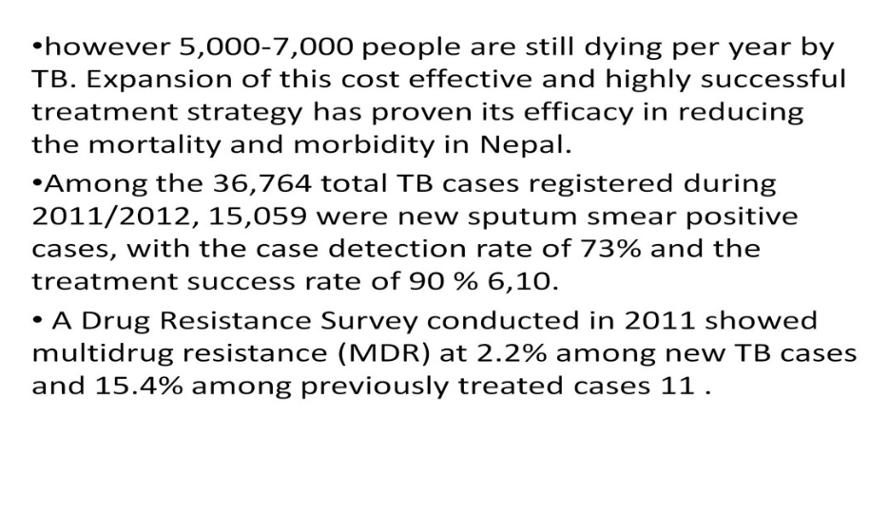

Slide 47
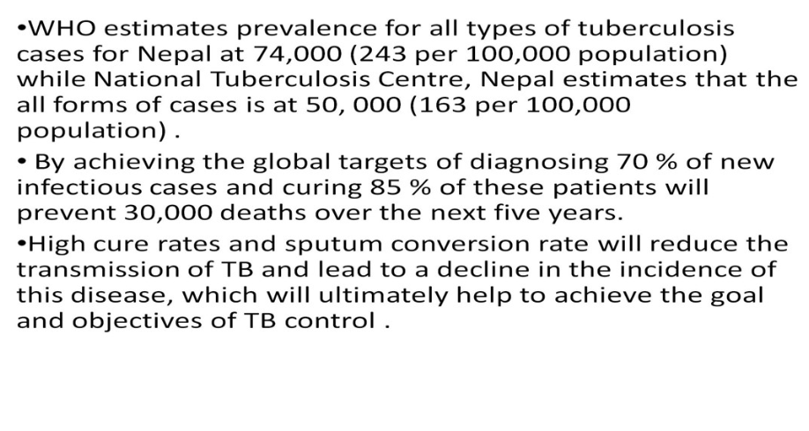

Slide 48
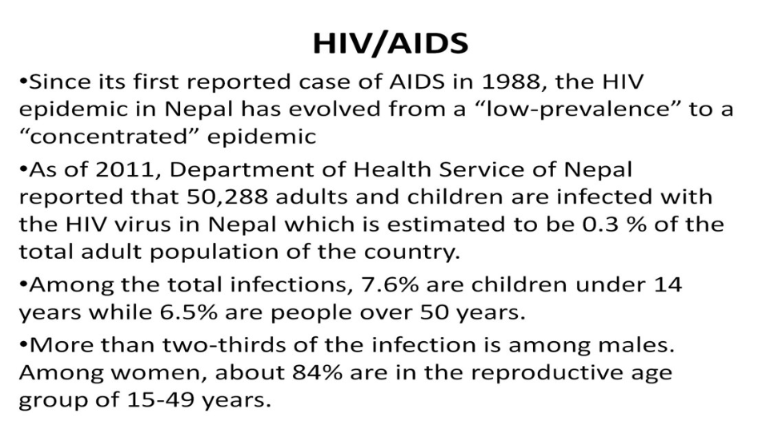

Slide 49
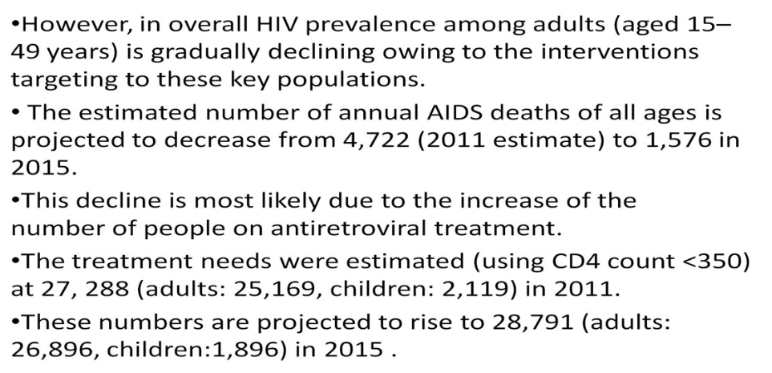

Slide 50
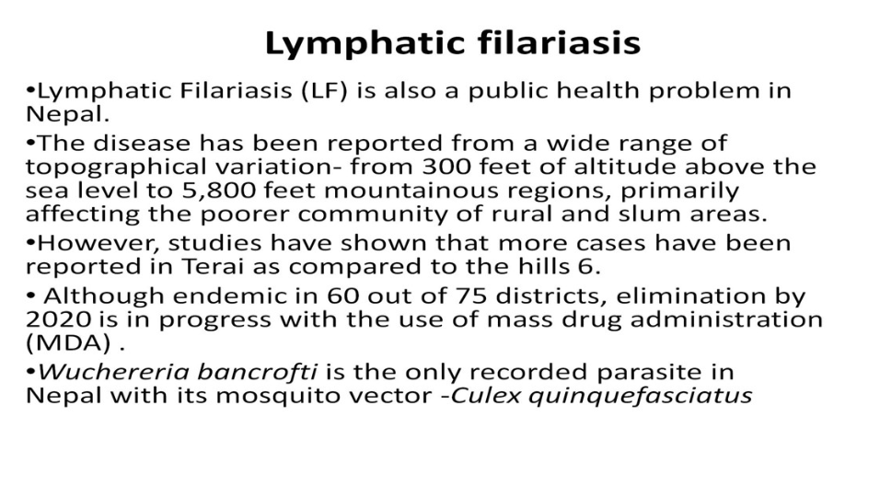

Slide 51
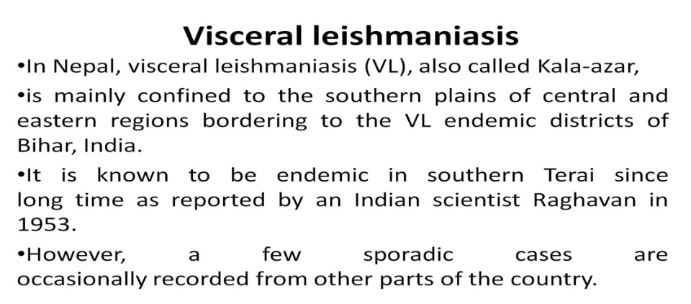

Slide 52
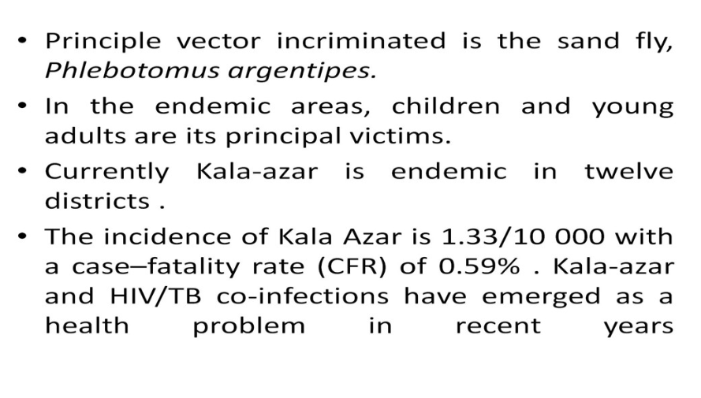

Slide 53
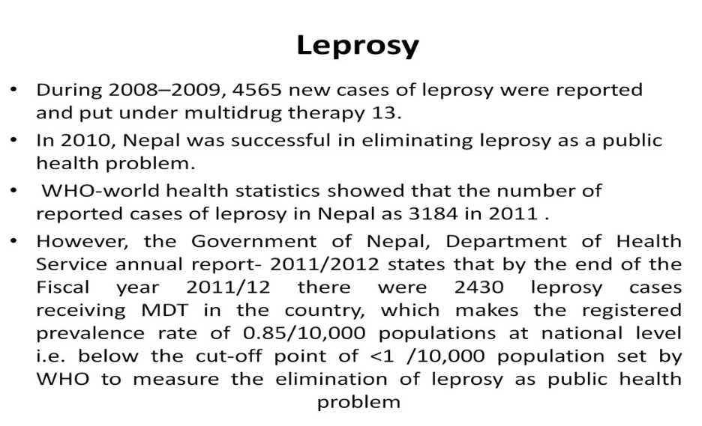

Slide 54
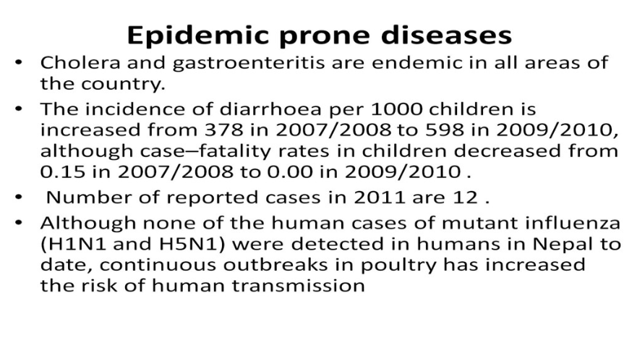

Slide 55
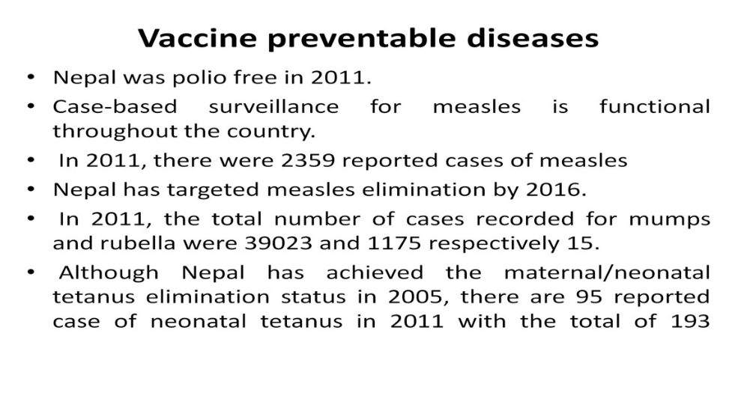

Slide 56
