Slide 1
Reproductive system of frog
Male Reproductive System- Testes, vas-efferentia, Seminal vesicles, Urinogenital duct
Female reproductive system- Ovary, Oviduct, Ovisac and Uterus
Presented By: Puja Shrestha

Slide 2


Male reproductive system
A pair of testes, Vasa efferentia (10-12 in number), and a urinogenital duct that opens into the cloaca comprise the male reproductive system. The cloaca is a compartment that is used to transport faeces, urine, and sperms to the skin’s surface. The male frog’s abdomen is small and thin. In a male, vocal cords are present.
Male and female reproductive systems in frogs are well-organized. Male reproductive organs are made up of a pair of yellowish ovoid testes that are attached to the upper part of the kidneys by a double fold of peritoneum known as the mesorchium.

Slide 3
Vasa efferentia are a group of 10-12 efferentia that arise from the testes. They enter the kidneys from the side and exit through Bidder’s canal. Finally, it communicates with the urinogenital duct, which emerges from the kidneys and enters the cloaca. The cloaca is a small, median chamber that transports faeces, urine, and sperms to the outside.

Slide 4
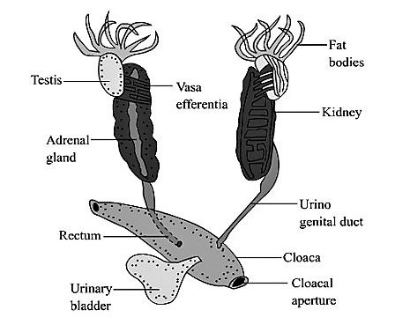
Male Reproductive System

Slide 5
Testes are made up of seminiferous tubules for producing sperms. From each testis 10-15 small ducts come out and are linked to Bidder’s canal present at the inner margin of the kidney. Bidder’s canal transports sperms to ureter via collecting tubules.
The testes of a male frog are located near his tail, one on each side of his kidneys. It is a paired, yellowish-colored oval that is surrounded by peritoneum and is close to the kidney’s dorsal divider. Parts of the urinary ducts serve as vessels for the production of sperm and the distribution of sperm. It is made up of interstitial cells, the emission of which allows it to display secondary sexual characteristics. When he mates, his sperm is released into his cloaca and then out of his body via the urinary ducts.

Slide 6
Sperm
Sperm consists of a head, neck, and tail. The head is a thick and inflated formation with acrosomes in its top that contain a nucleus of similar size. The neck connects the head and tail parts, which include the centrosome and mitochondria. The tail is a thread-like formation that aids in sperm wriggling.

Slide 7
Vasa efferentia
It is a collection of 10-12 ducts that emerge from the testis and connect to Bidder’s tube. Internally, it is surrounded by epithelium, and externally, by connective tissues. Finally, it cooperates to open into a network of ducts known as rete testis.
Seminal vesicle
Each urinogenital duct expands to form a decisive vesicle in which sperms are stored until they are released during copulation.

Slide 8
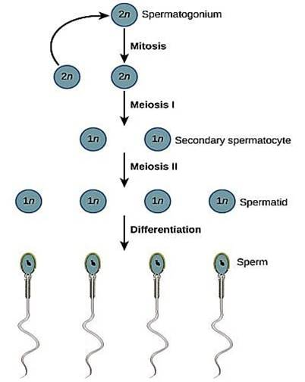
Sperm formation
Fig: Spermatogenesis

Slide 9
Spermatogenesis is the process by which sperm develops in the genital epithelium. It is divided into four stages.
Multiplication phase: Mitotic separation divides the genital epithelium cell into numerous cells known as spermatogonia. The number of chromosomes remains constant at 24.
Growth phase: Key spermatocytes are spermatogonia that expand in volume by engrossing nutrients. The chromosomes have the same number of residues.
Maturation phase: By meiotic separation, a major spermatocyte divides into two cells. Each primary spermatocyte is divided further, and each secondary spermatocyte is transformed into four secondary spermatocytes.
Metamorphosis: This is the stage at which sperm, mitochondria, and centriole form the head, the Golgi complex provides an augment to the acrosome, and the centriole forms the tail and its cover, which are shaped from mitochondria.

Slide 10
Female Frog
A pair of ovaries is among the female reproductive organs. The ovaries are located near the kidneys but have no functional connection with the kidneys. Separate oviducts emerge from the ovaries and enter the cloaca. The female reproductive system consists of two ovaries and two oviducts that open into the cloaca separately.
A mature female can lay between 2500 and 3000 eggs at a time. The cloacal aperture allows gametes to exit. The mature eggs are shed by the ovaries in the coelomic cavity. To reach the oviduct, eggs must pass through the oviducal funnel. Eggs enter the cloaca via the oviducts on both sides. External fertilisation is observed in frogs and takes place in water.

Slide 11
Fertilization is done externally in water. Tadpoles are the larval stage of development. The tadpole goes through metamorphosis to become an adult. Frogs are beneficial to humans because they consume insects and protect crops. Frogs keep the ecosystem in balance because they are an important link in the food chain and food web.

Slide 12
Ovary
Mesovarium is a paired yellowish black coloured formation that is covered by a peritoneum membrane. Throughout the reproductive term, this is teeming with eggs. Ovaries are small structures with three layers: the outer theca external, the middle germinal epithelium, and the inner theca internal, which contain blood cells, muscle cells, nerve cells, and germinal epithelium.

Slide 13
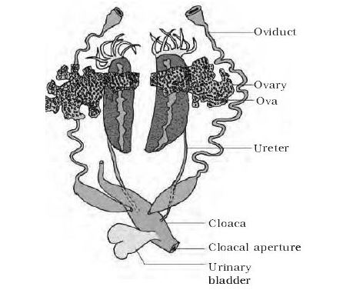
Fig: Female reproductive organs

Slide 14
Oviduct
It is a long, curved duct with a thick wall that is not related to the kidneys. It’s divided into three sections.
Oviduct funnel
Construction with a wide opening, located in the forward part of the body cavity near the lungs and oesophagus. The ostium is the ciliated wide opening.
Middle region
Coiled part with a thin body wall in some areas and a thick body wall in others It is made up of glands that secrete albumen, which hardens the ova.
Uterus
Uterus, It is the important middle part near the cloaca which is wide, thin-walled formation and forms uterus.

Slide 15
Egg formation
The germinal epithelium produces eggs. Frog larvae are aquatic and breathe through their gills. Tadpoles undergo metamorphosis when they develop into lung-breathing, terrestrial frogs.
Multiplication phase: Genital epithelium divides into several cells called oogonia by mitotic division.
Growth phase: After absorbing nutrients, these cells become big which are called major oocytes. Here, the chromosome number is 22.

