Slide 1
Plasmodium vivax (Malaria parasite)
Knowledge source: A Textbook Of Biology and online website
Presented by: Puja Shrestha

Slide 2
Plasmodium vivax (Malaria parasite)
Systematic Position
Kingdom : Protista Phylum : Protozoa Class : Sporozoa Genus : Plasmodium
Species : vivax

Slide 3

Habits and habitat:-
Plasmodium is an intracellular sporozoan parasite causing malaria in man. The parasite lives in the RBC’s and liver cells of man and alimentary canal and salivary glands of female Anopheles mosquito.

Slide 4
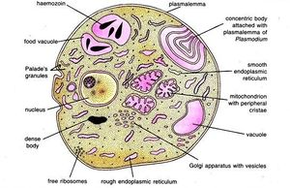
Body structure:
Structure:-
Structure of plasmodium is different stages of its life cycle. Dimorphic parasite viz. Trophozoite and sporozoite.
Trophozoite
A fully grown malarial parasite is amoeboid and uninucleated structure known as trophozoite.
surrounded by double layered plasma lemma.
Cytoplasm contains Palade’s granules, endoplasmic reticulum made from smooth and rough vesicles, ribosome, mitochondria, golgi body and vacuoles having haemozoin, contains nucleus having nucleolus and granular nucleoplasm.

Slide 5
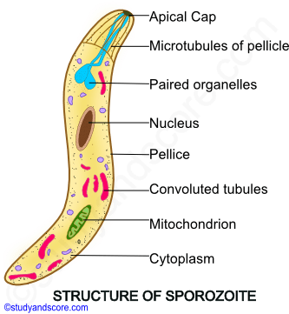
Sporozoite:
Infective stage with 10-15 mm in size
Are uninucleated, motile with sickle-shaped body, consisting of pellicle, cytoplasm and nucleus.
Microtubules present in apical region helps in wriggling movements.

Slide 6
Hosts:-
Plasmodium completes its lifecycle in two hosts (digenetic): Man and female Anopheles mosquito.
Malaria parasites transmitted by mosquito bite are remarkably efficient in establishing human infections.
The infection process requires roughly 30 minutes and is highly complex as quiescent (inert)sporozoites injected with mosquito saliva must be rapidly activated in the skin, migrate through the body, and infect the liver.
1. Primary or definitive host:
Female Anopheles mosquito is the primary host of Plasmodium in which it completes its sexual life cycle.
2. Secondary or Intermediate host:
Man is the secondary host of plasmodium in which it completes its asexual life cycle.

Slide 7
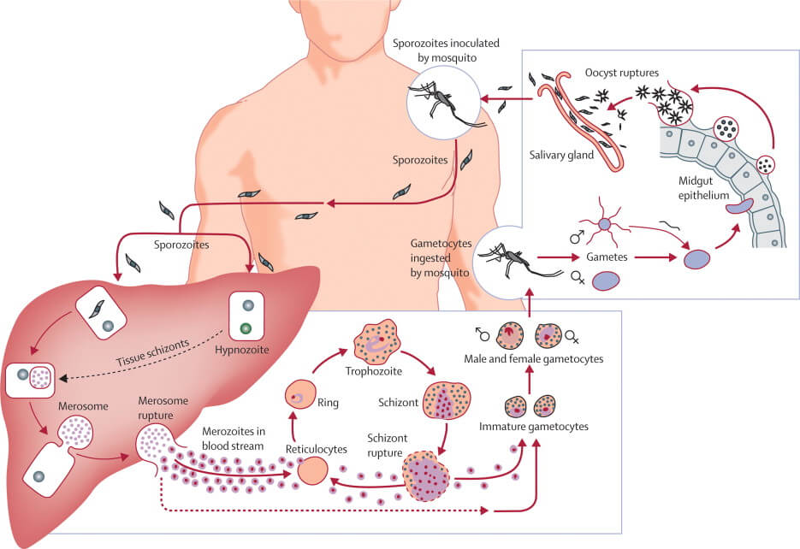

Slide 8
The lifecycle of Plasmodium can be divided into three phases:
1. Asexual schizogony
2. Sexual gamogony
3. Asexual sporogony

Slide 9
ASEXUAL CYCLE OF Plasmodium, IN HUMAN
Infective form of Plasmodium is known as sporozoites. Sporozoites are 11-12µ long slender, uni-nucleated,sickle-shaped structure present in the salivary glands of infected mosquito. When an infected female Anopheles mosquito bites a healthy man, a large number of sporozoites enter into the blood stream of man. Within half an hour, sporozoites enter the liver cells and undergo asexual multiplication called schizogony.
1. Asexual Schizogony:-
Schizogony is the asexual phase of reproduction of Plasmodium. It takes place in liver cells and RBC’s of man. Schizogony can be divided into following phases:
a) Pre-erythrocytic schizogony
b) Exo-erythrocytic schizogony
c) Erythrocytic schizogony
d) Post- erythrocytic schizogony

Slide 10
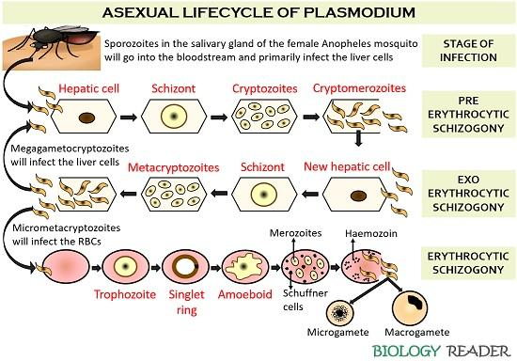

Slide 11
a. Pre-erythrocytic schizogony:
In the liver cells, sporozoites grow to form a large and spherical schizont. Schizont divides by multiple fission and forms many cryptozoites. They may either pass into the blood circulation to start erythrocytic schizogony or enter fresh liver cells to start Exo-erythrocytic schizogony. Pre-erythrocytic schizogony takes 8 days to complete.
b. Exo-erythrocytic schizogony:
After re-entering fresh liver cell each cryptozoites divides to form many metacryptozoites that enter the RBC’S to start erythrocytic schizogony.

Slide 12
c.Erythrocytic schizogony:-
As stated above, the erythrocytic schizogony begins when the RBC’s of blood are attacked either by pre-erythrocytic cryptozoites or by exo-erythrocytic micro-metacryptozoites. It takes normally in 8 to 12 days after above 2 phases. Stages of erythrocytic schizogony are:
i. Trophozoite Stage:-
The merozoites (cryptozoites and micro- metacryptozoites) after entering into the blood stream, feed on erythrocytes, become rounded and modify into trophozoite.

Slide 13
ii. Signet Ring Stage:-
As the merozoites grow a vacuole appears in the center and the nucleus is pushed to one side. It gives a ring like appearance and known as signet ring stage.
The parasite ingests haemoglobin and decomposes it into protein and haematin. Protein is use as food whereas unused haematin forms toxic. Yellowish brown malarial pigment, haemozoin.
iii. Amoeboid Stage: –
As the signet ring parasite grows, vacuole disappears and the parasite becomes amoeboid in appearance, thrusting out pseudopodial processes. This stage is called amoeboid stage. At this stage RBC develops numerous granules, the Schuffner’s granules.
iv. Schizont Stage:-
Parasite grows in size, becomes rounded and almost completely fills the RBC called Schizont.

Slide 14
v. Rosette Stage:-
The nucleus of schizont divides by multiple fission to form 6 to 24 daughter nuclei. These nuclei arrange at the periphery, while the toxic haemozoin granules accumulate at the center of RBC. It appears as a flower rose, so called rosette stage.
Nuclei of rosette stage are surrounded by a little cytoplasm and are developed into merozoites. With the rupture of the RBC, these merozoites are liberated into the blood plasma along with toxic haemozoin. These normally attack fresh RBC’s to repeat the erythrocytic cycle or may change into gametocytes. One complete erythrocytic cycle takes 48 hours in Plasmodium vivax.
d. Post-erythrocytic schizogony:-
Sometimes, some merozoites produced in erythrocytic schizogony reach the liver cells and undergo schizogony development in liver cells. This is called post-erythrocytic schizogony.

Slide 15
SEXUAL CYCLE OF Plasmodium in MAN
2. Sexual Gamogony:-
Formulation of gametocytes:
After many generations in about 4-5 is the blood some merozoites increase in size to form two types of gametocytes; larger macro (9-10µ), less numerous and contain large nucleus. Micro gametocytes are smaller (10-12µ), more numerous and contain smaller nucleus.
SEXUAL CYCLE OF Plasmodium IN MOSQUITO
When a female Anopheles sucks the blood of a malaria patient, the gametocytes reach the stomach of mosquito and formation of gametes take palace as follows:

Slide 16
a. Gametogenesis (gemetogony) :
Process of formulation of gametes (male and female gametes).
i. Formulation of male gametes:
The nucleus of microgametocyte divides to form 6-8 daughter nuclei. The cytoplasm gives out same number of flagella like projections and daughter nuclei enter each projection. These projections separate from the cytoplasm and form 6-8 haploid microgamete or male gametes. This process of formation of microgamete is called exflagellation.
ii. Formation of female gamete:-
The mega gametocyte undergoes some reorganization to form a single haploid mega gamete or female gamete which is ready for fertilization.

Slide 17
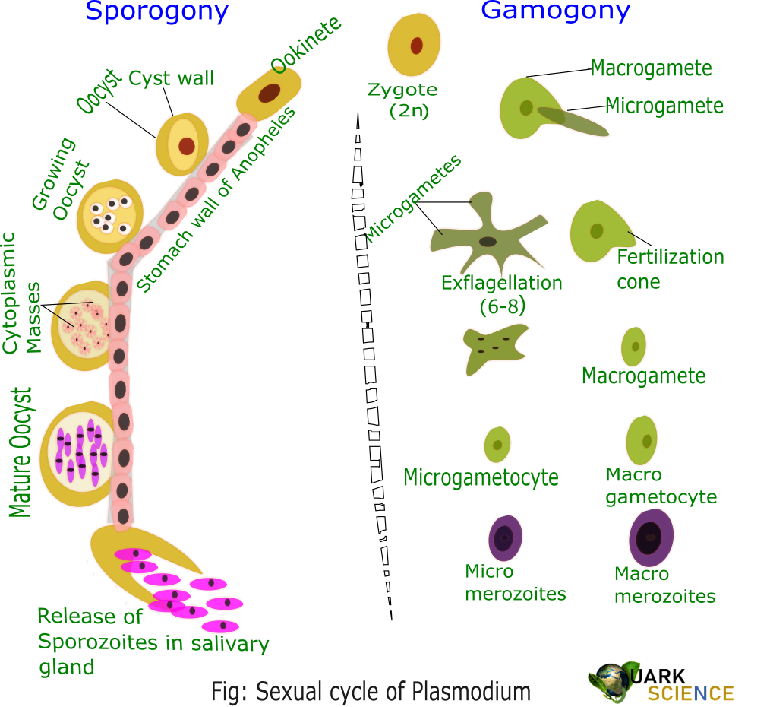

Slide 18
b. Fertilization:
The male gamete enters the female gamete through the fertilization cone formed at female gamete and form diploid zygote or synkaryon. Fusion is anisogamous. (Anisogamy is a form of sexual reproduction that involves the union or fusion of two gametes that differ in size and/or form.)
c. Ookinete stage:
The zygote remains inactive for sometimes and then elongates into a worm like Ookinete or vermicule, which is motile. The Ookinete penetrates the stomach wall and comes to lie below its outer epithelial layer.
d. Oocyst stage:
The Ookinete gets enclosed in a cyst. The encysted zygote is called Oocyst. The Oocyte absorbs nourishment and grows in size.

Slide 19
3. Asexual Sporogony
The nucleus of Oocyte divides repeatedly to form a large number of haploid daughter nuclei. At the same time, the cytoplasm develops vacuoles and gives numerous cytoplasmic masses. The daughter nuclei pass into each cytoplasmic mass and develop into slender sickle-shaped sporozoites are formed in each Oocyet. This phase of asexual multiplication is known as sporogony.
Lastly, the Oocyte brusts and sporozoites are liberated into the haemolymph of the mosquito. They spread throughout the haemolymph and eventually reach the salivary glands and enter the duct of the hypopharyx. The mosquito is now becomes infective and sporozoites get inoculated or injected the human blood when the mosquito bites. The cycle is repeated.

Slide 22


