Slide 1

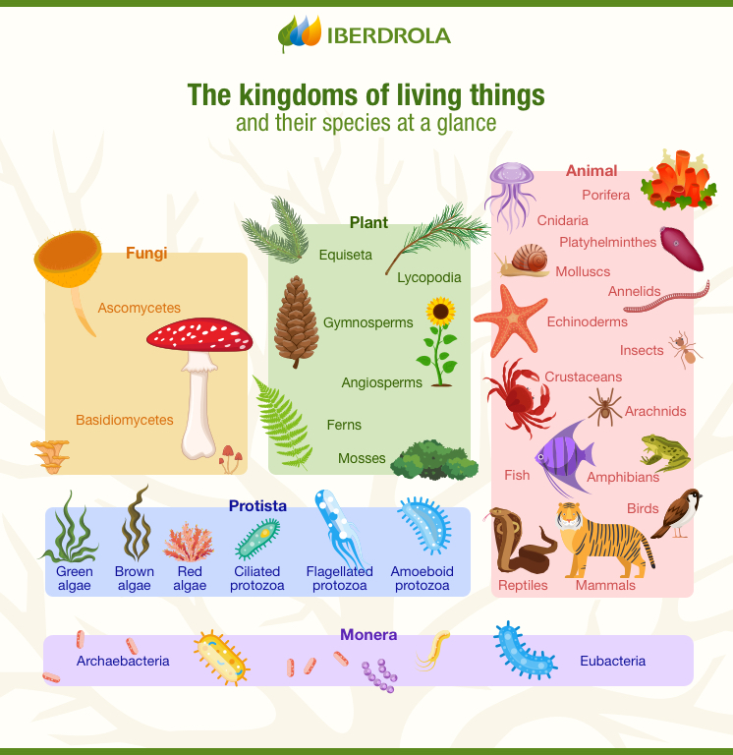
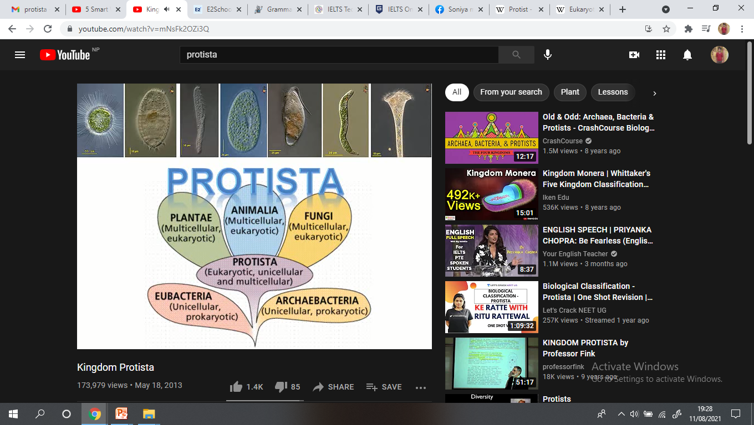
Kingdom Protista
The term protista, meaning the first of all or primordial (existing at or from the beginning of time; primeval).
Plant like Protists
What is a protist?
a) Animal b) Plant
c) Fungi d) none
Notes:
Their evolutionary importance is quite incredible from the bubble diagram you can see the Kingdom Protista gave rise not just animals but also to fungus and plants.

Slide 2
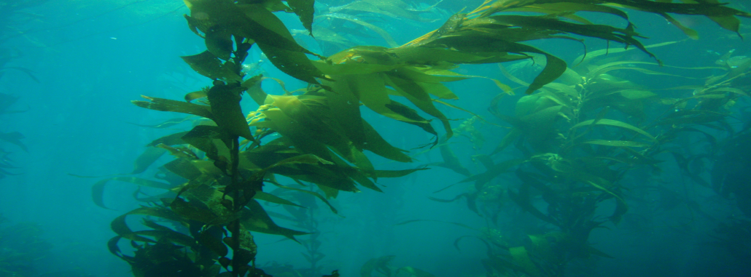
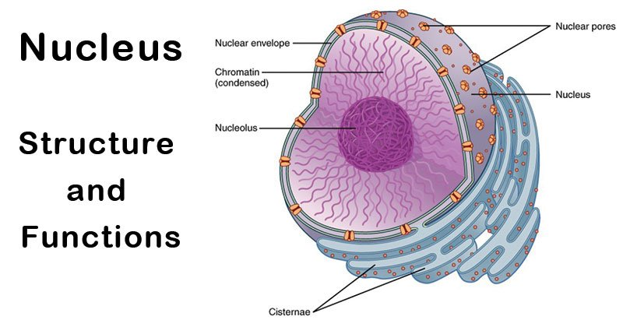
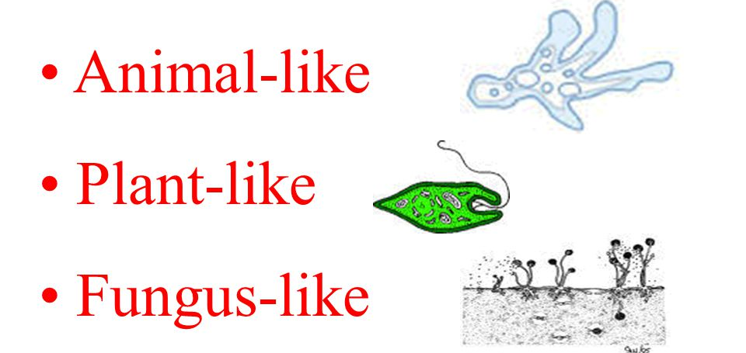
Introduction
Giant Kelp
Usually unicellular, few multicellular like largest protist giant kelp in the word
Eukaryotic organisms whose cells have a nucleus enclosed within a nuclear membrane.
microscopic organisms.
They are classified into 3 different major groups. They are as follows:
Nucleus of eukaryotic cell
Protozoan protists (animal like)
Photosynthetic Protists (plant like)
Slime molds (fungus like)
Idea:Make mnemonics
for example PSP.

Slide 3
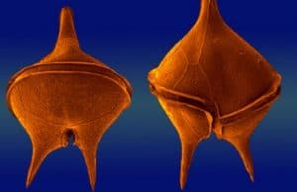
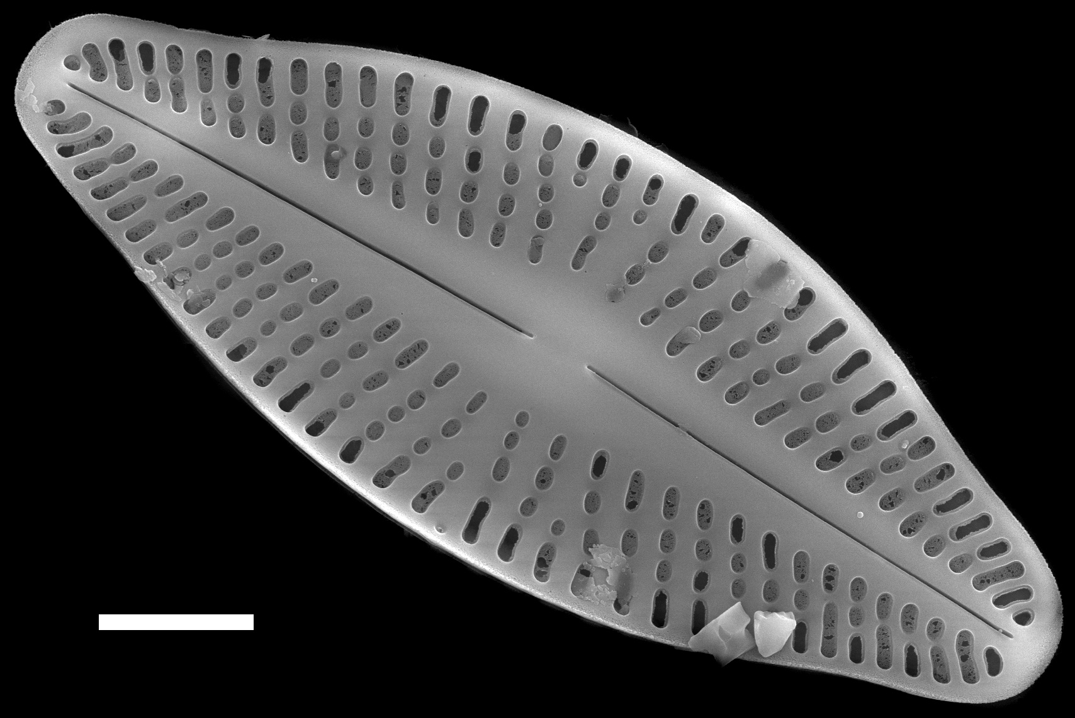
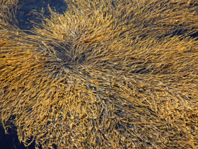
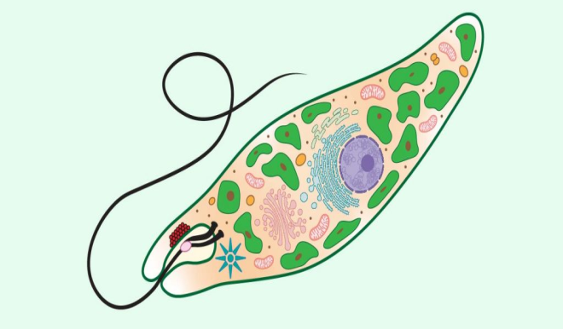
Photosynthetic protists (plant like) It includes unicellular eukaryotic algae called protistan algae. Photosynthetic algae are of 3 different phyla:
Pyrrophyta: Pyrrhos means flames like. It includes dinoflagellates
Chrysophyta: It includes diatoms and golden brown algae
Euglenophyta: It includes euglena like flagellates.
Dinoflagellates
Golden brown algae
Diatoms
Mnemonic : CPE
Euglena
Notes:
They also contain chlorophyll, a pigment which absorbs light energy for photosynthesis.

Slide 4
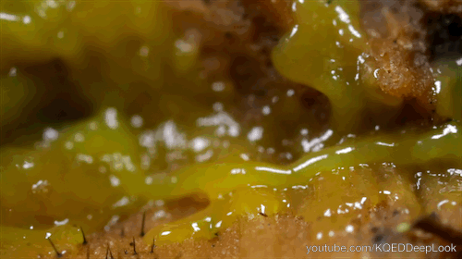
Slime molds (Consumer decomposer fungi)
The protist which have character of both fungi (they feed on decaying leaves) and animals (they can move from one place another).
Move with the help of flagella, pseudopods, or cilia.
They are also termed as protistan fungi.
They include about 500 species.
Pulsating slime mold

Slide 5
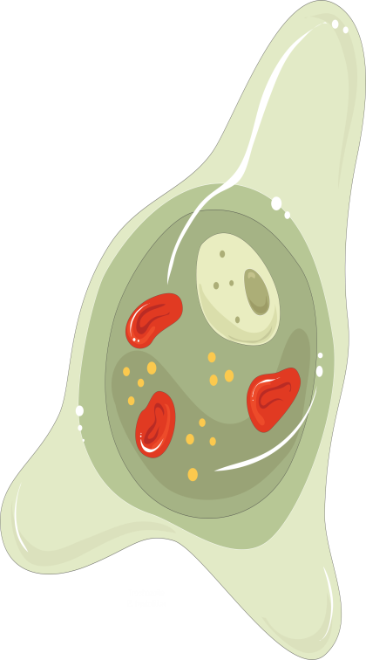
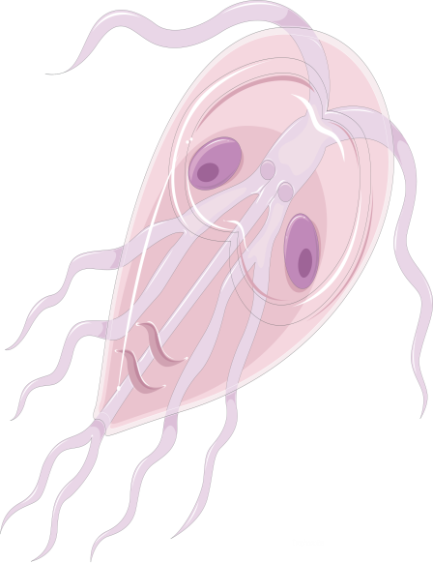
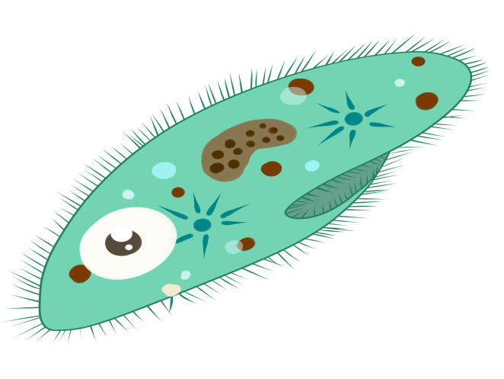
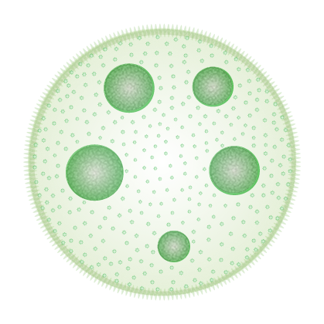
Protozoa (Animal like) Different species of Protozoa
Paramecium
Volvox
Entamoeba
Giardia
It is diverse group of organisms which consists of about 50,000 species. It is regarded as phylum protozoa.
Protozoa are acellular or unicellular microscopic organism
Notes:
Acellular: Because cell is not unit of their body but the whole body.

Slide 6
General characteristics of phylum protozoa
Habit (Form of living): Most of them are free living (Euglena, Volvox, Amoeba and Paramecium) whereas some are parasitic (Entamoeba, Plasmodium, etc.) and few are saprophytes or commensals. Majority of protozoan are solitary but some like Volvox and Proterospongia are colonial.
Habitat: They live in freshwater (Salt-less), marine water(Sea water) or damp soil
Body shape: The shape of body is variable. For e.g. irregular in Amoeba, slipper shaped in Paramecium
Symmetry: Their body is mostly asymmetrical except Giardia which have symmetrical body.
Glossary
Free living: living not as a parasite or attached to a substrate
Parasitic: Living in others body
Saprophytes: lives on dead or decaying organic matter.
Commensals: an association between two organisms in which one benefits and the other derives neither benefit nor harm
Symmetry: is the arrangement of body parts around a central axis.

Slide 7
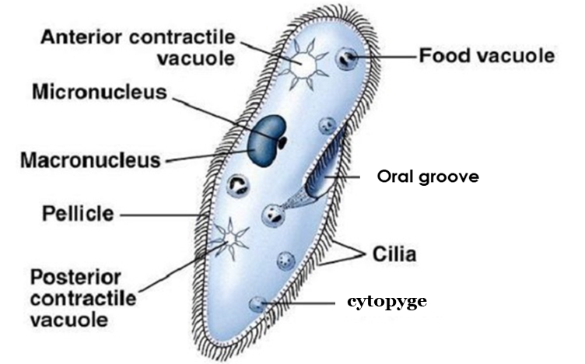
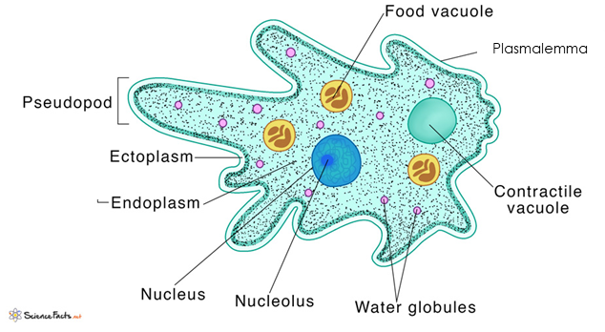
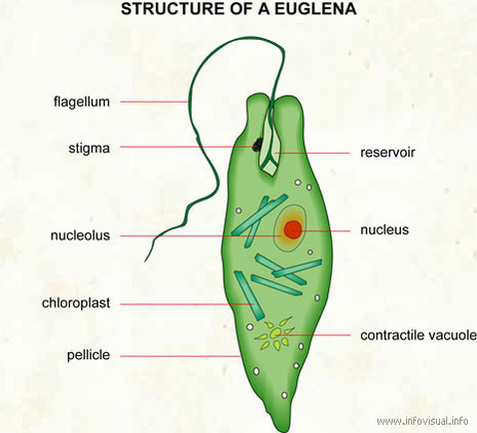
Body organization: They show protoplasmic grade of body organization with outer clear and transparent ectoplasm and inner granular and semi fluid inner endoplasm.
Body covering: The body is either naked or bounded by plasmalemma or definite layer called pellicle.
Locomotion: It takes place by finger like pseudopodia (Amoeba), hair like cilia (Paramecium), whip like flagella (Euglena). In some protozoans, locomotory organ is absent (Plasmodium)
Nucleus: The number of nuclei vary from 1 to several. Some species like Paramecium shows nuclear dimorphism.
flagella
pseudopod
Cilia
Paramecium
Amoeba
Euglena

Slide 8
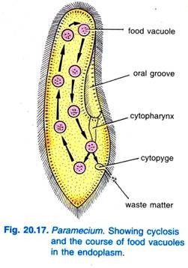
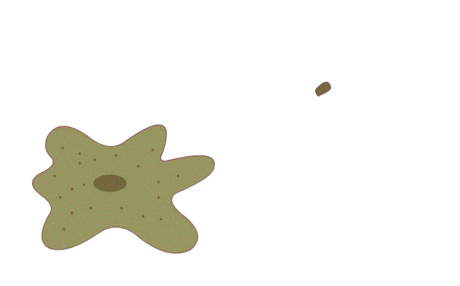
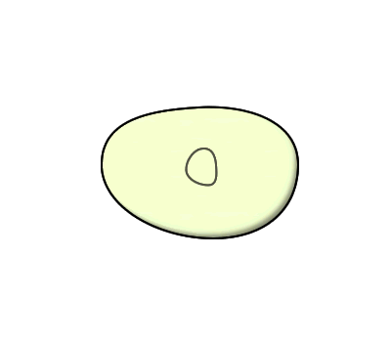
Nutrition: It may be holozoic, holophytic, saprophytic or parasitic.
Digestion: It is intracellular which occurs inside food vacuoles. Cyclosis helps in circulation of food
Respiration: It takes place by general body surface through diffusion.
Excretion: It takes place by general body surface mostly ammonotelic (excrete nitrogenous waste in the form of ammonia).
Osmoregulation: It takes place through contractile vacuoles.
Reproduction: Asexual reproduction takes place by fission, budding etc. Sexual reproduction takes place by conjugation or syngamy.
Terminologies
Holozoic: the internalization (ingestion) and internal processing of liquids or solid food particles.
Holophytic: organisms that produces its own food through photosynthesis
Intracellular: takes place within the cytoplasm of the organism and also without a digestive tract
Cyclosis : Streaming of cytoplasm inside a living cell
Diffusion: movement of a substance from an area of high concentration to an area of low concentration.
Osmoregulation : physiological processes that maintain a fixed concentration of cell membrane-impermeable molecules and ions
Cyclosis in Paramecium
Holozoic nutrition
Binary fission

Slide 9
Phylum Protozoa is classified into 4 different classes on the basis of locomotory organ.
1: Rhizopoda
2: Ciliata 3: Flagellata 4: Sporozoa
Class 1: Rhizopoda/ Sarcodina/ amoeboids
Locomotory organelle is pseudopia (Temporary arm)
Body is irregular in shape covered with plasmalemma
They are free living or parasitic
Nutrition is holozoic or saprozoic

Slide 10
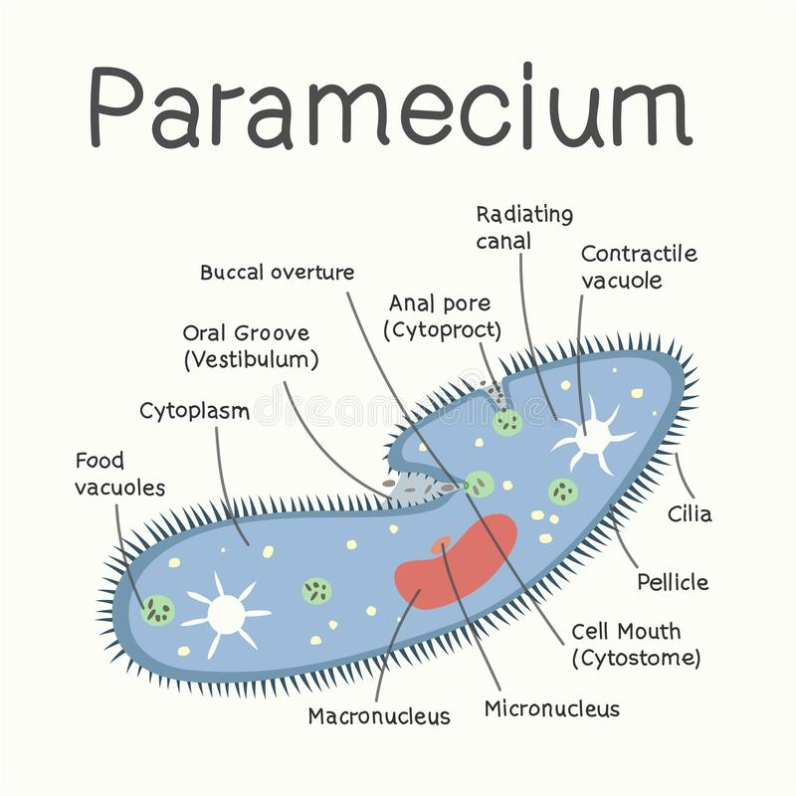
Class 2: Ciliata
Locomotory organelle is hair like cillia, body is fixed in shape covered with pellicle
They are free living or parasitic, presence of dimorphic nucleus and one or more contractile vacuole
Vorticella, Dileptus, Stentor, Lacrymaria

Slide 11
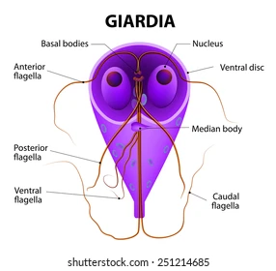
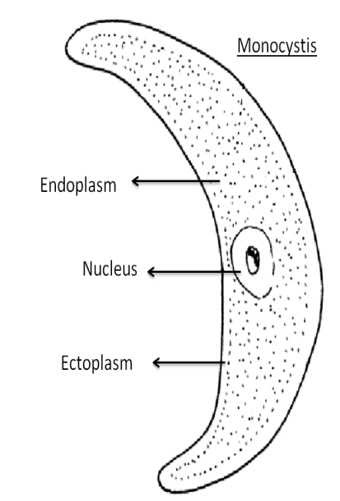
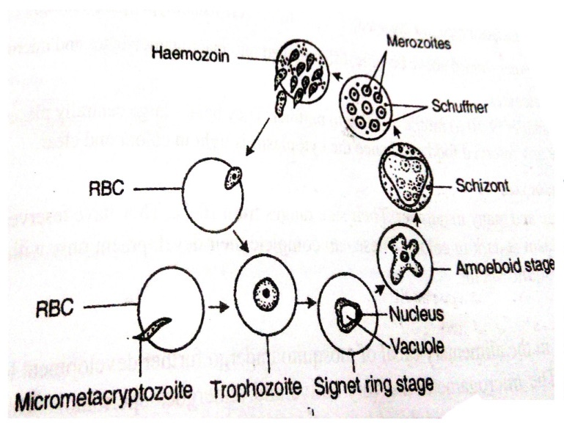
Class 3 Flagellata/Zoomastigophora
Locomotory organelle is flagella
Body is fixed in shape covered with pellicle
They are autotrophic, heterotrophic or both
They are free living or parasitic
Giardia
Euglena
Class 4 Sporozoa
Locomotory organelle is absent
Asexual reproduction takes place by spores.
They are endoparasites
Contractile vacuole is absent
monocystis
Plasmodium vivax
10

Slide 12
Any questions? Thank you

