Slide 1
Unit 6: Introduction to biology
Subject: Zoology
Lecture one
Book writer: Phd Arvind Keasri
Presented by Sunil Gautam

Slide 2

Biology: Biology is a branch of science which deals with the living beings whereas other branch of science is called physical science deals with physics, chemistry, math, meterology, etc.
The word biology is coined by two great scientists, John Baptist Lamarck and Ireviranus in 1802. In Biology which deals with the study of plants called botany and deals with the animals called zoology.
The father of botany was Theophrastus (287 – 370 B.C). Similarly father of zoology, embryology and founder of taxonomy was great philosopher Aristotle (384-322 B.C).
Notes:
Images with a green circle means its just an example for better understanding, you don’t have to draw it in exams.
Images with a Yellow circle are rare and it carries little importance, which is better if you practice.
Images with a Red circle are the most important, you must know how to draw it.
Sentences with italic font means those which you already leaned in your lower grades, try to remember it for your own sake.

Slide 3
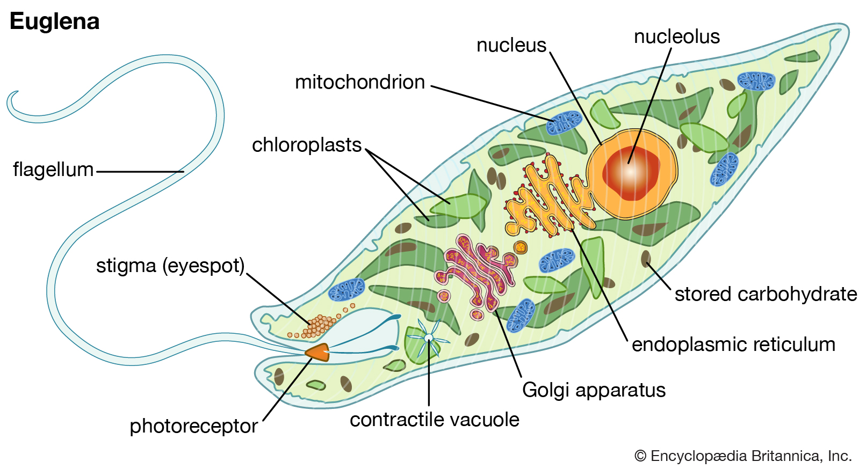
Unlike physical science, Biological sciences have very few universally applicable principle rather there are numerous exceptions which have biology as a science of exception. Few examples are:
Euglena shows both plant and animals characters. It lacks cell wall but bears chloroplast (chlorophyll). Therefore, placed under Protista kingdom.

Slide 4
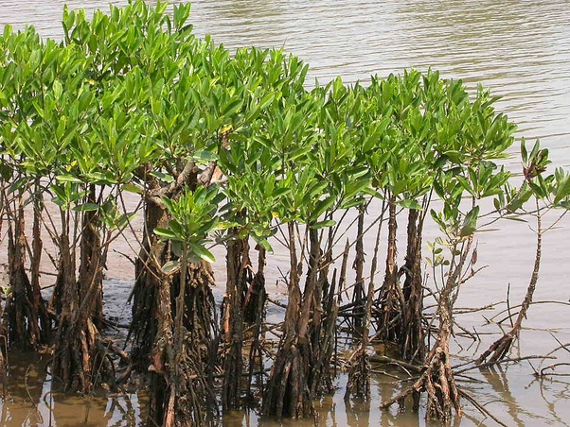
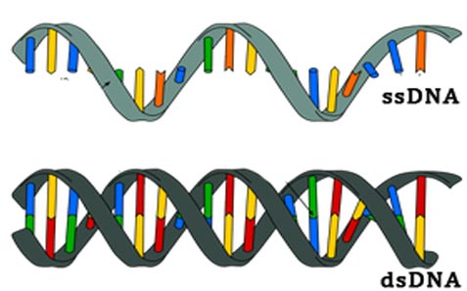
2. Virus is a living organism but it lacks the cellular organization. Thus, acts like both living (inside a host’s body) and dead (in environment) organism.
3. DNA is double stranded whereas in bacteriophage it is single stranded.
4. Mangroves produce respiratory roots which grow towards
light against gravity.
Notes:
DNA, or deoxyribonucleic acid, is the central information storage system of most animals and plants, and even some viruses.
Each strand has a backbone made of alternating sugar (deoxyribose) and phosphate groups. Attached to each sugar is one of four bases--adenine (A), cytosine (C), guanine (G), and thymine (T). The two strands are held together by bonds between the bases; adenine bonds with thymine, and cytosine bonds with guanine.
Pneumatophores: Respiratory or knee roots (pneumatophores) are characteristic of many species; they project above the mud and have small openings (lenticels) through which air enters, passing through the soft spongy tissue to the roots beneath the mud. Lack of oxygen in salty water logged soil (Hydric condition)

Slide 5
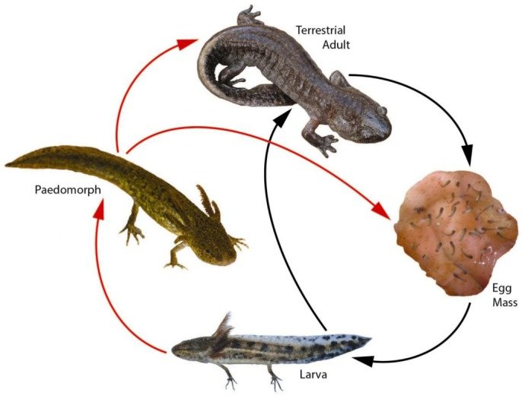
5. Animals must become adults to reproduce but larval stages of salamander can reproduce.

Slide 6
Scope of Biology:
Biological members such as plants and animals have been utilizing in various fields because of their importance. The major or importance or scope of biology is as follows:
1. Economic value
2. Food value
3. Medicinal value
4. Research value

Slide 7
5. Industrial value
6. Ecological value
7. Aesthetic value
Tallow (a hard fatty substance made from rendered animal fat) is a common ingredient in many products, including eye makeup, lipsticks, makeup bases and foundations, shampoos, shaving soaps, moisturizers and skin care products. It's made by boiling animal carcasses(dead body) to create fatty by-products
8. Game value

Slide 8
MCQ for Interaction
Study of external form and structure of living organism is called;
A. Morphology B. Mycology
C. Histology D. Virology E. none
Study of reptiles and amphibians is called;
A. Ornithology B. Entomology
C. Herpetology D. Parasitology

Slide 9
Branch and relation with other sciences:
1. Morphology: Study of external form and structure of living organism is called morphology.
2. Anatomy: Study of internal structure of plants and animals.
3. Histology: Study of details of tissues structure of organisms.
4. Psychology: The study of human behaviour and mental quality.
5. Palaeontology: The study of extinct and fossils organisms.

Slide 10
6. Mycology: Study of fungi.
7. Phycology: Study of algae.
8. Bryology: Study of liverworts and mosses.
9. Helminthology: Study of worms/ helmints.
10. Parasitology: Study of parasitic organisms.

Slide 11
11. Entomology: Study of insects.
12. Ornithology: Study of birds
13. Mammalogy: Study of mammals.
14. Herpetology: Study of reptiles and amphibians
15. Protozoology: Study of one – celled animals. 16. Zoology: Study of animals.
17. Botany: Study of plants. 18. Ichthyology : Study of fishes.
19. Evolution: Study of origin. 20. Embryology: Study of embryos.

Slide 12
21. Palynology : Study of pollen grains.
22. Pteridology: Study of Pteridophyte. 23. Cardiology: Study of heart.
24. Neurology: Study of neurons. 25. Virology: Study of virus.
26. Ethology: Study of animal behaviour.
27. Ethnology: Study of different rules mankind in different distribution.
28. Eugenics: Study of improvement of races.
29. Cytology: Study of cells. 30. Protozoology: Study of protozoans.

Slide 13
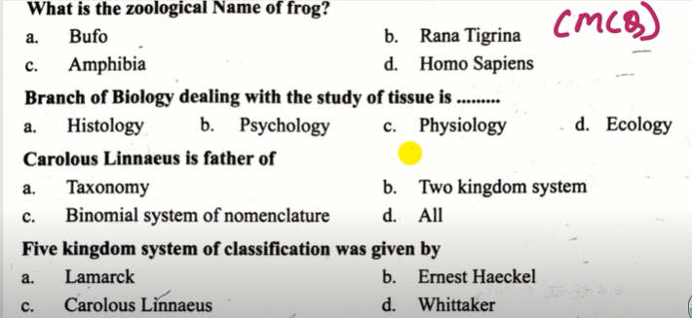
Homework
Father of zoology and embryology is;
A. Aristotle B. Linnaeus
C. Lemark D. R.H. Whitaker

Slide 14
Any Question

Slide 15


