Slide 1
Unit 7: Evolutionary Biology
Subject: Zoology
7.2 Evidences of organic evolution
Book writer: Dr. Arvind K. Keasri
Presented by: Puja Shrestha

Slide 2

Paleontological evidences
The study of fossils is called paleontology.
Leonardo De Vinci is considered as the pioneer of paleontology.
Georges Cuvier is often considered the founding father of paleontology
Paleontology is the study of past life based on the fossil record.
Fossils are the remains, replicas or impressions of ancient organisms preserved in the rocks or anywhere else in the earth.
Tough parts like teeth, bones etc. or impression or an entire body of an ancient organism is preserved as fossils.

Slide 3
Formation of Fossils
When the animals and plant are buried either by sinking in oceans or by landslide, sedimentary rocks are formed by the deposition of silts or mud.
The whole body or some body parts are preserved from decaying due to the cut off of oxygen forming the fossils.
Land animals have also been found preserved in the ice, volcanic ash, peat bogs, wind dust, etc.
The process of formation of fossil is called fossilization.

Slide 4
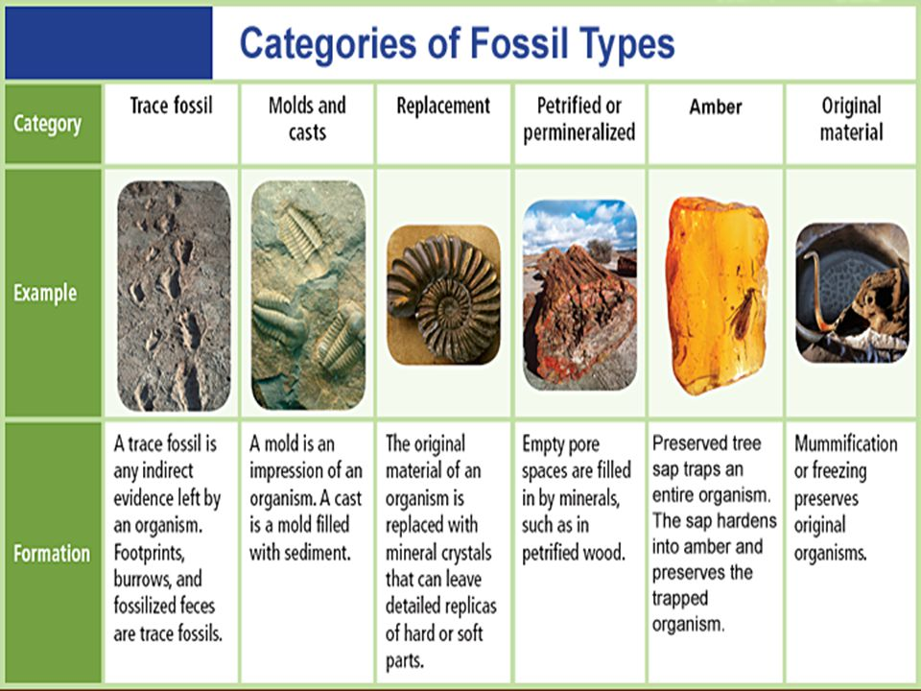
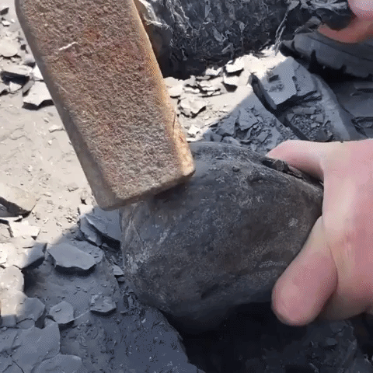
Intact or entire or
Impressions

Slide 5
Determination of age of rocks and fossils
Carbon dating method and radioactive disintegration methods are the modern techniques to study the age of fossils.
Carbon isotopes C₁₄ and C₁₂ in certain years, C₁₄ changes into C₁₂. The amount of C₁₄ changed into C₁₂ is found out to determine the age of rocks and fossils.
Uranium 238 changes into lead due to radioactive disintegration after certain period i.e. 4.5 billion years for 50% Uranium to convert into lead.
The age of fossil can be determined by studying the amount of Uranium that is disintegrated.
Notes:
Once the organism dies, however, it ceases to absorb carbon-14, so that the amount of the radiocarbon in its tissues steadily decreases. Carbon-14 has a half-life of 5,730 ± 40 years—i.e., half the amount of the radioisotope present at any given time will undergo spontaneous disintegration during the succeeding 5,730 years and limits only to 60,000 years old fossils. Because carbon-14 decays at this constant rate, an estimate of the date at which an organism died can be made by measuring the amount of its residual radiocarbon.

Slide 6
Significance of Fossils
It suggests the extinction of certain species.
Study of fossils suggests the similarity of present days species with ancient species.
Different animals were appeared at different time. Trend of evolution can be studied. Example: first vertebrates were fishes while mammals are the youngest vertebrates.
A series of fossil records of a particular type of animal can easily explain its ancestry.

Slide 7
Evolutionary history of different organisms can be known by the study of the fossils.
Fossils help to know the habits and behaviour of extinct species.
Structure of extinct animals can be known.
Evolution of animals can be explained by the fossils of connecting links or bridging animals.

Slide 8
Connecting links:
The organisms having the intermediate characters of two or more than two groups of are called connecting links.
The connecting links that are extinct are generally known as missing links.
The examples of connecting links are:
Archaeopteryx: Reptiles and aves
Duck-billed platypus: Reptiles and mammals
Euglena: Plant and animals
Peripatus: Annelida and arthropoda
Lung Fishes: Fishes and amphibians

Slide 9
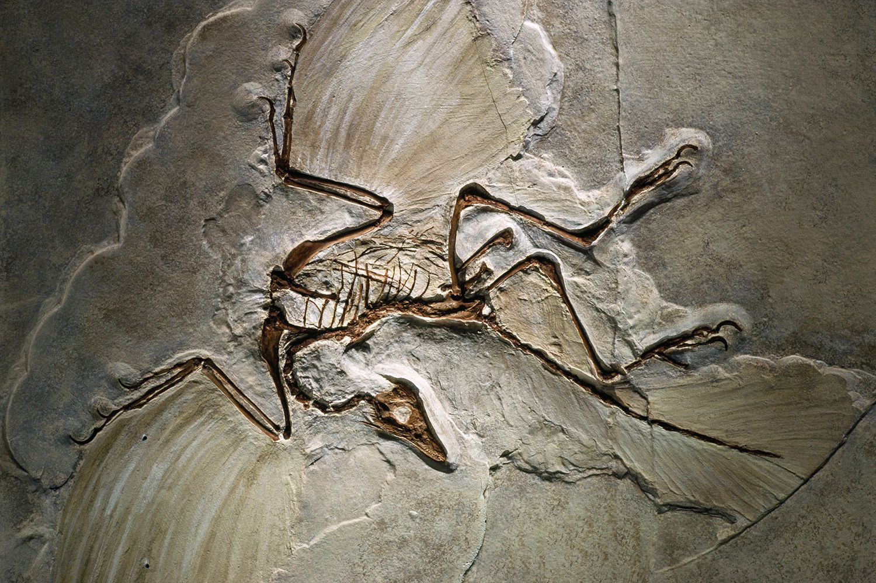
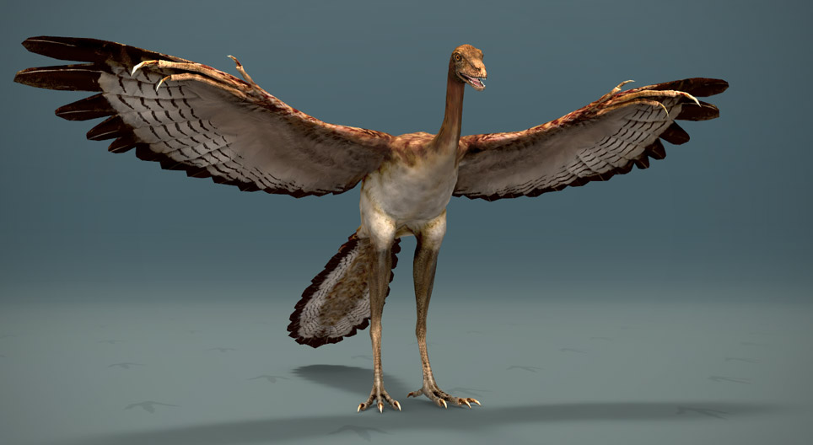
Fig; Cast of the Berlin specimen of Archaeopteryx lithographica, from the collections of UCMP. Original at Humboldt University, Berlin.
Fig; Archaeopteryx 3D just imaginary image
A particularly important and still contentious discovery of Archaeopteryx lithographica, found in the Jurassic Solnhofen Limestone of southern Germany, which is marked by rare but exceptionally well preserved fossils. Archaeopteryx is considered by many to be the first bird, being of about 150 million years of age. It is actually intermediate between the birds that we see flying around in our backyards and the predatory dinosaurs.

Slide 10
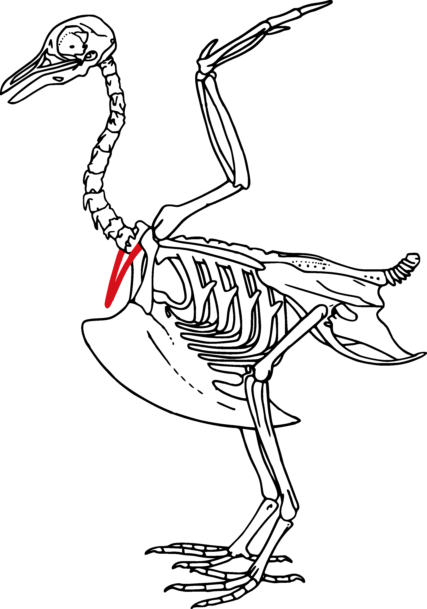
Why is Archaeopteryx is considered as the connecting link between birds and reptiles?
Avian characters:
Body covered by feathers
Forelimbs modified into wings
Presence of tail feathers
Pneumatic bone
Flying habit
Reptilian Characters
Hind limbs scaled
Beak with teeth
Short tail
Crawling habit
Forelimb with claws
Therefore, Birds are glorified reptiles

Slide 11


