Slide 1
Zoology
Unit 7: Evolutionary biology Lecture 1-4
Book Author: Dr. A.K.Keshari and B.S.Mishra
Presented by Puja Shrestha

Slide 2

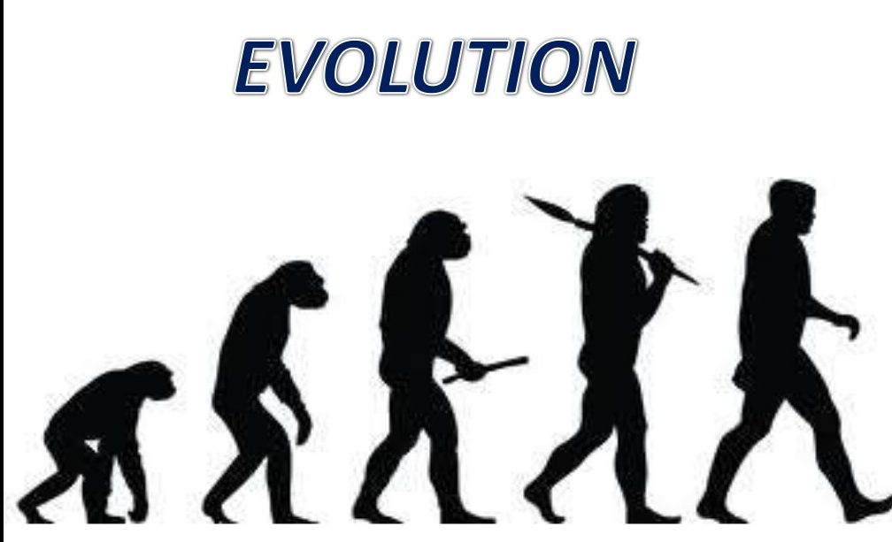
The term evolution is 1st used by philosopher Herbert Spencer in 1852

Slide 3
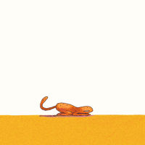
INTRODUCTION
Universe
Earth
First life form (originated in water)
Evolution of complex biodiversity
Evolution is defined as the change in heritable characteristics of biological populations over successive generations. These traits are the manifestations of genes that are handed down from parent to offspring during reproduction. As a result of mutation, genetic recombination, and other causes of genetic diversity, different traits tend to exist within any given population.

Slide 4
Discussion
1. What is the unit of evolution?
Population
2. What causes the evolution?
Natural selection is the driving force of evolution
3. What is the unit of natural selection?
Individual
3. What provides the raw material for the evolution?
Variations (no two individuals are exactly alike)
We are product of Sexual reproduction that is what brings variations
4. What is the ultimate source of variation?
Mutation
Notes:
Lets look in an example of mosquito which has become resistant to DDT nowadays.
If some genotype feature does not reflect in phenotype then there is no advantage for evolution.
Human, apes, and monkeys evolved from a common ancestors. Do not say humans evolved from monkeys or apes.

Slide 5
Theories of origin of Life
Theory of Special Creation
Theory of spontaneous generation or abiogenesis (life from non living)
Theory of biogenesis (life from life)
Theory of cosmogeny (Panspermia)
Theory of biochemical origin of life ( Oparin-Haldane thoery)
Notes:
The almighty created life by divine act of creation
Unit of life of spore called panspermia came from outer space

Slide 6
Theory of special creation
Super natural power of god created everything including plant and animals
Universe was created within seven days comprehending plant, animal, and men that’s what bible says. Adam and eve were the 1st and we are their legacies.
Describe that Earth and heaven were created on the first day and the sky on the second day. Plant and animal originated on the third day, while the sun, the moon, and stars were created on 4th day; birds and fishes appeared on the fifth day, and finally, men and beasts were created on the sixth day. the one women constricted on the seventh day from the 12th rib of men.

Slide 7
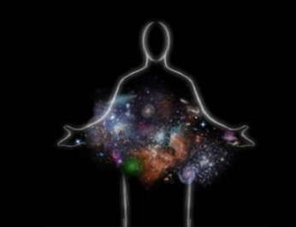
On the other hand, Hindu mythology says just in one stroke the almighty Bramha Dev created several forms of life likewise, Manu and Shradha were 1st born.
Whatsoever, this theory has no scientific proves thus not accepted; only Spanish priest Father Saurez claimed its true at that time.

Slide 8
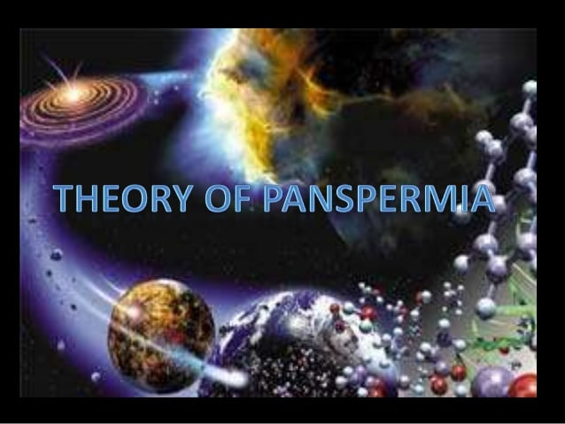
2. Theory of cosmogeny
Proposed by philosopher Ritcher in 1865 and supported by Arrhenius in 1908.
Life came on the earth from another planet in the form of small spores, called panspermia. This panspermia could survive at high temperatures. When the planet collided with the earth, panspermia came on the earth and develop in different forms of life.
Not accepted anyway.

Slide 9
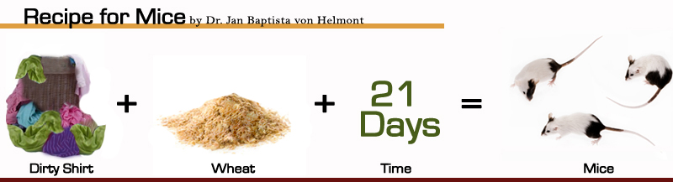
Theory of spontaneous generation ( Abiogenesis)
Life from non living
Frog, toad , snakes were believed to be created from mud
Parasites, beetles, flies etcetra arose from sweet and manures.
Fly maggots and some insects arose from flesh.
Microorganism arose spontaneously from air or water.
Supported by Aristotle
Von Helmont.

Slide 10
Theory of Biogenesis (life from life)
The live was created from living organisms already present in atmosphere in pre-existing form.
When they get suitable condition , they grow and multiply
The experiment in favours of it are;
i. Redi’s Experiment
ii. Spallanzani Experiment.
iii. Pasteur’s Experiment.

Slide 11
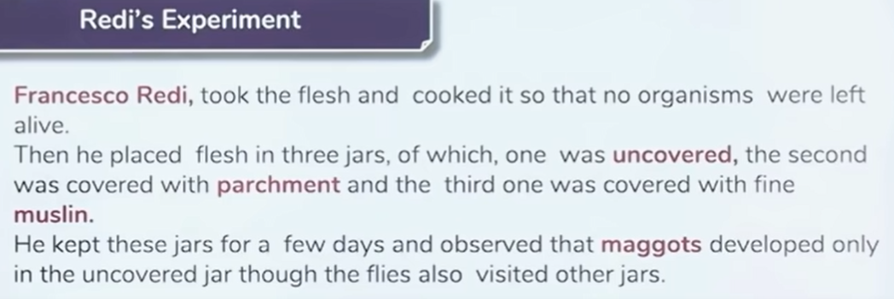
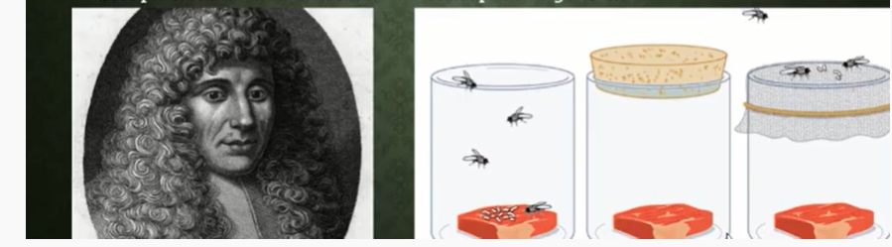
Francesco Redi (1621-1697) demonstrate that fly maggots were not created from meat.

Slide 12
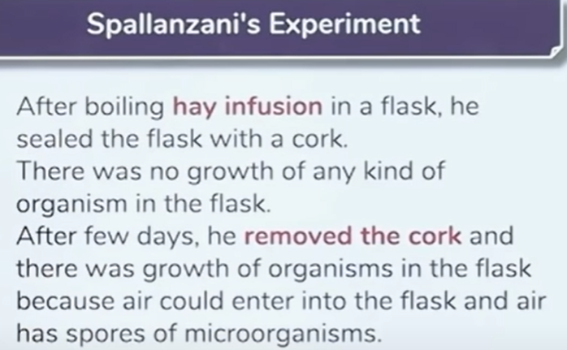
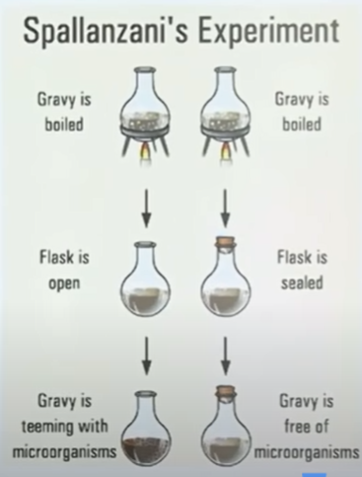
Spallanzani Experiment

Slide 13
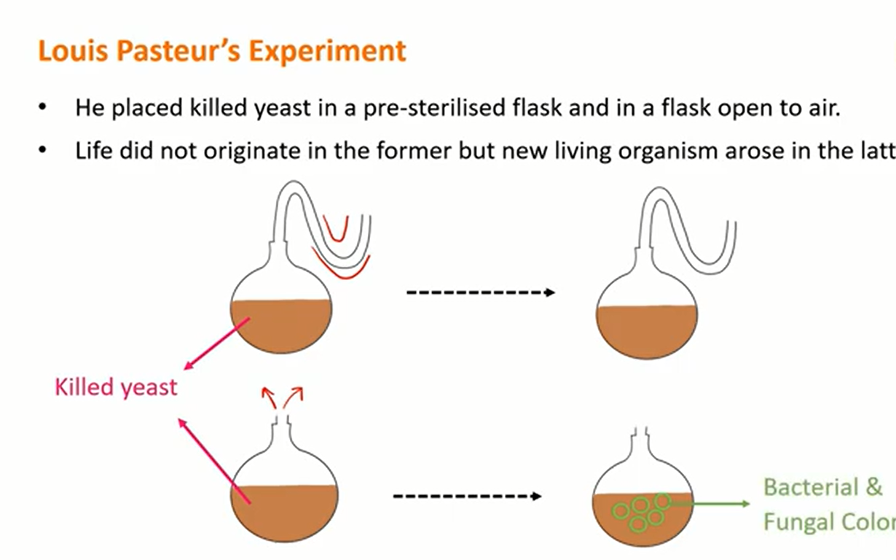
.
.

Slide 14
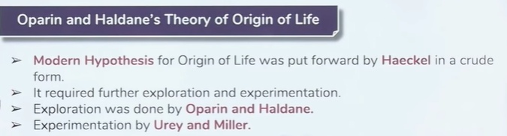
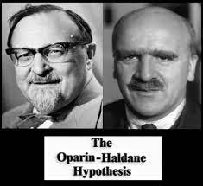
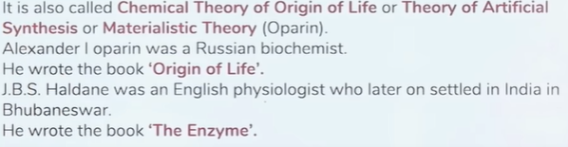

Slide 15
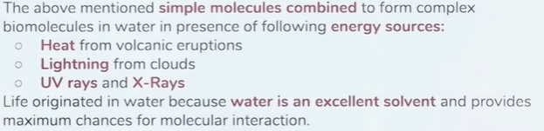
According to them, Conditional primitive atmospheres were entirely different from present-day conditions
The atmosphere was reducing type no free O₂ was available
There was no ozone.
The temperature was very high.
There was abundance of Methane, ammonia, H₂, and water vapours.

Slide 16
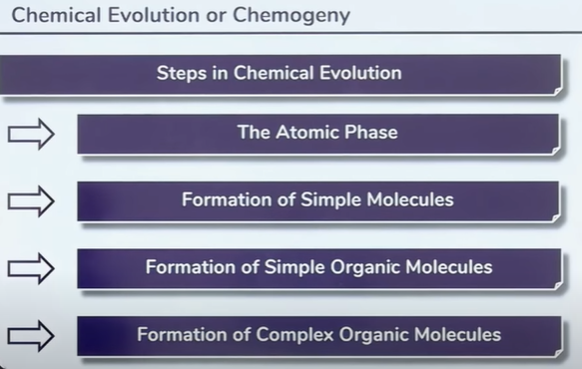
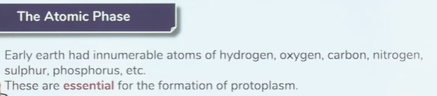
A. Chemogeny

Slide 17
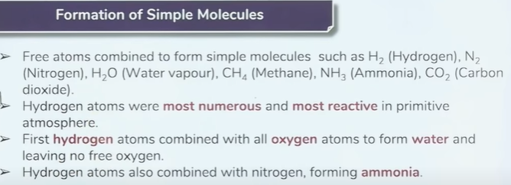
Thus primitive atmosphere was reducing type without free oxygen unlike the present of oxidizing atmosphere (with free oxygen).
So water and ammonia were probably the 1st molecules of primitive earth.

Slide 18
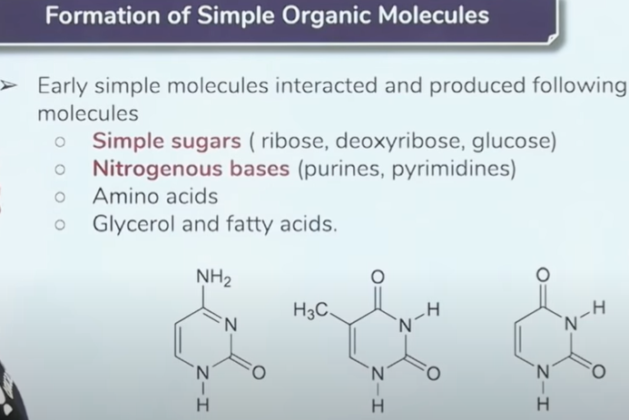
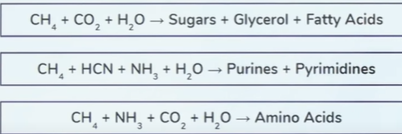
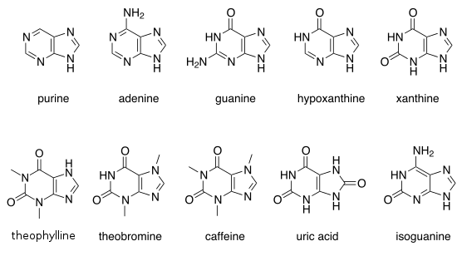
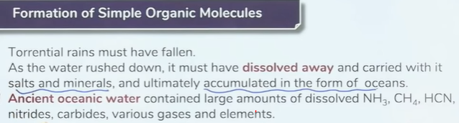

Slide 19
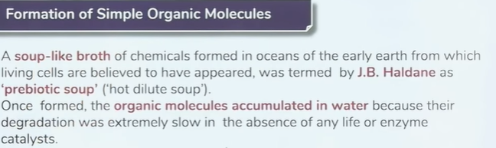
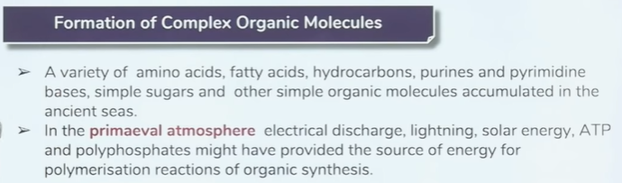
Oparin said abiogenesis is 1st ,but biogenesis is ever after.

Slide 20
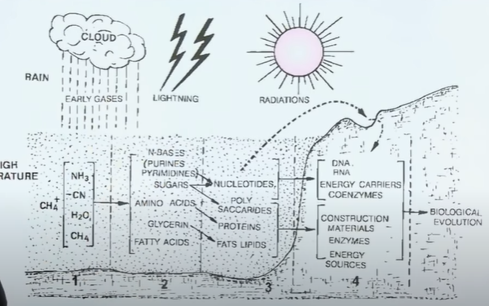
High Temperature

Slide 21
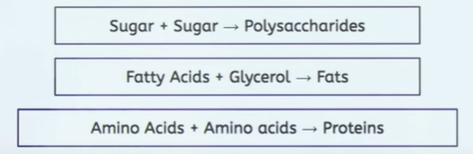
Formation of complex organic molecules

Slide 22
B. Biogeny
Biogeny is also known as the biological evolution of life.
The biomolecules formed during chemogeny were aggregated to form a chemical mixture, which later evolved into primitive life.
Biogeny can be studied in following successive steps.
Formation of nucleotides and nucleic acids
Sugar, phosphate, purines and pyrimidine combine together to form nucleotide or nucleoproteins
Huge mass of formation nucleotide were combined to form DNA and RNA;
These DNA and RNA has potential of self-duplication or multiplication.
Thus such self duplicating molecules are assumed the 1st sign of life.

Slide 23
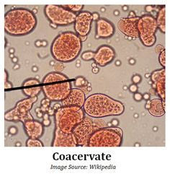
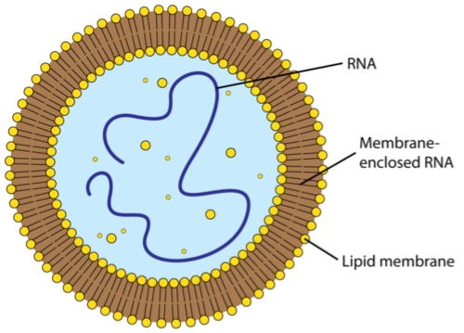
ii. Formation of coacervates
Nucleoproteins with other macromolecule of primordial soup in ocean come together and holded water layer to form colloidal system called coacervates.
Intermediate living organism that gave rise to life
Formation of protobionts (oparin called it ebionts as well)
Absorbed organic molecules and started multiplying
Resulted in anaerobic heterotrophs or proto-cells or 1st cell.
Then give rise to prokaryotes and eukaryotes
Prokaryotic cells without definite nuclei monera and monera evolved into BGA
Eukaryotic cell with definite nuclei like protist and gave rise to protozoa, metazoa and metaphyta
Fig. Protobiont

Slide 24
C. Cognogeny
Cognogeny is the modification and advancement of primitive life.
Due to the scarcity of food in the sea water and changing environment, organisms had to change their feeding habits.
They developed into different forms like parasitic, saprophytic, chemosynthetic, photosynthetic and so on.
Due to change of reducing atmosphere into oxidizing type, the organisms diverged into various forms evolving into complex life forms by acquiring the characteristics like ability of perception, expression and communication.
Conditions for the above reactions
Presence of UV rays due to the lack of ozone layer.
High intensity of light due to lightening.
Enough and optimum heat energy due to frequent volcanic eruptions.

Slide 25
Origin of Autotrophs
Due to scarcity of food heterotrophs (one that can not produce for themselves aka consumers) evolved into autotrophs (one that can make their own food aka producers)
Chemo-autotrophs
Few prokaryotes made enzymes in order to boost the synthesis of carbohydrates from inorganic molecules available in ocean; starting of autotropism(an ability to produce organic matter by redusing inorganic matter)
Photosynthesis
Certain bacteria evolved chlorophyll which made photosynthesis possible thus, used water instead of hydrogen sulfide (H₂S) to emit carbohydrate, blue green algae (BGA) is an example.

Slide 26
Miller-Urey Experiment
Experiment that proves the biochemical origin of life on earth.
Stanley Miller and his professor Harold C. Urey performed an experiment in 1953 A.D to prove the Oparin Haldane Theory.
For the experiment, they attempted to recreate the conditions of primitive earth in the laboratory.
They designed a glass apparatus comprising a glass flask, a condenser and a liquid trap interconnected with tubes and fitted with source of energy as shown in the figure.

Slide 27
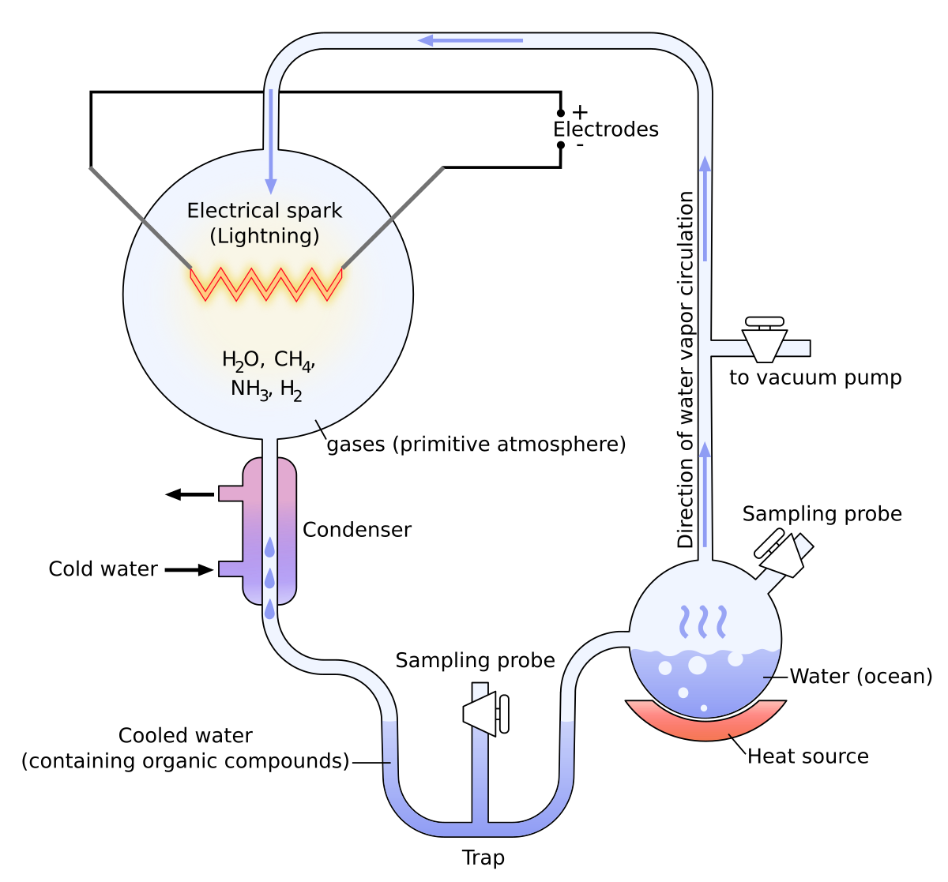
The apparatus was set up to achieve the condition of the primitive earth i.e. the reducing atmosphere and primitive ocean.
The mixture of methane, ammonia and hydrogen was kept in the ratio of 2:1:2 in the gas chamber.
The hot water vapour was circulated through the gas chamber.

Slide 28
The essential energy for the chemical reaction was provided by the electric sparks, UV rays and high temperature.
Continuous electric sparks were fired between the electrodes in the gas chamber to simulate lightening of the primitive earth.
High temperature was maintained by the supply of hot water vapour from the water boiler.
The set up was left for one week.

Slide 29
A mixture of different small organic molecules was formed in the gas chamber(atmosphere) during that time.
Thus formed organic molecules was carried by condenser (rain) to the liquid flask trap of the apparatus set up (ocean).
They analysed the chemicals of the liquid trap.
Different organic molecules like amino acids (glycine, alanine and asparatic acid), adenine and simple sugars such a ribose was found in the liquid.
Hence, Miller-Urey’s experiment verified the Oparin-Haldane’s theory of biochemical origin of life.

Slide 30
Conclusions
The abiotic synthesis of organic molecules in the experimental condition suggests the biochemical origin of life i.e. life originated from non-living forms at the beginning.
The building blocks of cells like amino acids could have been formed on the primitive earth in similar conditions.
At present, origin takes place from pre-existing life.
Hence, Miller-Urey’s experiment verified the Oparin-Haldane’s theory of biochemical origin of life.

Slide 31
Questions
Describe the theory of biogenesis.
Explain the Miller and Urey’s experiment with diagram.
Explain Oparin-Haldane concept.
What are the evidences of organic evolution? Describe.

Slide 32


