Slide 1
Unit 8.3: Nervous System of earthworm
Subject: Zoology
Book writer: Dr. Arvind K. Keasri
Presented by Puja Shrestha

Slide 2

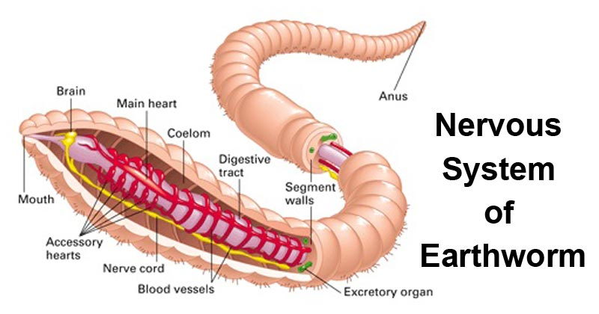

What is nervous system?
The nervous system is a complex network of nerves and cells that carry messages to and from the brain and spinal cord to various parts of the body.
The nervous system includes both the Central nervous system and Peripheral nervous system. The central nervous system is made up of the brain and spinal cord, and the peripheral nervous system is made up of the Somatic and the Autonomic or sympathetic nervous systems.

Slide 3
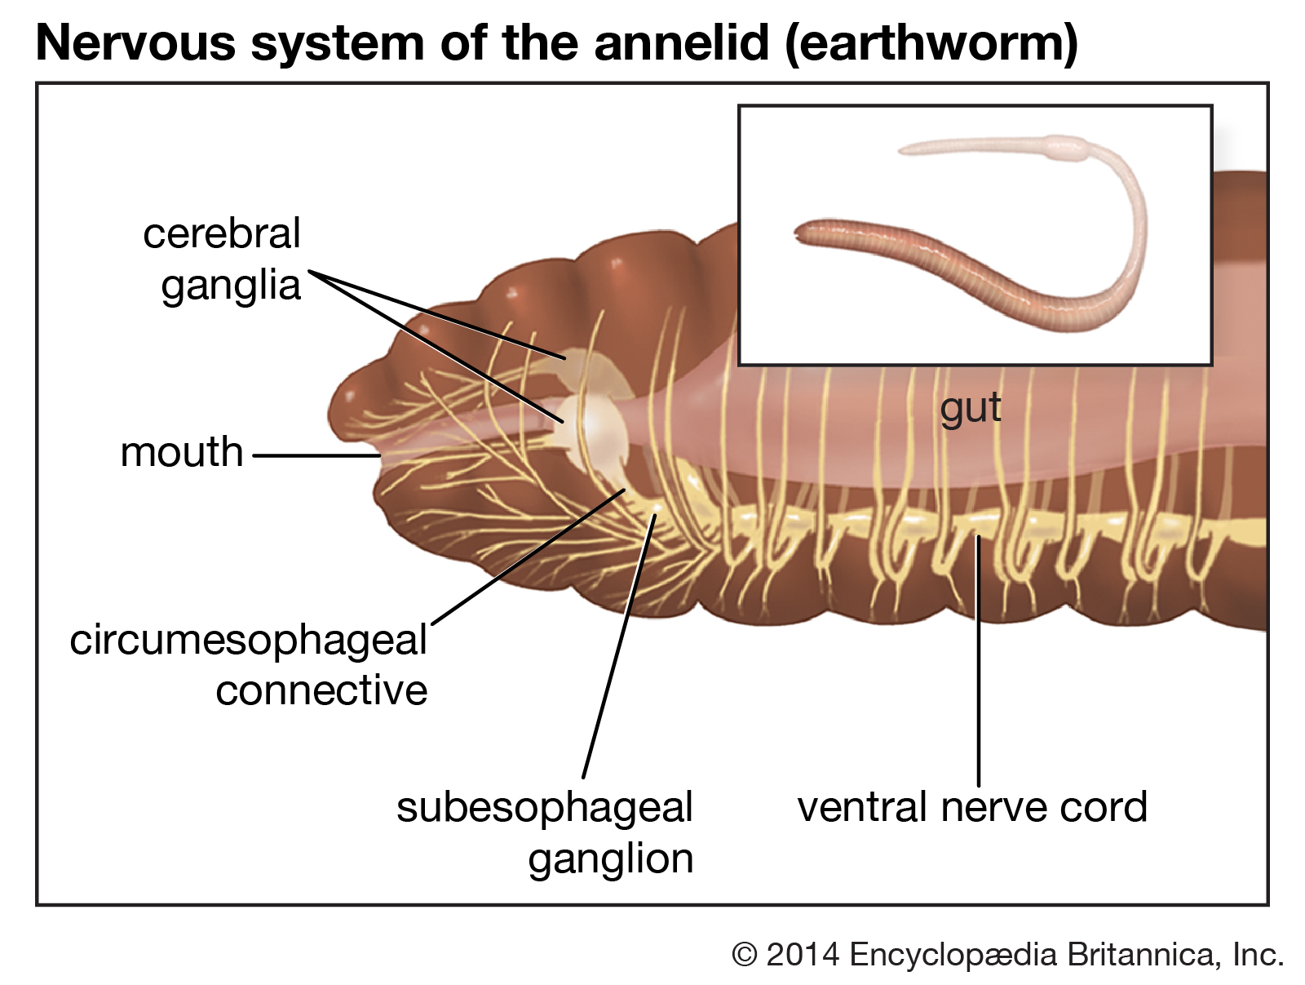
The nervous system of earthworm is well developed. It consists of 3 parts:
Central nervous System
Peripheral nervous system
Sympathetic nervous system
Or Involuntary Nervous system

Slide 4
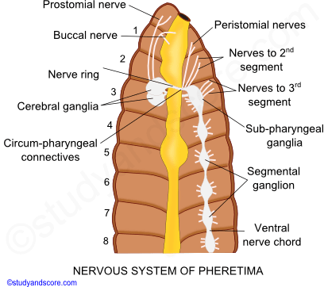
Central nervous system
This part of nervous system lies along the mid-line of the body.
It consists of 2 parts: Nerve ring and Ventral nerve cord.
Nerve ring and b. Ventral nerve cord
Description for Nerve ring
It is ring like spherical structure which lies around the pharynx in 3rd and 4th segment.
It has 3 parts:
i. Supra-pharyngeal ganglia
Also called cerebral ganglia.
They are bilobed in structure.
A pair of whitish pear-shaped supra pharyngeal ganglia fused to form brain.
Lies dorsally in the 3rd segment in the depression between the buccal cavity and the pharynx

Slide 5
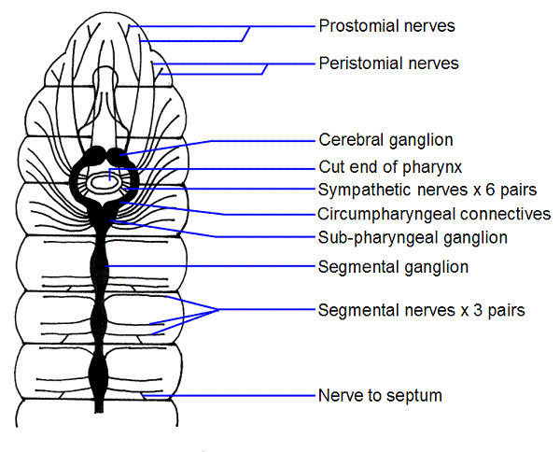
ii. Circum-pharyngeal connectives/ Peri-pharyngeal connectives
From either side of supra-pharyngeal ganglia, a pair of thick short band circum-pharyngeal connectives arise which enclose the pharynx.
It is outer buldging part which extends from 3rd to 4th segment.
iii. Sub-pharyngeal ganglia
Found in lower region of nerve ring which lies in 4th segment.
Ventrally Circum-pharyngeal ganglia meet with a pair of sub-pharyngeal ganglia. Thus a complete nerve ring is formed around the pharynx.

Slide 6
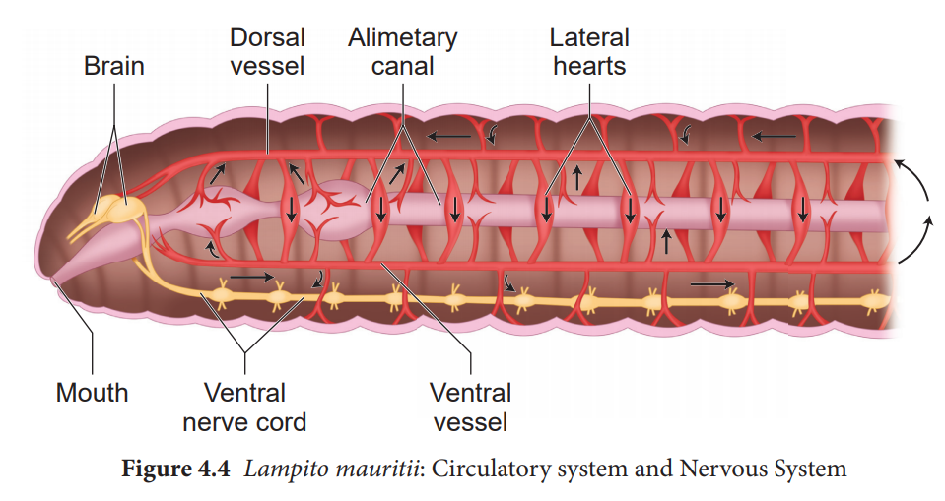
b. Ventral nerve cord
It is long thread like double layered structure, which arises from the posterior part of sub-pharyngeal ganglia and runs the posteriorly up to the last segment of the body.
Extends from 5th to last segment.
Formed by nerve cells and nerve fibres
NOTE: Nerve cord are two in number but they are fused. So they are called double ventral nerve cord.
It has swelling bulb like structure in each segment called segmental ganglion.

Slide 7
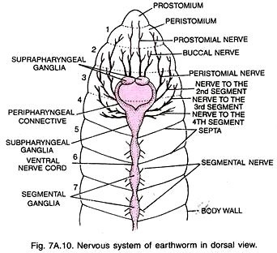
Peripheral nervous system
Those nerve which arise from different parts of central nervous system are called peripheral nervous system.
Following pairs of nerve arise from brain:
8 to 10 pairs of nerve arise from brain which communicates or innervate or supply to prostomium, buccal cavity and pharynx.
2 pairs of nerve arise from cirum-pharyngeal connectives which supply to the wall of prostomium and peristomium segment.
3 pairs of nerves arise from sub-pharyngeal ganglia which supply to the 2nd, 3rd and 4th segment.
3 pairs of nerves arise from each segmental ganglion which supply to the various parts of segment, gut wall, body wall and other internal organ.

Slide 8
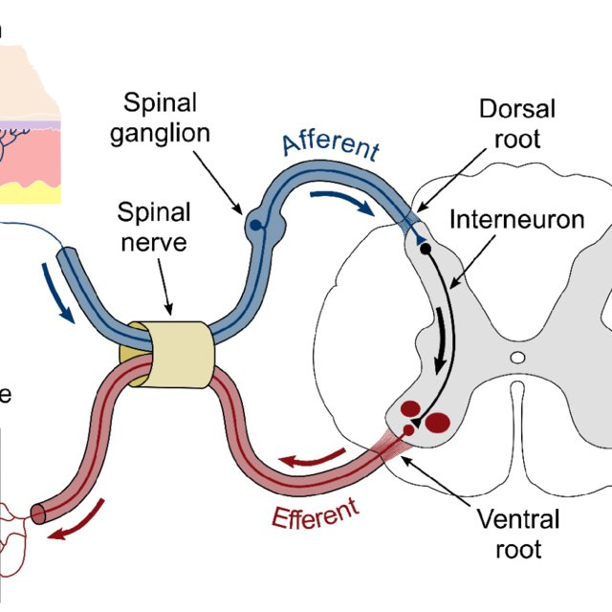
Sympathetic nervous system
Sensory and motor nerve fuse to form nerve plexuses ; a plexus is a bundle of intersecting nerves, blood vessels, or lymphatic vessels which moves ventrally through alimentary canal.
These plexuses are connected with the peri-pharyngeal connectives.

Slide 9
Physiology (Mechanism) of nervous system
The afferent nerve fibre arise from a receptor organ in the epidermal cells and terminate in the mid ventral nerve cord in a tuft to fine branches. Afferent forms a synapse with near branching of the nerve cord.
The efferent nerve fibres arise from synapse ( a neuronal junction) which run outward and innervates the muscles (effectors) which cause them to contract. This circuit of stimuli or impulses forms a simple reflex arch.
The nervous impulses are brought by the afferent fibres to the ventral nerve cord whence (from which) they are reflected back as motor impulses along the efferent fibres.
Receptor organs
Afferent nerve fibres
Ventral nerve cord
Efferent nerve fibres
Effector organs

Slide 10
Neurohormones
Regeneration of injured tissue
Development of clitellum
Maturation and shedding of gametes
Cocoon formatation etc.

Slide 12


