Slide 1
Unit 7: Excretory system
Subject: Zoology
Book writer: Dr. Arvind K. Keasri
Presented by: Puja Shrestha

Slide 2

Excretory system collectively includes the organs that help in excretion.
Excretion- Elimination of nitrogenous wastes from body
Excretory organs of Earthworm- Nephridia/nephridium, highly coiled and microscopic so called micronephridia
Nephridia ectodermal in origin and are anologus to vertebrate kidney
Removes waste from both blood and coelomic fluid

Slide 3
Types of Nephridia
3 types of Nephridia are found in Earthworm. They are:
Integumentary nephridia:
Attatched to skin/integument from 3rd segments of earthworm to last segments
Smallest nephridia as well as most numerous type of nephridia
Maximum in clitellar region; 2000-2500(14th,15th, and 16th). So called “forest of Nephridia”.
Each segments consists 200-250 in number
They are closed type as they lack nephrostome(the rounded funnel shaped terminal part of nephridia which opens into the coelom)
Collect waste from blood and excrete outside the body by Nephridiopores. So called exonephric nephridia

Slide 4
2. Pharyngeal Nephridia:
Present in 3 paired tufts, one on either side of alimentary canal, in the segments 4,5 and 6 near to the pharynx and oesophagus.
100 numbers in each tuft
Least in number
Also closed type due to lack of Nephrostome.
Collect excretory matter from blood, pour into pharynx through nephridial duct. So they are endonephric.

Slide 5
3. Septal nephridia:
Attached to integumental septa behind 15th segment to last. Also known as typical nephridia
Holonephric: complete and contain nephrostome
80-100 per segment
Collect waste from blood and coelom and emptied into the lumen of the intestine mid-dorsally at segmental intervals(septa). So they are also endonephric

Slide 6
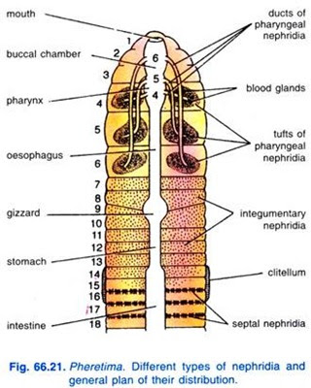

Slide 7
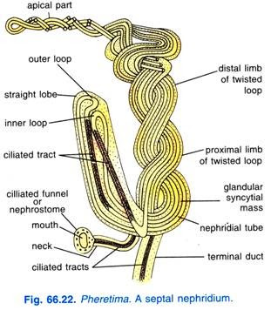
Structure of Typical Nephridia
Nephrostome or Nephridiostome:
Body: Divisible into:
a. Straight lobe and
b. Twisted lobe
3. Terminal duct

Slide 8
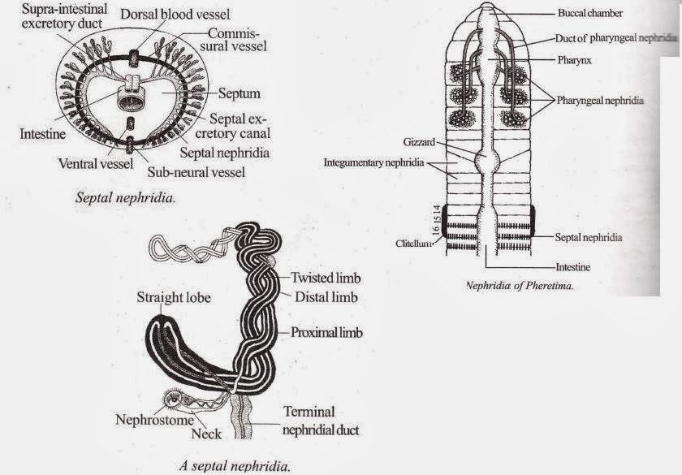

Slide 9
(i) Nephrostome:
It is also known as ciliated funnel or nephridiostome. It is the proximal flattened funnel-shaped structure of the nephridium lying in the coelom.
It has an elliptical mouth-like opening leading into an intracellular canal of the large central cell, the margins of the opening are surrounded by a large upper lip and a smaller lower lip. The lips are provided with several rows of small ciliated marginal cells and the central canal is also ciliated.
(ii) Neck:
The nephrostome leads into a short and narrow ciliated canal forming the neck. It joins the nephrostome to the body of nephridium.

Slide 10
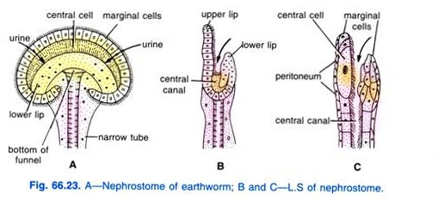

Slide 11
(iii) Body of Nephridium:
The body of nephridium has two parts a short straight lobe and a long twisted loop. The loop is formed by two limbs— the proximal limb and the distal limb.
Both these limbs are twisted spirally around each other, the number of twists varies from nine to thirteen. The neck of nephridium and the terminal duct join together and remain connected with the proximal limb of the twisted loop, while the distal limb becomes the straight lobe.
Internally the nephridium is made of a connective tissue matrix having long coiled neph­ridial duct forming loops. There are four such canals in the straight lobe, three in the lower part and two in the upper part of the limbs of twisted loop. Two canals of the straight lobe out of the four are ciliated like the ciliated canal of the neck.

Slide 12
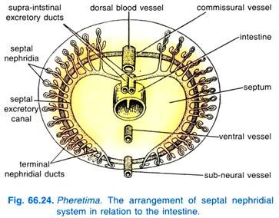
(iv) Terminal Duct:
It is short and narrow with a terminal excretory duct. It joins the nephridium with septal excretory canal lying on the posterior surface of the septum, one on each side of the intestine, each begins ventrally but dorsally it opens in the supra-intestinal excretory duct of its own side.
The supra-intestinal excretory ducts are two parallel longitudinal canals lying above the gut and below the dorsal vessel. These excretory ducts begin from the 15th segment and run to the last segment, they communicate- with each other for a short space behind each septum, then either the right or the left duct opens by a ductule into the lumen of the intestine near the septum.

Slide 13


