Slide 1

Circulatory System in human
Prepared by: Puja Shrestha

Slide 2
Blood
Blood is the body’s fluid connective tissue and it plays an important role in circulating nutrients, hormones, minerals and other necessary products to different parts of the body. Blood flows through a specified set of pathways called blood vessels. The organ which is involved in pumping blood to different body parts is the heart. Blood cells, blood plasma, proteins, and other mineral components (such as sodium, potassium, calcium etc) together constitute human blood. The compositions of blood are:
Plasma is the fluid part of the blood and is composed of 90% of water.
Red blood cells, white blood cells and platelets constitute the solid part of blood.

Slide 3
Types of Blood Cells
The human body consists of three types of blood cells, they are as follows:
Red blood cells (RBC) / Erythrocytes
Red blood cells are mainly involved in transporting oxygen, nutrients, and other substances to various parts of the body. These blood cells also remove waste from the body.
White blood cells (WBC) / Leukocytes
White blood cells are cells that specialize in defense. They provide immunity by fending off pathogens and harmful microorganisms.
Platelets / Thrombocytes: Platelets are cells that help to form clots and stop bleeding. They act on the site of an injury or a wound.

Slide 4
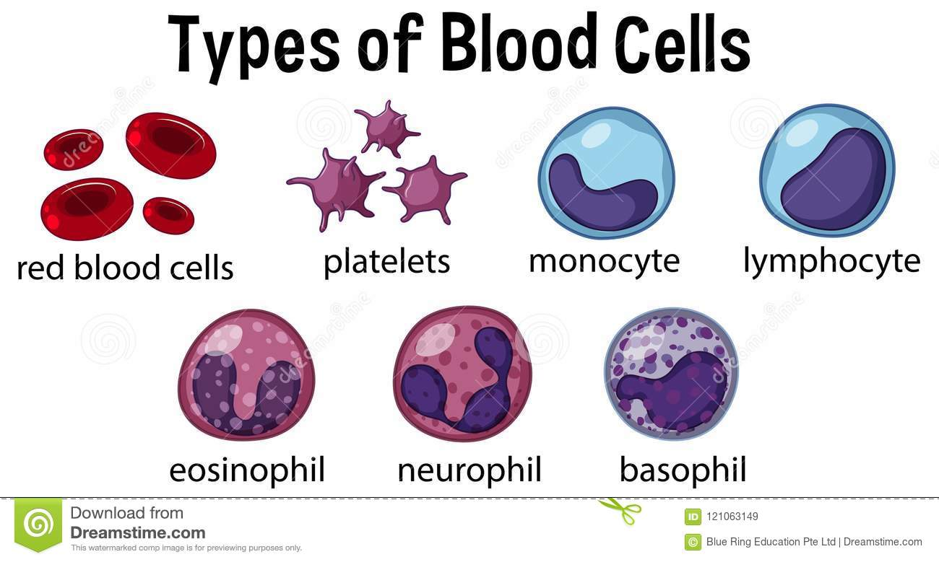

Slide 5
Blood Vessels
Blood vessels are a network of pathways through which blood travels throughout the body. Arteries and veins are the two primary types of blood vessels in the circulatory system of the body.
Arteries
Arteries are blood vessels that transport oxygenated blood from the heart to various parts of the body. They are thick, elastic and are divided into a small network of blood vessels called capillaries. The only exception to this is the pulmonary arteries, which carries deoxygenated blood to the lungs.
Veins
Veins are blood vessels that carry de-oxygenated blood towards the heart from various parts of the body. They are thin, elastic and are present closer to the surface of the skin. However, pulmonary and umbilical veins are the only veins that carry oxygenated blood in the entire body.

Slide 6
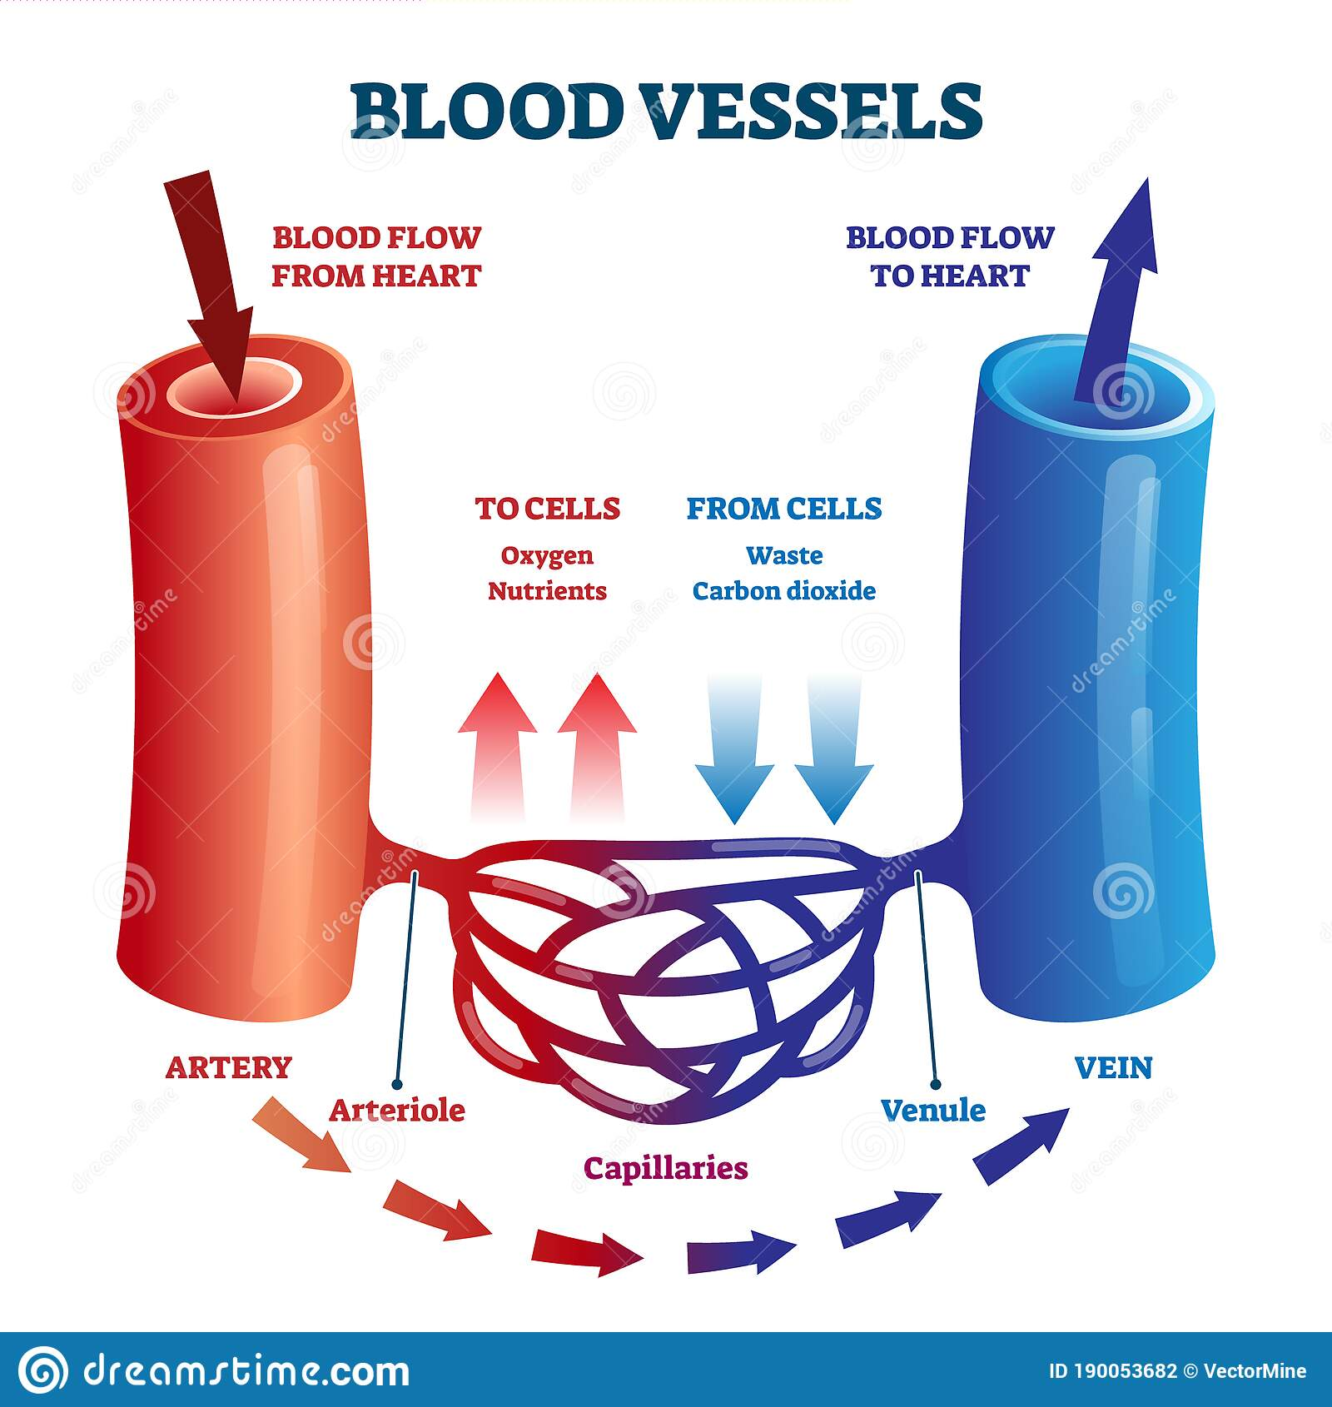

Slide 7
Lymph
The human circulatory system consists of another body fluid called lymph. It is also known as tissue fluid. It is a colorless fluid consisting of salts, proteins, water, etc. which transport and circulates digested food and absorbed fat to intercellular spaces in the tissues. Unlike the circulatory system, lymph is not pumped; instead, it passively flows through a network of vessels.

Slide 8
Functions of Circulatory System/Blood : The most important function of circulatory system is transporting respiratory gases, digested nutrients and harmful nitrogenous wastes throughout the body. The other important functions of the human circulatory system include:
It helps in sustaining all the organ systems.
It protects every cell from pathogens.
It transports blood, nutrients, oxygen, carbon dioxide and hormones throughout the body.
It helps in the cell to cell interaction.
The substances present in the blood repair the damaged tissue.

Slide 9
Heart
The heart is a muscular organ located in the chest cavity, between the lungs, It is positioned slightly towards the left in the thoracic region and is enveloped by the pericardium. The human heart is divided into four chambers – two upper chambers called atria (singular: atrium) and two lower chambers called ventricles.
The human heart
In all vertebrates including human beings, there is a single heart which acts as a pumping organ of blood vascular system. It receives and pumps blood from and to different organs of the body respectively. For this purpose, it undergoes spontaneous, rhythmical and ceaseless contractions (beats) throughout the life.

Slide 10
Appearance and position:
Is a hollow, muscular organ (made up of involuntary cardiac muscles), roughly of the size of one’s fist (12×9 cm)
Average weight is about 300gm in males and 250gm in females
Is reddish-brown in color and somewhat conical in shape
Located almost in the middle of the thoracic cavity close to its front wall and between the lungs. Its broad base faces upward and backward whereas the narrow apex is directed downward, forward and slightly to the left.

Slide 11
Protective covering:
The heart is enclosed in a tough, two-layered sac, the pericardium, comprising inner visceral pericardium attached to the heart and the outer parietal pericardium.
The two layers have a potential space or cavity in between them, the pericardial cavity which consists of about 50 ml of pericardial fluid.
This fluid keeps the heart moist, allows its free movement and reduces the friction between the heart wall and the surrounding tissues when the heart beats.
The pericardium protects the heart from mechanical injury and checks its overstretching and overfilling with blood.

Slide 12
External structure:
The smaller upper chambers, auricles (atria) are demarcated externally from the lower larger chambers ventricles by an irregular groove called the coronary sulcus.
The two ventricles are demarcated externally from each other by an oblique groove termed as inter-ventricular sulcus. This groove contains coronary blood vessels that supply blood to the heart muscles.

Slide 13
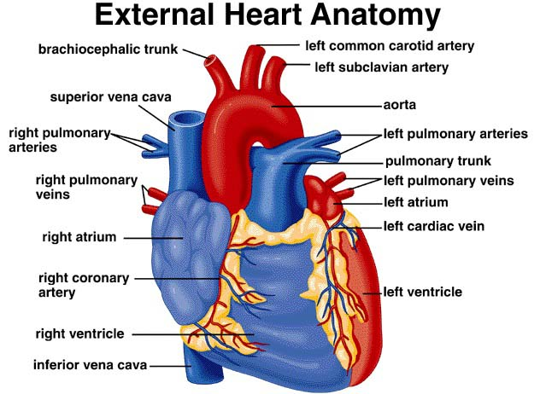

Slide 14
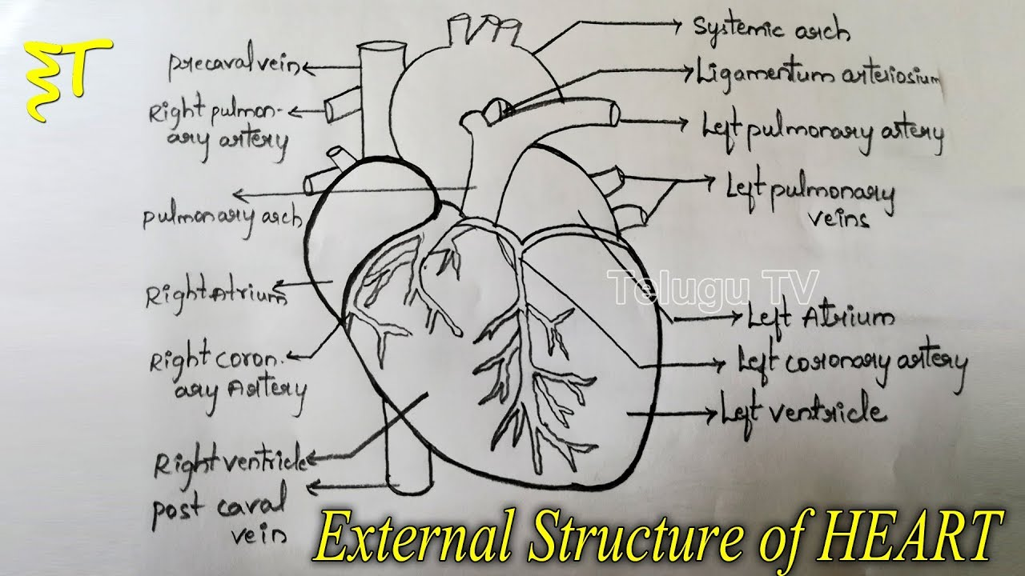

Slide 15
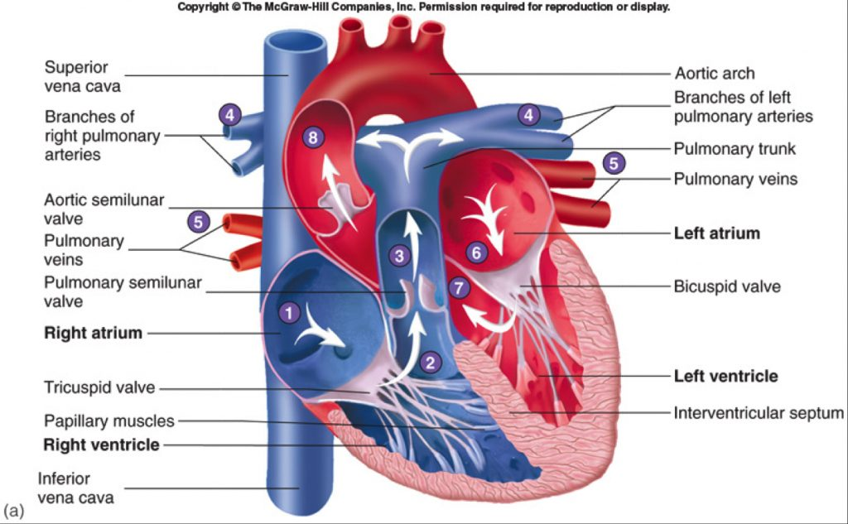
Internal Structure of Heart

Slide 16
a) Chambers of the heart:
The upper smaller chambers of the heart are auricles or atria which receives blood returning to the heart. They have thin walls, because they have to force blood into the ventricles that lie just below them. The two auricles are separated from each other by a partition, the inter-auricular septum or inter-atrial septum.
The lower larger chambers of the heart are ventricles which pump and distribute the blood to the body parts. The two ventricles are separated from each other by inter-ventricular septum.
The ventricles have thicker walls than auricles and the left ventricle is about three times as thick as that of the right ventricle, which is because the left ventricle has to pump the blood to the farthest end of the body whereas the right ventricle has to pump blood to the lungs.
Internal structure: The heart is a hollow organ that contains four chambers, various apertures, valves and great blood vessels.

Slide 17
b) Great vessels, apertures and valves of the heart:
The four heart valves allow the blood to flow through the heart in only one direction; they also prevent the back flow of blood. i) Venae cavae:
The right auricle receives two large veins: superior venacava brings deoxygenated blood from the head and upper body parts and inferior vena cava brings the deoxygenated blood from the lower body parts. ii) Right auriculo-ventricular aperture (A-V aperture) and tricuspid valve:
The right auricle opens into the right ventricle through a wide passage, the right auriculo-ventricular aperture which is guarded by a one-way valve called the tricuspid valve.
The valve consists of three membranous flaps which prevent the backflow of blood from right ventricle back to the right auricle during the contraction of the right ventricle.

Slide 18
iii) Pulmonary aorta and pulmonic semi-lunar valves:
From its upper left corner, the right ventricle gives off a large blood vessel called the pulmonary arch or pulmonary artery.
It divides into right and left pulmonary arteries that carry deoxygenated blood to the lungs for oxygenation.
At the base of the pulmonary arch are three membranes, pocket-shaped flaps, the pulmonic semilunar valves.
Pulmonic semilunar valves prevent the return of blood to the right ventricle.
iv) Pulmonary veins:
The left auricle receives four pulmonary veins, two from each lungs bring oxygenated blood from the lungs.
They don’t have any valves.

Slide 19
v) Left auriculo-ventricular aperture and bicuspid valve:
The left auricle opens below into the left ventricle by a large passage, the left auriculo-ventricular aperture which is guarded by a one-way valve known as bicuspid valve or mitral valve.
The valve consists of two membranous flaps which prevent the backflow of blood from left ventricle back to the left auricle during the contraction of the left ventricle.
vi) Systemic aorta and systemic semi-lunar valves:
At its upper right angle, the left ventricle gives off a large blood vessel called the systemic aorta consisting of three regions; ascending aorta, arch of aorta and the descending aorta.
At the base of the ascending aorta are three membranous, pocket-shaped systemic semilunar valves that check the return of the blood to the ventricle.

Slide 20
Blood circulation (flow of blood through the heart)/ Mechanism of heart
The sinu-auricular node (SA node) also called a natural pacemaker, initiates a wave of contraction which spreads over the walls of auricles and the ventricles.
Because of the electrical impulse initiated by the SA node, the heart chambers undergo alternate contraction called systole and relaxation called diastole to pump the blood to and from different parts of the body.
The superior and inferior venacavae carry deoxygenated blood from the upper and lower body parts respectively to the right auricle.
From the right auricle, the blood passes into the right ventricle through the tricuspid valve which prevents the backflow of blood into the right auricle.

Slide 21
The blood is pumped into the pulmonary trunk from the right ventricle which then divides into two pulmonary arteries (left and right pulmonary arteries) and carry blood to the lungs for oxygenation.
The opening of the pulmonary aorta is guarded by three semilunar valves preventing the backflow of blood into the right ventricle.
In the lungs, there is gaseous exchange and blood receives oxygen releasing carbon dioxide into the lungs.

Slide 22
The oxygenated blood is carried from each lung to the left auricle by four pulmonary veins (two from each lung).
The oxygenated blood from left auricle now passes to the left ventricle through bicuspid or mitral valve which prevents the backflow of blood into the left auricle.
From the left ventricle, the blood is now pumped into the systemic aorta guarded by three semilunar valves at the opening.
Subsequently, the blood is now taken to different parts of the body by arteries.

Slide 23
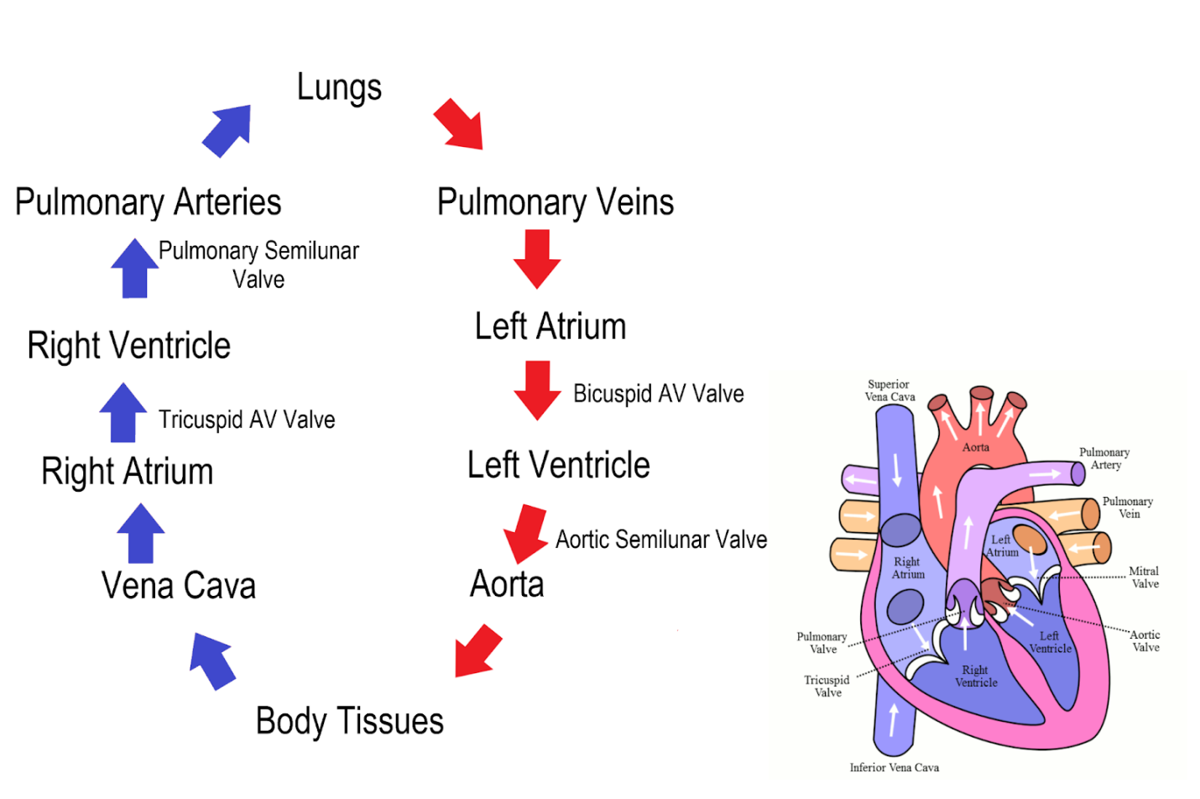

Slide 24
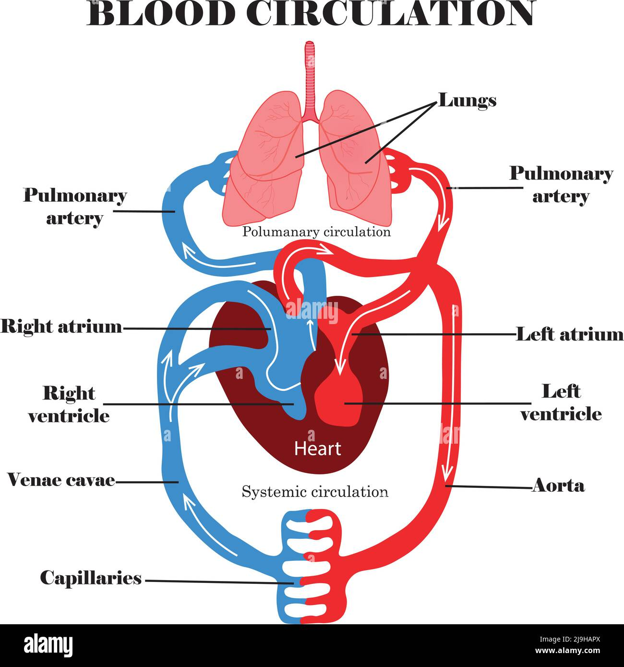

Slide 25
Blood circulatory system
The human circulatory system is a complex network consisting of arteries, veins, capillaries and the heart. Its primary role is to provide essential nutrients, minerals and other important components such as hormones to various parts of the body. Alternatively, the circulatory system is also responsible for collecting metabolic waste and toxins from the cells and tissues to be purified or expelled from the body.

Slide 26
The systemic circulation:
It carries oxygenated blood from the heart to all parts of the body through a complex system of arteries and capillaries. It also carries deoxygenated blood from these organs back to the heart through veins.
The pulmonary circulation:
After the heart receives the deoxygenated blood from different parts of the body, it pumps those to the lungs for expelling the carbon dioxide and other impurities and collect oxygen, after which the oxygenated blood is sent back to the heart for systemic circulation.

Slide 27
Heart beat: The rhythmic contraction and relaxation of heart to pump the blood is called heart beat. Each beat consists of a phase of systole and a phase of diastole.
Average rate of heart beat in a healthy adult-72 times/min
If a condition called bradycardia is develop , the rate of heart beat is less than less than 60 times/min
If a condition called trachycardia occurs, the rate of heart beat is more than 100.

Slide 28
Origin and conduction of Heart beat
Human heart is myogenic (heart beat originates from the muscles of the heart controlled by a mass of neuromuscular tissue called node).
Two kinds of nodes :
S-A node(sino-auricular node):
It is a small bundle of modified cardiac muscles lies in the upper part of right ventricle near to the superior –venacava. It generates the wave of contraction and spread it throughout the auricles. Also known as pace-maker as it initiates the heart beat.
A.V node(Auricle-ventricular node):
It is a nodal tissue lies in the right auricle at the auriclo-ventricular septum.
Provided with a mass of specialized nerve fibres called Bundle of His present in inter-ventricular septum and divided into right and left purkinje fibres.
A-v node stimulates the wave comes from S-A node and magnifies them. Also known as pace setter.

Slide 29
Types of Circulatory System
Almost all multicellular organisms need a circulatory system to transport oxygen and nutrients through the body. Evolution has led to the existence of two types of circulatory systems namely:
Open circulatory system: primarily found in invertebrates. Here, the blood flows freely through cavities and there are no vessels to conduct the blood.
Closed circulatory system: is found in vertebrates and a few invertebrates like earthworms. This system has the presence of vessels that conduct blood throughout the body.
Vertebrates and few invertebrates have a closed circulatory system. The open circulatory system, on the other hand, is most commonly seen in invertebrates such as cockroaches and crabs.

Slide 30
Blood vessels
Blood vessels are the network of vessels which distribute and collect the pure and impure blood throughout the entire body continuously. There are mainly two types of blood vessels system: Arterial and Venous system.
Arterial system:
Network of blood vessel which carries the oxygenated blood throughout the body except pulmonary artery is known as arterial system.

Slide 31
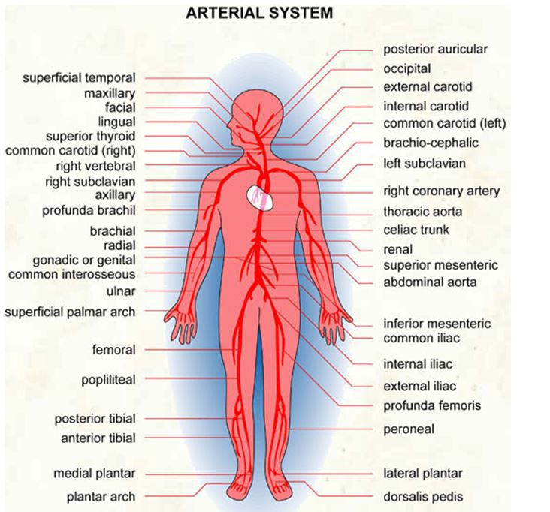

Slide 32
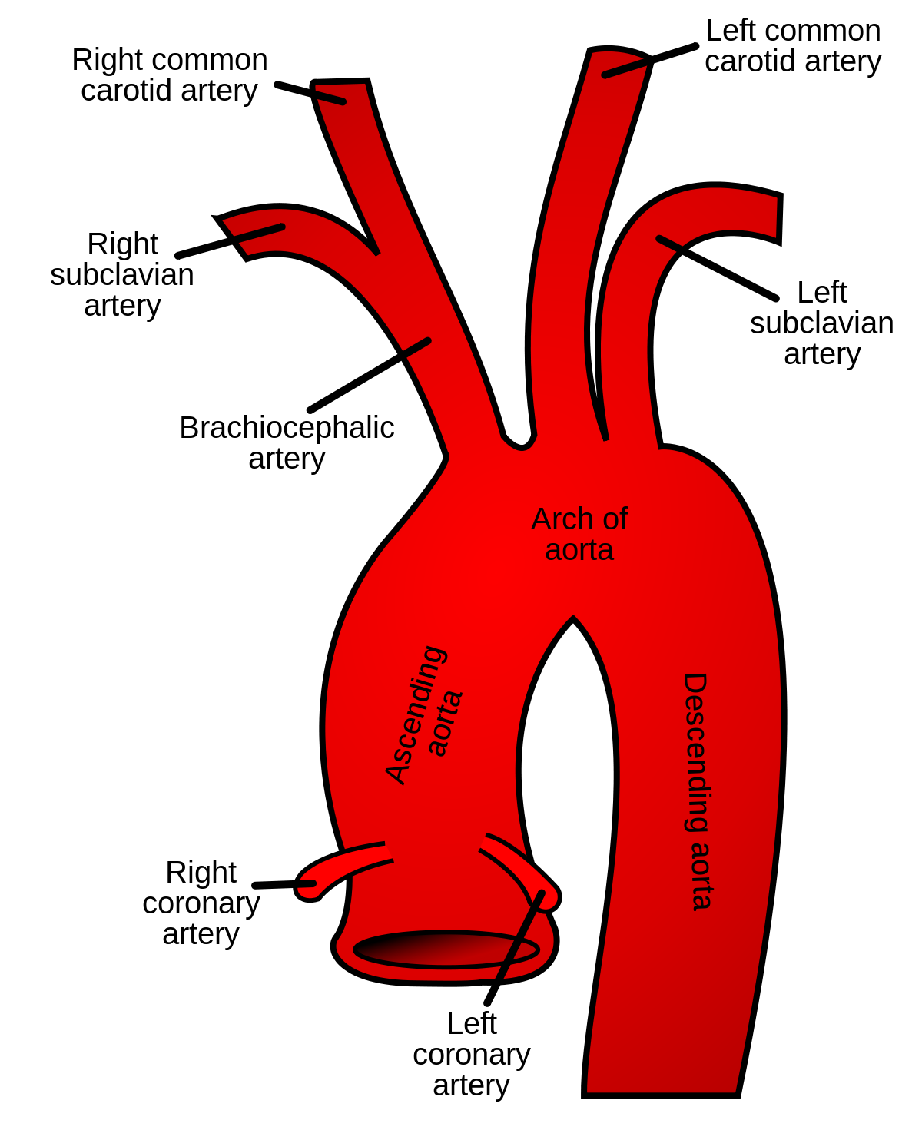

Slide 33
Large network of arteries that supplies oxygenated blood throughout the body except pulmonary arteries is known as arterial system.
Blood supplies through aortic system and pulmonary system. This system supply pure blood to body organs and impure blood to lungs.
Pulmonary (from right ventricle)- impure blood to two lungs.
Coronary arteries – to heart
Aortic arch (from the left ventricle) - It gives one branch called innominate( Brachioceplalic) on the right side. It divides into
Right common carotid and right subclavian.
On the left side, aortic arch gives left common carotid and left subclavian.
Common carotids – supplies blood to head and facial parts.
Internal carotids (Brain) and external carotids (Head and face).
The right and left subclavians - to fore limbs (hand). Subclavians divide into radial and ulnare arteries. They all supply pure blood to different parts of hand.
Vertebral arteries - to neck region.

Slide 34
The aortic arch runs down and forms the dorsal aorta. It gives many branches. Intercostal arteries- to intercostal muscles
Inferior phrenic arteries to the lower part of diaphragm
Coeliac artery divides into the hepatic and leinogastric arteries. Hepatic artery supplies blood to liver and leinogastric supplies blood to stomach and spleen.
Superior mesenteric arteries _ to duodenum, jejunum and ileum
The right and left renal arteries -to the kidneys.
The genital arteries - to testes in male and ovaries in female.
The lumbar arteries supply blood to the wall of abdomen.
The inferior mesenteric artery supplies blood to the large intestine like ascending, transverse, descending colon, pelvic colon and rectum.
Then the dorsal aorta divides into two branches called common iliacs. They enter into two legs.
The right and left iliacs give small internal iliacs to supply blood to urinary bladder. The external iliacs give deep femoral which supply blood to thigh. The external iliacs run down as popliteal.
These divide into anterior and posterior tibials. They supply blood to lower part of leg.

Slide 35
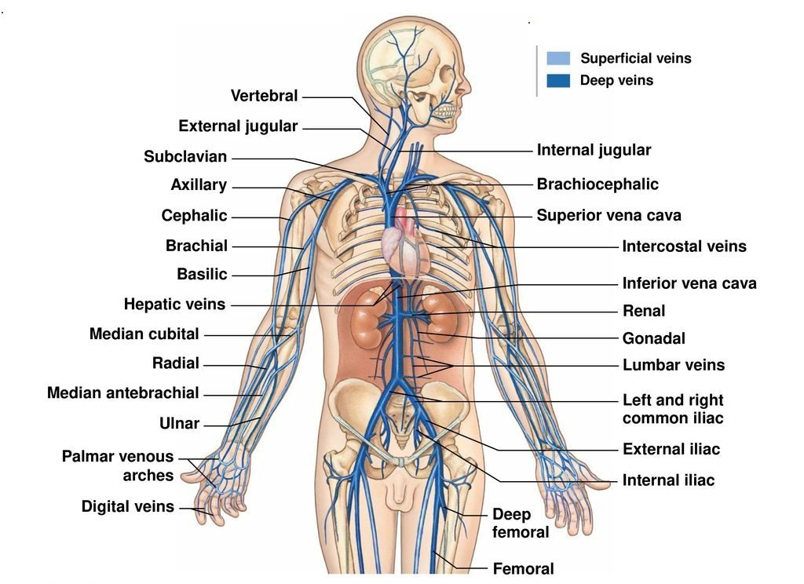
Venous blood Circulation

Slide 36
All veins in the body together make venous system. This system is for collection of pure blood from lungs and impure blood from rest of the parts of body. Four pulmonary veins collect pure blood form lungs and open into left atrium.
Superior venacava collect blood from anterior part of body. It is made by different veins. Right and left innominate/Brachiocephalic veins join to form superior venacava. Each innominate is made by right and left external and internal jugular veins collecting blood from head and brain.
The right and left subclavians collect from hand. The subclavian is again made by axillary and cephalic veins.
Azygous vein collects from chest region in the right side. Hemiazygous collect from left side. Both open into superior venacava.
Inferior venacava is made by different veins. Two short and thick hepatic veins collect blood from liver.
Two common iliac veins join to make the inferior venacava. Each iliac vein is made by internal iliac from urinary bladder, large saphenous from thigh.
Anterior and posterior tibial from lower part of leg.

Slide 37
Hepatic Portal System
The blood collection form stomach and intestine has different arrangement. It is called Portal system. The blood is not directly carried to the heart. It is taken to liver first. Gastric vein, duodenal vein, intestinal veins etc join to form hepatic portal vein. It enters into liver to form hepatic portal system.

Slide 38
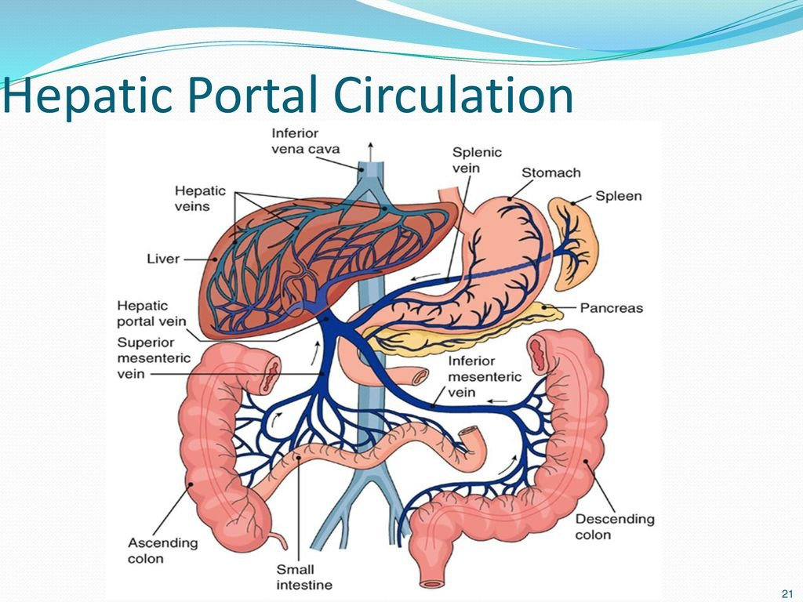
Fig: Hepatic portal system

Slide 40
Note: Following topics are also important therefore make short note (Definition) on followings:
Cardiac output, Cardiac cycle, Heart rate, Stroke volume, Heartbeat, Blood pressure,
Pulse rate, Heart sound, Artificial pacemaker, Rh Factors
and ECG.

Slide 41



