Slide 1

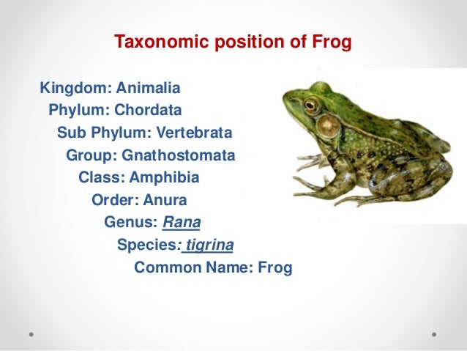
Detailed Study of frog

Slide 2
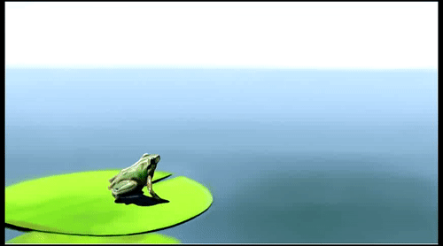
Characteristic features of frog
Habits:
Frogs are non-poisonous, harmless and usually silent animals.
Unless disturbed, the detection of frog’s presence is difficult.
Along with being an excellent jumper, it is very agile.
Habitat of frog:
Frogs commonly dwell in or near water and in relatively damp areas on land.
Indian bull frog (Rana tigrina) lives in or near permanent freshwater lakes, ponds and streams.
It spends its most of the time in the water.
The reasons for why the frog reside near the water are:
To keep skin moist so as to perform cutaneous respiration.
To escape from enemies by jumping into the water.
Their oviposition, fertilization and embryonic development takes place in water.

Slide 3
Locomotion of frog:
Frog locomotes in two ways, by leaping on ground and swimming in water.
Its muscular and endoskeletal systems have been modified to do so.
Leaping:
While resting on land, frog’s short forelimbs are kept upright and the long hind limbs are folded in the manner of Z.
The hind limbs are powerful.
As the front part is inclined upwards during normal resting position, it is termed as squatting posture.
The sudden extension of hind limbs during leaping acts as springs throwing the body to air.
In a single jump, frog can jump a distance of 1.5 to 2 meters.
The forelimbs act as shock absorbers on landing back to the ground.
The forelimbs also manipulate and adjust the direction of the jump.

Slide 4
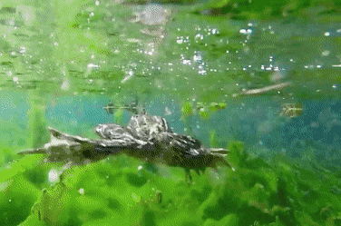
Swimming:
The swimming of frog in water is possible because of the powerful backwards thrusts of its hind limbs that act like propellers.
In course of their backward strokes, the toes are spread apart and the broad webs push against water, leading the body forward.
When the frog is paddling around leisurely, the right and left forelimbs move alternately.
Forelimbs carry out two roles i.e. assist in propelling and in guiding the direction of movement.
Only the tip of snout carrying nostrils is exposed, when frog comes to surface to breathe, or just float. In this time, the fore and hind limbs are extended in water.
If disturbed in this position, it dives under water right away.

Slide 5
Feeding habit of frog:
Being carnivorous in nature, it feeds on living insects, worms, molluscs and tadpoles.
It catches its prey by a sudden flip of its protrusible sticky tongue which is attached at the front end and is free behind.
It ignores motionless object or food.
It doesn’t chew, but swallows whole food.
Croaking sound of frog:
Croaking is a term given for characteristic noise or sound produced by frogs.
It is commonly heard during rains which is its breeding season.
It is considered as mating call.
The air is forced from lungs over vocal cords into mouth cavity and is returned back again. This is how croaking sound is produced.
Croaking can be done under water and on land as well.
Croaking is heard louder in males due to presence of a pair of distensible balloon-like loose skin folds on throat, called vocal sacs.
Vocal sacs act as resonators.

Slide 6
Hibernation and aestivation in Frog:
As frogs are cold-blooded animals, the body temperature alters with that of surrounding.
In the time of adverse environmental conditions such as cold winter and hot summer days, frogs hide themselves in the soft damp bottom mud for protection.
They now stop feeding and become metabolically inactive.
They survive on glycogen and fat stored in their bodies.
Pulmonary respiration is suspended.
Cutaneous respiration through moist skin is sufficient.
This condition of dormancy or suspension of liveliness is termed as hibernation or ‘winter sleep’ during winter and aestivation or ‘summer sleep’ in summer.
As soon as the cold winter or hot summer ends, the frogs return back to their normal active life.

Slide 7
Camouflage adaptation in frog:
Frogs have the color changing ability of skin to match with that of surroundings.
It helps them to escape from enemies by remaining unnoticeable.
This type of protective coloration is termed as camouflage.
The change in color is possible due to dispersion or concentration of special amoeboid pigment cells in their skin.

Slide 8
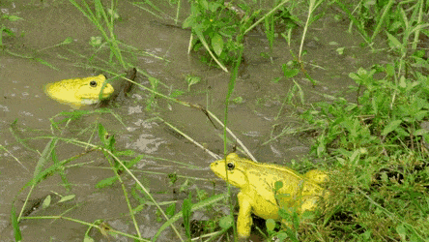
Breeding in frog:
As soon as the rainy season starts, frog comes out from aestivation.
It starts breeding immediately which lasts from July to September.
Males gather in shallow waters and attract females by croaking which is often a sex call.
The male mounts upon the back of the female and grasps firmly around her thorax by his forelegs.
The males have nuptial pads (holding the slippery female) on the bases of inner fingers which are fully developed during breeding season.
It helps them in Amplexus is the term given for this sexual embrace.
Amplexus continues for several days till the female deposits several hundred ova or eggs through her cloaca into water.
Milt or seminal fluid contains spermatozoa is discharged by males over eggs.
Hence, fertilization is external.
Now, the male releases grip, leaving the female.
Frog’s spawn (mass of eggs) is embedded in a gelatinous material which on contact with water swells into a protective transparent jelly.
The fertilized eggs or zygotes develop into tadpoles within two weeks of time.
Tadpoles are free-swimming aquatic larvae that undergo metamorphosis to become adult terrestrial frogs.

Slide 9
Enemies of frog:
The number or frogs and tadpoles are reduced by several natural enemies.
The major enemies are snakes, mongooses, turtles, racoons, crows, vultures, aquatic birds, fishes, other amphibians and man.
Frogs also becomes host for different kinds of parasites such as protozoans (Opalina, Nyctotherus, Balantidium, Trichomonas, Entamoeba), lung flukes (Haemotoloechus, Pneumobites) and nematodes (Rhabdias).
Economic importance of frog:
As a vertebrate type, frog is studied widely in laboratory.
It is also used for researches in Physiology, Pharmacology and human pregnancy tests.
It is also used as a fish bait.
It is regarded as farmer’s friend as it feeds on insects harmful for crops.
The hindlegs of frogs are used as food source by men.
In some parts of world, they are reared at farms.

Slide 10
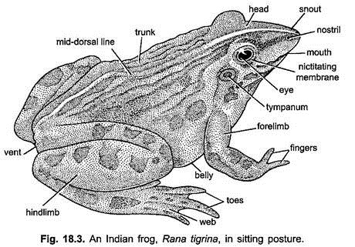
External features of Frog:
1. Morphology of frog
Shape and size:
Body of a frog is somewhat spindle-shaped, pointed anteriorly and rounded posteriorly.
It is slightly flattened dorsoventrally.
It is streamlined so that it offers least resistance while swimming.
Body is divisible into distinct head, trunk and limbs.
Both neck and tail are absent.
Size varies from 12 to 18cm in length and 5 to 8cm in width.
Skin and color:
Skin of frog is thin, moist, and smooth.
It fits loosely on the body.
Skin lacks placoid scales or any other hard exoskeletal parts.
Dermal plicae (dorso-lateral folds or thickenings) is present on skin of back.

Slide 11
Head:
Head of frog is flat, roughly triangular in outline and has a short blunt anterior snout terminating in a wide transverse mouth.
Just above the mouth, at the tip of the snout, two openings are present; termed as the external nares or external nostrils which lie dorsally. It helps in respiration.
On top of head, two very large, spherical and protruding eyes are present dorso-laterally.
These eyes make marked prominences on the roof of buccal cavity when pressed downwards. Eyes do not rest on any bone unlike higher animals.
Upper eyelid is almost immovable and is thick and pigmented.
Lower eyelid is freely moveable and is thin and semitransparent.
A transparent third eyelid or nictitating membrane arises from the lower eyelid.
This membrane covers and protects eyes during swimming and prevents from drying in air.
Vestigial pineal eye is present just in front of eyes.
It is represented by median light-colored patch or brow spot.
The ear drum or tympanum is present behind and below each eye.
The eardrum is a conspicuous, flat and deeply pigmented circular patch that receives sound waves. Frog lacks external ear.
In male, vocal sacs are present in form of two bluish patches of skin.

Slide 12
Trunk:
Head is broadly joined behind with the flat trunk.
Trunk is ovoid in structure.
Its back is raised in the middle in a characteristic sacral prominence of hump.
It is clearly seen when the frog is squatting.
A small circular cloacal aperture or vent is present at the posterior end of trunk.
It serves for the discharge of faecal and urinary wastes as well as reproductive products (ova or sperm).

Slide 13
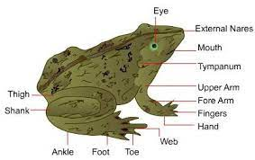
Limbs:
Laterally, the trunk bears two pairs of limbs or appendages.
The short forelimbs arise anteriorly from trunk just behind the head.
Each forelimb consists of:
The upper arm (brachium), Forearm (antebrachium)
Wrist (carpus)
Hand (manus) bearing 4 digits without web.
Thumb or pollex is vestigial.
In case of male frog, the base of first inner finger is thickened, especially in breeding season. It forms the nuptial pad for clasping the female during amplexus.
The much elongated and powerful hind limbs or legs arise close together posteriorly from trunk.
Each hind limb consists of:
the thigh, shank (crus) and much lengthened ankle (tarsus) and large foot (pes)
Foot has 5 slender clawless toes connected by broad thin webs of skin which assist in swimming.
A rudimentary sixth digit called prehaullex is present in addition to it.
It is enclosed within the skin and is not seen as sixth digit.

Slide 14
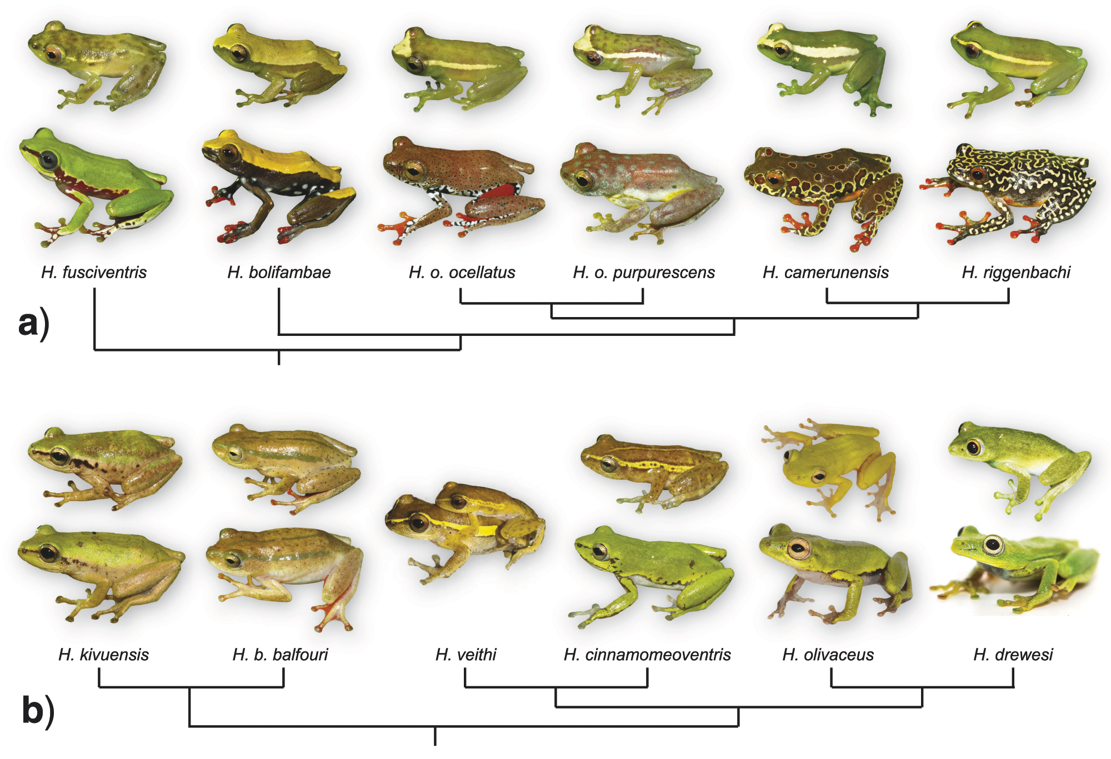
2. Sexual dimorphism in frog:
There are some variations in external characters by which male and female frogs can be differentiated:
Males are normally smaller in size and darker in color than females.
Males are slim while females are stout, especially when they bear eggs.
Males croak loudly as they have vocal sacs whereas vocal sacs are absent in females. The eardrum is larger in male.
Males have swollen copulatory or nuptial pads on inner fingers whereas it is lacking in females.
During amplexus, the upper one is male and the lower one is female.

Slide 15
3. Coelom and viscera of frog:
A large body cavity or coelom is present inside the trunk of frog.
It consists most of the internal organs or viscera.
A thin, transparent membrane of mesodermal origin is termed as the peritoneum.
It lines the body cavity (parietal peritoneum) and also covers the internal organs (visceral peritoneum).
Most digestive and reproductive organs are suspended from mid-dorsal body wall by mesenteries (double layers of peritoneum).
Through mesenteries, nerves and blood vessels connect to the organs.
A watery coelomic fluid fills the body cavity.
It lubricates the viscera and prevents from friction.
Pericardium encloses the heart.
Pericardium is a special coelomic cavity.
The remaining coelom is termed as perivisceral or abdominal cavity.

Slide 16
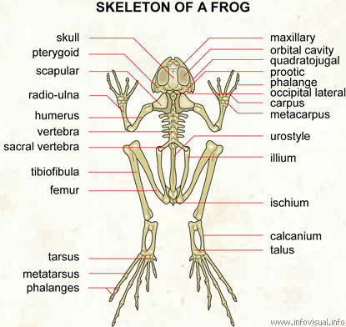
4. Endoskeleton of frog:
There is absence of exoskeleton in modern Amphibia.
The frog has well developed endoskeleton.
It consists largely of bone and cartilage.

Slide 17


