Slide 1
Subject: Biology
Section ‘A’-Botany
Presented by: Mukesh Yadav

Slide 2

Chapter 1. Biomolecules and cell biology
1.2 Cell
Cell is the basic structural and function unit of life.
The cell may be defined as “a unit of biological activity delimited by a selectively permeable membrane and capable of self-reproduction in a medium free of other living systems.”
Each cell is capable of performing basic life functions such as respiration, reproduction, excretion, growth and so on.
Cytology is the branch of biological science which studies structure and function of cell and its components.

Slide 3
Chapter 1. Biomolecules and cell biology
1.2 Cell
Discovery of cell:
The cell was discovered after the invention of compound microscope by Jansens in 1590.
The term ‘cell’ was coined by an English scientist Robert Hooke in his book Micrographia published in London in 1665.
Robert Hooke examined a thin slice of cork under the microscope and reported that the solid piece of cork is actually perforated and porous bounded by definite walls. To refer those cavities, Hooke coined the term ‘cell’ from the latin word ‘cella’ which means ‘hollow space’ or ‘chamber’.

Slide 4
Chapter 1. Biomolecules and cell biology
1.2 Cell
Discovery of cell:
Anton Van Leeuwenhoek, the famous Dutch scientist was able to observe free cells. He was first explorer to observe green colored bodies in cells now called chloroplast. He also observed and described bacteria and unicellular organism.
In 1831, Robert Brown, an English Botanist described nucleus as a spherical body in the plant cells.

Slide 5
Chapter 1. Biomolecules and cell biology
1.2 Cell
Discovery of cell:
Schleiden (Botanist) and Theodar Schwann (Zoologist) German scientist proposed their well known “cell theory”.
In 1839, Purkinje the Bohemian physiologist termed protoplasm for the living content of the cell.
Rudolf Virchow stated that the cells in the body arise from the pre-existing cells by cell division.

Slide 6
Chapter 1. Biomolecules and cell biology
1.2 Cell
Cell Theory:
The German Botanist, Mathian Schleiden and Zoologist Theodar Schwann first summarized the cell theory in 1839 and later it was refined by the works of R. Virchow (1855).
The statements of cell theory are:
All living organisms are composed of small living units called ‘cells’.
All cells are fundamentally similar in chemical compositions and metabolic activities.
The functions of an organism as a whole is the outcome of the activities and interactions of the cells constituting the body of that organism.

Slide 7
Chapter 1. Biomolecules and cell biology
1.2 Cell
Cell Theory:
The statements of cell theory (cont.)
4. All cells arise from pre-existing cells.
5. The cells are structural and functional units of life.
6. The growth of organism occurs by cell division and cellular growth in multicellular organisms while in unicellular organisms, it occurs by cellular growth.

Slide 8
Chapter 1. Biomolecules and cell biology
1.2 Cell
Limitations/shortcomings of cell theory
Bacteria and cyanobacteria lack true nucleus. Their nuclear material (DNA) is not enclosed by a nuclear membrane but lies directly in the cytoplasm.
Some fungi like Rhizopus, Mucor has coenocytic (multinucleated) hyphae which is not in accordance to cell theory.

Slide 9
Chapter 1. Biomolecules and cell biology
1.2 Cell
Limitations/shortcomings of cell theory
The tissues like connective tissues are composed of non-living materials in intercellular spaces. Cell theory does not explain such structural organizations.
Viruses are also the exceptions to cell theory. They consist of core of the nucleic acid (DNA and RNA) surrounded by a protein sheath. They are non-living outside the living tissue.

Slide 10
Chapter 1. Biomolecules and cell biology
1.2 Cell
Cell as a self-contained unit
The activities of cells are integrated for the survival of the organisms, yet the cells are independent in carrying on the fundamental life processes they act as a autonomous unit.
The following characters shows the independence of the cells.
Each cell can carry out the anabolic processes and can build new structures.
Each cell can oxidise the food molecules to produce energy and store this energy in the form of ATPs.
The cell can respire and exchange gases with their surroundings.
Each cell can reproduce daughter cells with similar hereditary characters.

Slide 11
Chapter 1. Biomolecules and cell biology
1.2 Cell
Cell as a self-contained unit
The following characters shows the independence of the cells.
Each cell can reproduce daughter cells with similar hereditary characters.
Each cell builds up new cell components from its own macromolecules, for the growth and to replace worn out cells.
By regulating its own activities, each cell maintains the necessary internal physico-chemical conditions.
Each cell has its own lifespan.

Slide 12
Chapter 1. Biomolecules and cell biology
Cellular totipotency
The ability or capacity of the mature living cells when free from the plant body develop into a new organism in controlled condition is known as totipotency.
Haberlandt in 1902(German botanist) has first given the concept of cellular totipotency in plant body.
He stated that ever living cell of the plant body able to regenerate the whole plant body because it is derived from the fertilized egg and contain hereditary information.
He tried to grow isolated green cells of leaves but failed to achieve the success.

Slide 13
Chapter 1. Biomolecules and cell biology
Cellular totipotency
Later in 1950 F.C. Steward and his co-worker got success in proving the cellular totipotency.
Cellular totipotency is a property of plant cell because a differentiated plant cell retain its capacity to give rise to a whole plant but in animal cell its losses the capacity of regeneration after differentiation.

Slide 14
Chapter 1. Biomolecules and cell biology
Cellular totipotency
Steward’s experiment to understand the concept of cellular totipotency
Steward took the 2mg. slices of phloem tissue of carrot (Daucus carrotd) and grown in a liquid nutrient medium containing coconut water.
The part of the plant is taken for tissue culture is known as explants (ex. Phloem tissue of Carrot root).
The liquid nutrient medium containing explants was allowed some hours for shaking.
Then the culture cell divide continuously to form mass of undifferentiated tissue known as callus.

Slide 15
Chapter 1. Biomolecules and cell biology
Cellular totipotency
Steward’s experiment to understand the concept of cellular totipotency
Some of these cell cluster started differentiating the initial of root.
When it transfer to semi solid medium then it develop shoot system and give rise new plant.
These plant then transfer to pot/soil where they develop in to flowing plant.
Steward experiment shows that in plant even mature (fully differentiated cells) can dedifferentiate, divide, come together re-differentiate and produced a new plant. Plant tissue derived form root, stem, leaf, vegetative bud, floral bud, anther & embryo can exhibit cellular totipotency.

Slide 16
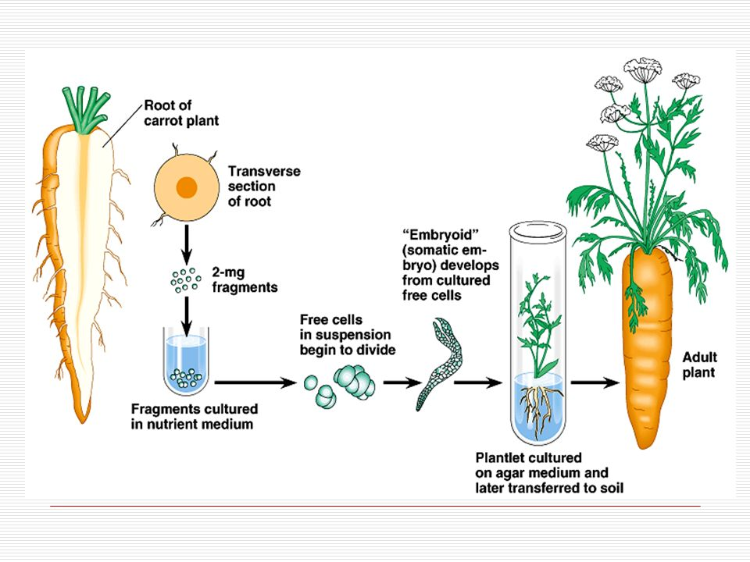
Chapter 1. Biomolecules and cell biology
1.2 Cell

Slide 17
Chapter 1. Biomolecules and cell biology
Application:
Totipotency character of plant cell has been used in tissue culture as follows:
1. It helps in rapid multiplication of plant with desirable character.
2. Multiplication of rare plants.
3. To pass the seed dormancy.
4. Quick propagation of useful plants.
5. Develop haploid plant.

Slide 18
Chapter 1. Biomolecules and cell biology
Application:
Totipotency character of plant cell has been used in tissue culture as follows:
6. Produce virus free & disease resistant plant.
7. Help in protoplast fusion & somatic hybridization.
8. Produce high yielding varieties crop plants.
9. Help in embryo rescue.

Slide 19
Chapter 1. Biomolecules and cell biology
Flow of energy through the cell
All system (both living and non-living) need a constant supply of energy for their existence and maintenance .
If no energy is provided, they disorganize and disintegrate leading to death.
A cell like other systems has a tendency to go from orderliness to disorderliness if free energy is provided .
Therefore, to maintain cellular ,tissue, organs, organ system, a constant supply of free energy from outside is required.

Slide 20
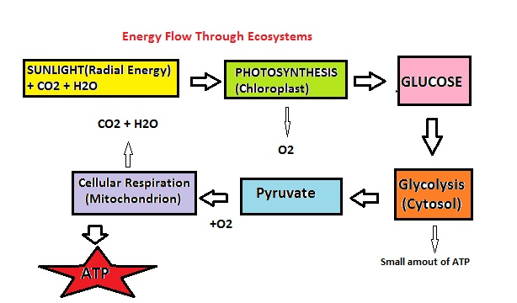
Chapter 1. Biomolecules and cell biology
Flow of energy through the cell

Slide 21
Chapter 1. Biomolecules and cell biology
Flow of energy through the cell
Cell utilizes energy either in the form of light or in the form of chemical (food).
The cells of green plants absorb light energy and synthesize food but cells of animals absorb chemicals from the surrounding.
The food absorbed by cells gets oxidized to release energy and energy is released and stored in eh form of ATP.

Slide 22
Chapter 1. Biomolecules and cell biology
Flow of information through the cell
Flow of intrinsic information:
DNA molecule contain genetic information and control intrinsic activities like metabolism and expression of characters by synthesizing protein molecules.
DNA transcribes the stored information into RNA molecules which translate the genetic information into specific proteins.
Proteins then perform and regulate all the activities of the cell.
Transcription
Translation
Proteins
DNA
RNA

Slide 23
Chapter 1. Biomolecules and cell biology
Flow of information through the cell
DNA
Transcription
RNA
Translation
Protein
Enzymes
Structural proteins
Catalysis of metabolic processes
Cell structure and function
Cell processes

Slide 24
Chapter 1. Biomolecules and cell biology
Flow of extrinsic information:
Some cells or specific glands secrete substances like hormones which on being transported to other cells or organs regulate their activities.
Some of these regulatory substances enter the cell and combine with cellular receptors present in the cell.
These substances and cellular molecules which control the metabolic activity of the cell.
Some of the informational molecules also bind with certain molecules present on the cell membrane. These all molecules then produce the cellular effect.

Slide 25
Chapter 1. Biomolecules and cell biology
Flow of extrinsic information:
External environment
Membrane receptors
Cellular receptor
Gene expression
Hormonal balance
Enzyme activity
Cellular metabolism
Cell properties

Slide 26
Chapter 1. Biomolecules and cell biology
Unicellular and multicellular organisms
Important features of unicellular organisms:
The size of the cell is large and there are numerous intracellular structures called organelles. Such organelles are necessary for all the life processes such as metabolism, excretion, reproduction, hereditary mechanism, etc.
To accommodate numerous organelles, a cell has to be sufficiently large. But if a cell is to be efficient, its ratio of volume to surface should be within a limited range. Thus, a unicellular organism has certain limitations of size and shape.

Slide 27
Chapter 1. Biomolecules and cell biology
Unicellular and multicellular organisms
Important features of unicellular organisms:
A unicellular organism cannot exhibit wide range of differentiation, which leads to greater efficiency.
Any injury to the cell may lead to the death of the organism. Even a light puncturing cell membrane and cell wall may bring an end to the life of unicellular organisms.

Slide 28
Chapter 1. Biomolecules and cell biology
Unicellular and multicellular organisms
Important features of multicellular organisms:
The size of multicellular organism does not largely depend upon the size of cells constituting its body rather it depends upon the large number of cells present in its body. Therefore, multicellular organism posses various size and shapes.
The cells of multicellular organisms are differentiated to perform specific functions. For examples neurons are specialized to conduct impulses, germ-cells are specialized to produce gametes etc. There is the division of labour.

Slide 29
Chapter 1. Biomolecules and cell biology
Unicellular and multicellular organisms
Important features of multicellular organisms:
Some of the dead cells of the multicellular organisms also have special functions and are useful for the organism e.g. the outer layer of skin and cork cells protect the underlying cells. Similarly, xylem vessels conduct water and minerals in vascular plants.
A number of cell work together in a coordinated manner in a very efficient way. For e.g. coordinated movement of muscle cells pumps the heart.

Slide 30
Chapter 1. Biomolecules and cell biology
Unicellular and multicellular organisms
Important features of multicellular organisms:
Multicellular organism have better adaptability or have capacity of survival.
The dead cells and worn out cells are continuously replaced by the underneath dividing cells. For e.g. the cells of skin and inner lining of intestine, R.B.Cs and W.B.Cs are continuously replaced by the new ones.

Slide 31
Chapter 1. Biomolecules and cell biology
Unicellular and multicellular organisms
Parameters | Unicellular Organisms | Multicellular Organisms
Definition | It’s a cellular organism with internal units all accumulated into a single cell | It’s a cellular organism with internal units all taken up by groups of cells assigned to different specialized functions
Complexity | Simple cell body Organization | Complex cell body Organization
Function | A single cell performs all necessary life processes | Groups of cells are divided into their functionalities and groups of cells take up different life processes

Slide 32
Chapter 1. Biomolecules and cell biology
Unicellular and multicellular organisms
Parameters | Unicellular Organisms | Multicellular Organisms
Shape | Irregular formation in structure | Structure is well defined
Size | Comparatively smaller than multicellular organisms i.e., they are microscopic | Comparatively larger than unicellular organisms i.e., they are macroscopic
Cellular structure | Both Prokaryotes and Eukaryotes | Only in the form of Eukaryotes.
Nature | These organisms are heterotrophs in nature | These organisms can be both heterotrophs and autotrophs in nature
Lifespan | These organisms have comparatively shorter life spans | These organisms have comparatively longer life spans

Slide 33
Chapter 1. Biomolecules and cell biology
Unicellular and multicellular organisms
Parameters | Unicellular Organisms | Multicellular Organisms
Evolution | These organisms are the oldest forms of life dating back to over 4 million years ago | These organisms are comparatively newer and more complex forms of life derived from prokaryotes
Differentiation | There is no differentiation in the cell as there are only single cells performing all units | The cell differentiation exists as there are groups of cells that perform different functional units
Functional segment | All the functional units are divided under an organelle level | All the functional units are divided at cellular, tissue, organs level

Slide 34
Chapter 1. Biomolecules and cell biology
Unicellular and multicellular organisms
Parameters | Unicellular Organisms | Multicellular Organisms
Reproduction | The dominant form of reproduction is asexual, although there are some unicellular organisms that take part in sexual reproduction | The multicellular organisms reproduce sexually as well as asexually
Reproduction process | The process of reproduction can be either by budding and by binary fission | The process of reproduction is occurred by gamete fusion
Efficiency | The efficiency of the functional units is low | The efficiency of the functional units is high

Slide 35
Chapter 1. Biomolecules and cell biology
Unicellular and multicellular organisms
Parameters | Unicellular Organisms | Multicellular Organisms
Regeneration | These organisms are capable of regenerating at a greater rate in comparison to the multicellular organisms | These organisms regenerate much slower or have a lower rate of regeneration in comparison to the unicellular organisms
Consequences | If the cell is injured, the whole organism dies | If a cell is injured, the organism does not die as it is being supported and replaced by various other cell groups
Examples | Amoeba, Paramecium, Plasmodium, Yeast, Algae, Euglena, Fungi, Protozoans | Vertebrates, Invertebrates, gymnosperms, angiosperms, plants

Slide 36


