Slide 1
Subject: Biology
Section ‘B’ Zoology
Writer: Arvind K Keshari, Ph.D
Presented by: Puja Shrestha

Slide 2
Animal Tissue
Epithelium

Slide 3
Compound/Stratified Epithelium:
More than two layers of epithelial tissue
Only the innermost layer of tissue is rest upon basement membrane
Innermost layer: Germinative layer which is able to divide into other layers of tissues

Slide 4
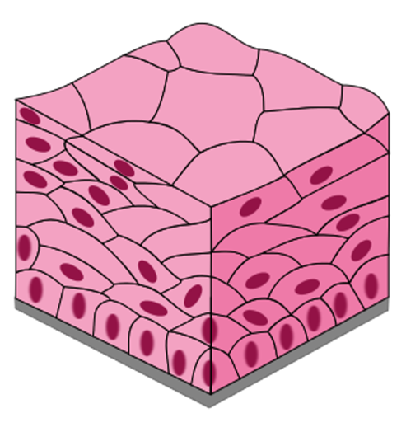
Compound epithelium

Slide 5
Types of Stratified epithelial tissues
1) Stratified Squamous Epithelium
Upper layers are made of polygonal cells and flat squamous cells
Lower germinative layers may be either cuboidal or columnar cells

Slide 6
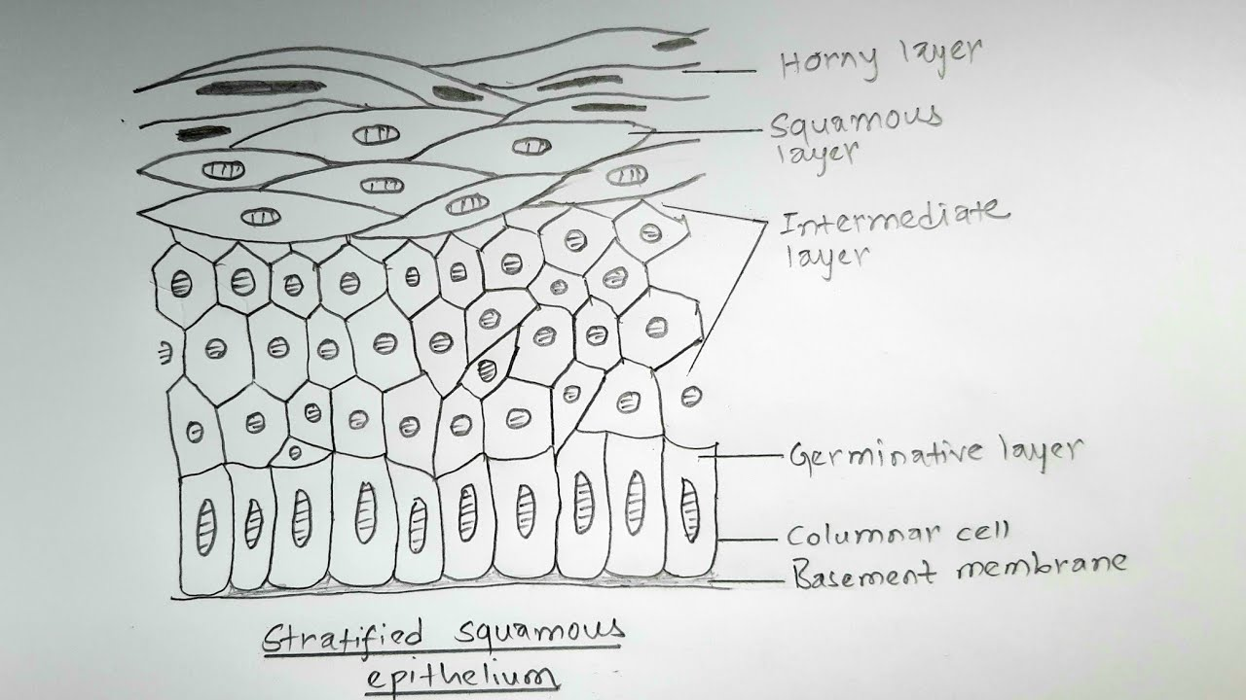
Stratified squamous epithelium

Slide 7
Types of Stratified Squamous Epithelium
Upper Squamous cells layer is deposited by thick layer of Keratin protein
Location:
Nail
Horn
Scales
Epidermis of skin
Hair

Slide 8
Functions
Protection
Impermeable to water

Slide 9
B) Non-keratinized Epithelium
Absence of keratin protein
The layer becomes wet
Location:
    Tongue
    Pharynx
    Oesophagus
    Vagina

Slide 10
Functions:
Protection
Conduction

Slide 11
2) Stratified Cuboidal Epithelium
Outermost layer or the upper layer is made of cuboidal cells
Lower germinative cells are either columnar or squamous cells

Slide 12
Stratified cuboidal Epithelium

Slide 13
Location:
Duct of sweat gland,salivary gland and pancreatic gland
Scales of fishes
Tail of Urodela
Urodela: tailed amphibians( salamander, Necturus)

Slide 14
Functions:
Conduction
Protection

Slide 15
Stratified Columnar Epithelium
Outermost layer consists of columnar cells
Lower layer consists of cuboidal cells

Slide 16
Locations:
Duct of mammary gland
In a part of urethra
Vasa differentia
Trachea and bronchi

Slide 17
Function:
Protection
Conduction

Slide 18
4) Transitional epithelium
Upper layer is made of polyhedral cells and squamous cell at the topmost layer
Lower layer or the germinative layer has columnar cells
Absence of basement membrane. So connected to other kind of tissue or connective tissue
Also known as Urothelium
Elastic in nature

Slide 19
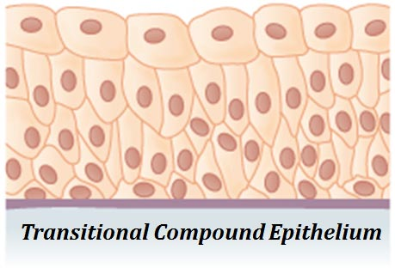
Transitional epithelium

Slide 20
Location:
Renal pelvis
Ureter
Urinary Bladder

Slide 21
Functions:
Conduction
Storage
Filtration

Slide 22
Specialized/Modified Epithelium
Ciliated Epithelium: Modified form of columnar or cuboidal cells bearing cilia at the free surface.
Location:
Oviduct and sperm duct
Trachea and bronchi
Function:
Conduction and filtration

Slide 23
Sensory Epithelium
Modified columnar cells where cells are connected to nerve or sensory fibre and are sensitive in nature
Location:
Sense Organs
Organs of corti
Olfactory chamber
Taste buds(lining of the tongue)
Function:
Receive sensitivity

Slide 24
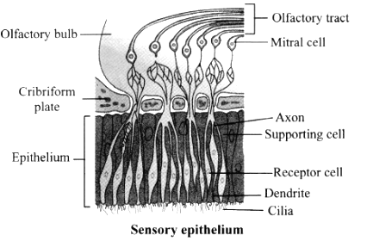
Sensory epithelium

Slide 25
Germinal Epithelium
Modified form of cuboidal cells
Found in the lining of testis and ovary
Able to divide and develop into gametes by meiosis
Location:
Seminiferous tubule of testis and lining of ovary
Function: Gamete formation

Slide 26
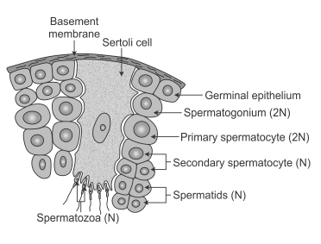
Germinal Epithelium

Slide 27
Glandular Epithelium:
Modified columnar or cuboidal cells specialized for manufacture and secretion of chemical substances
Forms gland

Slide 28
Types of Glands
A) Based on the no. of cells present
  Unicellular glands- if only one cell represents a gland and scattered in the columnar cells. Eg: Goblet cells
  Multicellular glands- if many cells represent a gland. Eg: Sweat gland, thyroid gland, salivary gland

Slide 29
On the basis of presence or absence of duct or the type of secretion
1)Exocrine gland: Synthesize and then secrete their product
Directly( mucous glands)
Via a Duct
Secrete enzymes and hydrolases
2)Endocrine Glands: Synthesize and the secrete their product directly into the intracellular space(blood)
Secrete hormones

Slide 30
Types of exocrine glands
On the basis of presence of no. Of ducts in a gland
A) Simple gland: Having only one duct
TYPES
I)Simple tubular glands: Having a duct with straight tubular secretory parts.
Eg: Crypts of Lieberkuhn of intestine
II) Simple branched tubular glands: Having a duct with branched tubular secretory parts. Eg: Gastric gland, Brunner's glands of intestine
III) Simple coiled tubular glands: Coiled secretory Parts. Eg: Sweat glands
IV) Simple Alveolar gland: Having a duct with alveoli like structure or round bottom flask in appearance. Eg: Sweat glands
V) Simple branched alveolar gland: having a duct with number of alveoli like secretory parts. Eg: sebaceous gland

Slide 31
B) Compound glands: Having more than 1 ducts
TYPES
I) Compound tubular glands: Salivary glands
II) Compound tubulo-alveolar gland: Cowper's gland, Bartholin's gland
III) Compound alveolar gland: Mammary gland, Pancreatic gland

Slide 32
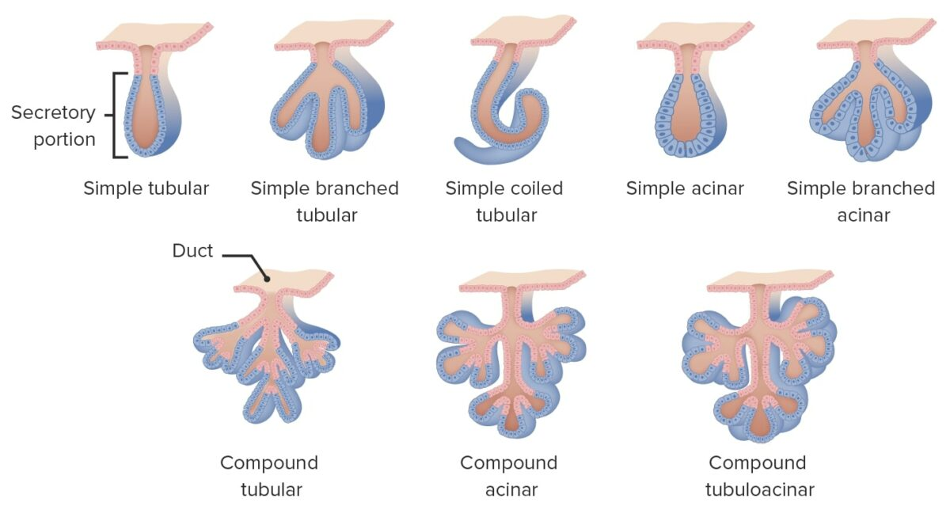

Slide 33
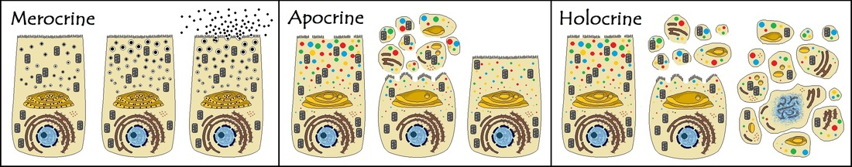

Slide 34
On the basis of nature of secretion
I) mucous gland:
Secretes the mucus
Also khnwn as mucocytes or mucous cells
Found in goblet cells in the intestine
II) Serous gland:
Secretes a clear watery fluid
Termed as serocytes
Found in intestinal gland, sweat gland, salivary gland
III) Mixed gland:
Made of both mucocytes and serocytes. So produced both kinds of secretion
Found in gastric glands, pancreatic gland

Slide 35
Connective tissue
Group of tissues that maintain the organs and body form of the body and provide cohesion and internal support
Mesodermal in origin with large intracellular space
3 compounds
Cells
Matrix( ground tissue)- liquid, semisolid or solid
Fibers- Thread like made from protein

Slide 36
Cells of Connective tissue
Fibroblast and fibrocytes:
-Are large sized, flat and spindle-shaped with long protoplasmic processes
Large prominent nucleus
Osteoblast & Chondrioblast cells to produce bone & cartilage
Produce protein fibres and secrete matrix

Slide 37
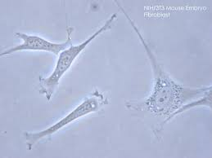

Slide 38
2) Macrophages/Histocytes:
Are large irregular shaped long-lived cells
Presence of oval and kidney-shaped nucleus along with granules, endocytic vesicles and abundant lysosomes
Phagocytic nature- engulfs foreign bodies, damaged cell tissues and microbes

Slide 39
3) Mast cells:
Oval shaped cells with centrally placed oval nucleus
Modification of basophils( types of WBC)
Secrete heparin( checks the clotting of blood into the blood vessels), histamine( cause inflammatory or allergic reaction to antigens) and serotonin(vasoconstrictor)

Slide 40
4) Plasma Cells:
Small, round or irregular shaped cells with an eccentric round nucleus
Are modified B-lymphocytes
Produce antibodies for defense

Slide 41
Other kinds of cells : Adipocytes, lymphocytes, chromatophores, reticular cells and mesenchyme

Slide 42
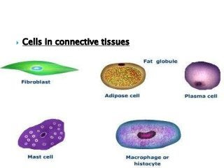

Slide 43
Matrix
Non-living, transparent fluid or semisolid intercellular substance
Contains various organic and inorganic substances

Slide 44
Fibres of Connective tissues
White collagen fibres:
Long unbranched, inelastic white fibres containing collagen protein
\Flexible but inelastic
Provides structural strength and tissue repairment

Slide 45
2) Yellow elastic fibres:
Long branched, elastic and straight fibre found singly
Formed from elastin protein
Flexible and elastic

Slide 46
3) Reticular fibres:
Fine and highly branched fibres forming networks
Do not form bundles
Contains reticulin protein
Form supporting network of spleen, bone marrow and lymph nodes

Slide 47
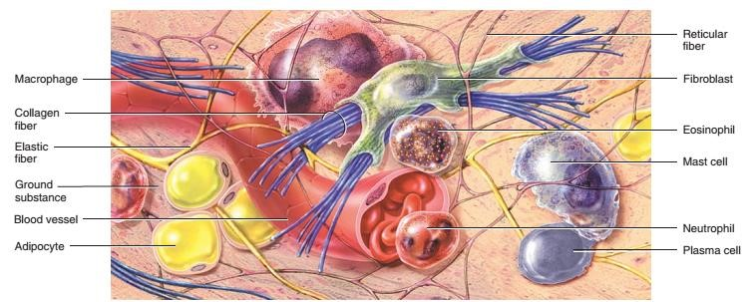

Slide 48
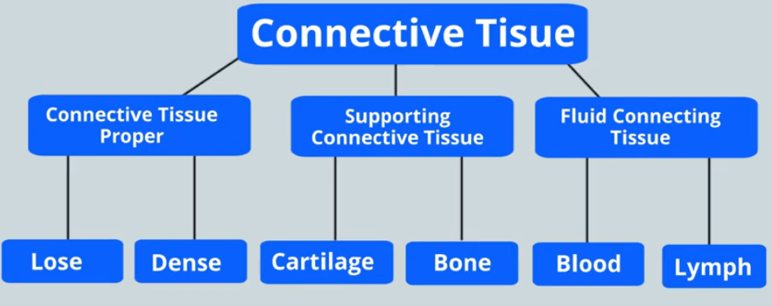

Slide 49
A) Connective Tissue proper
Connective tissue proper includes those types of connective tissues that exhibit a variable mixture of both connective tissue cell types and extracellular protein fibers suspended within a viscous ground substance.
connective tissue types differ with respect to their numbers and types of cells and the relative properties and proportions of their fibers and ground substance.
Its main function is to bind cells and tissues into organ and organ system

Slide 50
Loose connective tissue
Distributed throughout the body as a binding and packing material
The protein fibers loosely arranged rather than tightly packed together.
Contains relatively fewer cells and protein fibers than dense connective tissue but has more ground substance.
The cells are predominantly fibroblasts, with collagen and elastic fibers dispersed throughout the ground substance
Occupies the spaces between and around organs.

Slide 51
It binds the skin to the underlying muscles and is highly vascular, providing nutrients to the skin. Loose connective tissue that binds skin to underlying muscles is known as fascia .
Surrounds blood vessels and nerves, where it provides both protection and nourishment.
The irregular arrangement of this tissue provides flexibility, yet strength, in any direction

Slide 52
There are two types of loose connective tissue:
    areolar connective tissue
    adipose connective tissue

Slide 53
Areolar connective tissue
Areolar connective tissue is highly variable in appearance and most widely distributed tissue in the body.
It has a loosely organized array of collagen and elastic fibers and an abundant distribution of blood vessels.
consists of
  fibers (collagen, elastic) arranged randomly
  several kinds of cells (fibroblasts, macrophages, plasma cells, mast cell)
  semifluid ground substance (hyaluronic acid, chondroitin sulfate, dermatan sulfate, and keratan sulfate).
irregular arrangement of bundle of collagen fibres due to which many gaps are present. These spaces called Areolae.

Slide 54
The elastic fibers ensure independent movement.
LOCATION: Present everywhere in body including subcutaneous layer deep to skin, superficial region of dermis of skin, mucous membranes, around blood vessels, nerves, and body organs.
FUNCTION: strength, elasticity, support, protection, enhance natural immunity

Slide 55
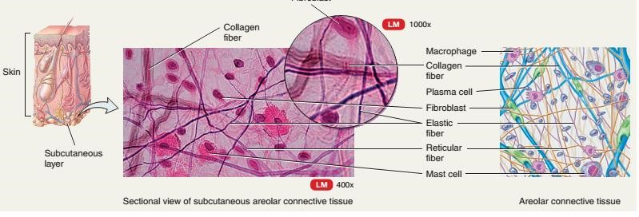

Slide 56
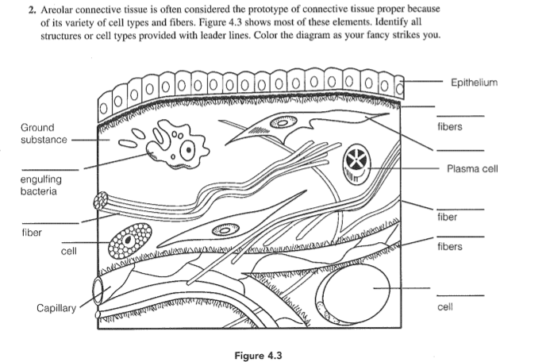

Slide 57
Adipose connective tissue
(fat laden tissue)
Made up of adipocytes that are specialized for storage of triglycerides (fats) as a large, centrally located droplet.
Blood vascular system is also present in this tissue.
Cell fills up with a single or multiple large triglyceride droplet, and cytoplasm and nucleus are pushed to periphery of cell.
It has two types: White adipose tissue- composed of single large triglyceride droplet present in adults and has less blood supply
Brown adipose tissue-composed of more than one or multiple no of triglyceride droplets present in infants and hibernating animals and have extensive blood supply.

Slide 58
LOCATION: Around visceral organs, subcutaneous layer, blubbers( a layer of fat present under the skin of aquatic animals),hump of camel,
FUNCTION: primary function: synthesize storage and utilization of fats
        Reduces heat loss through skin,
        serves as an energy reserve,
        supports and protects organs.
        In newborns, BAT generates heat to maintain proper body temperature.

Slide 59
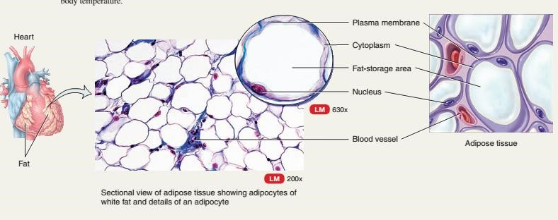

Slide 60
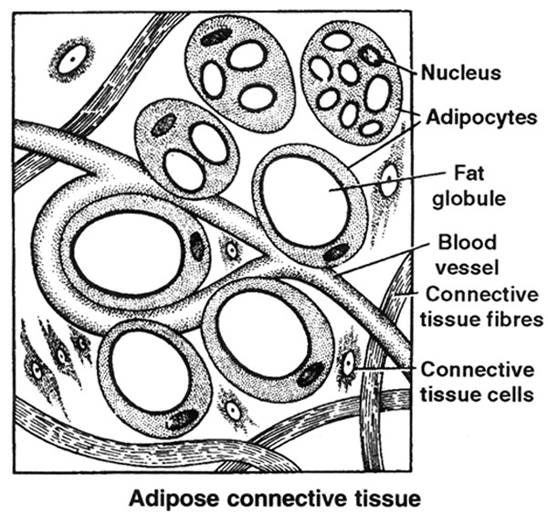
Adipose connective tissue

Slide 61
Dense connective tissue
Dense connective tissue consists of densely packed fibers with relatively little space between the fibers.
Has proportionately high protein fiber than ground substance.

Slide 62
Further divided into two categories:
White fibrous tissue
Yellow fibrous tissue
reticular connective tissue

Slide 63
A)White fibrous tissue(tendons)
Has densely packed white collagen fibers in the extracellular matrix and Modified form of areolar tissue
Occurs where strong, flexible support is needed
Has few blood vessels which is reason behind its slow healing properties.
Matrix contains fibroblast cells only cells present and lie in rows between the bundle of white fibres

Slide 64
Form tendons which are parallel running fibres with cord-like structures that helps to connect the skeletal muscles to the bones
LOCATION:
      Pericardium of heart
      Dura mater
      Perichondrium
      Capsule of kidney
      Testes and spleen
      Coverings of cartilage and bone
FUNCTION: Mechanical support against stretch

Slide 65
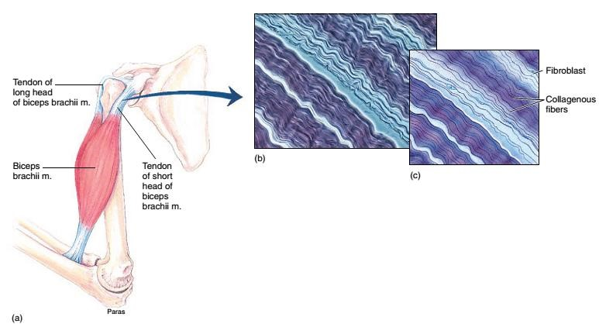

Slide 66
B) Yellow elastic tissue(ligament)
Elastic connective tissue is composed primarily of elastic fibers and yellowish in color .
They can be stretched to one and a half times their original lengths and will snap back to their former size.
Has sparse ground substance. The elastic fiber is packed in parallel bundles

Slide 67
LOCATION:
    in the walls of large arteries
    in the vocal cords
    trachea and bronchial tubes of the lungs.
FUNCTION: Provides stretch and elasticity

Slide 68
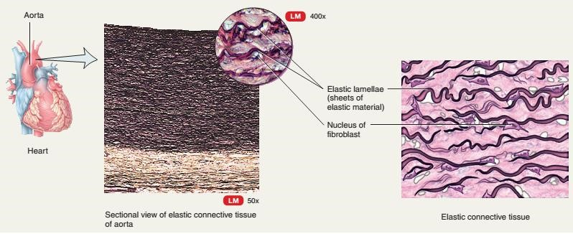

Slide 69
Reticular connective tissue
Reticular connective tissue contains a meshwork of reticular fibers, on which fibroblast and leukocytes are suspended.
Has very little ground substance.
LOCATION: hematopoietic system; spleen, lymph nodes, bone marrow
FUNCTIONS: filters and removes worn-out blood cells in spleen and microbes in lymph nodes

Slide 70
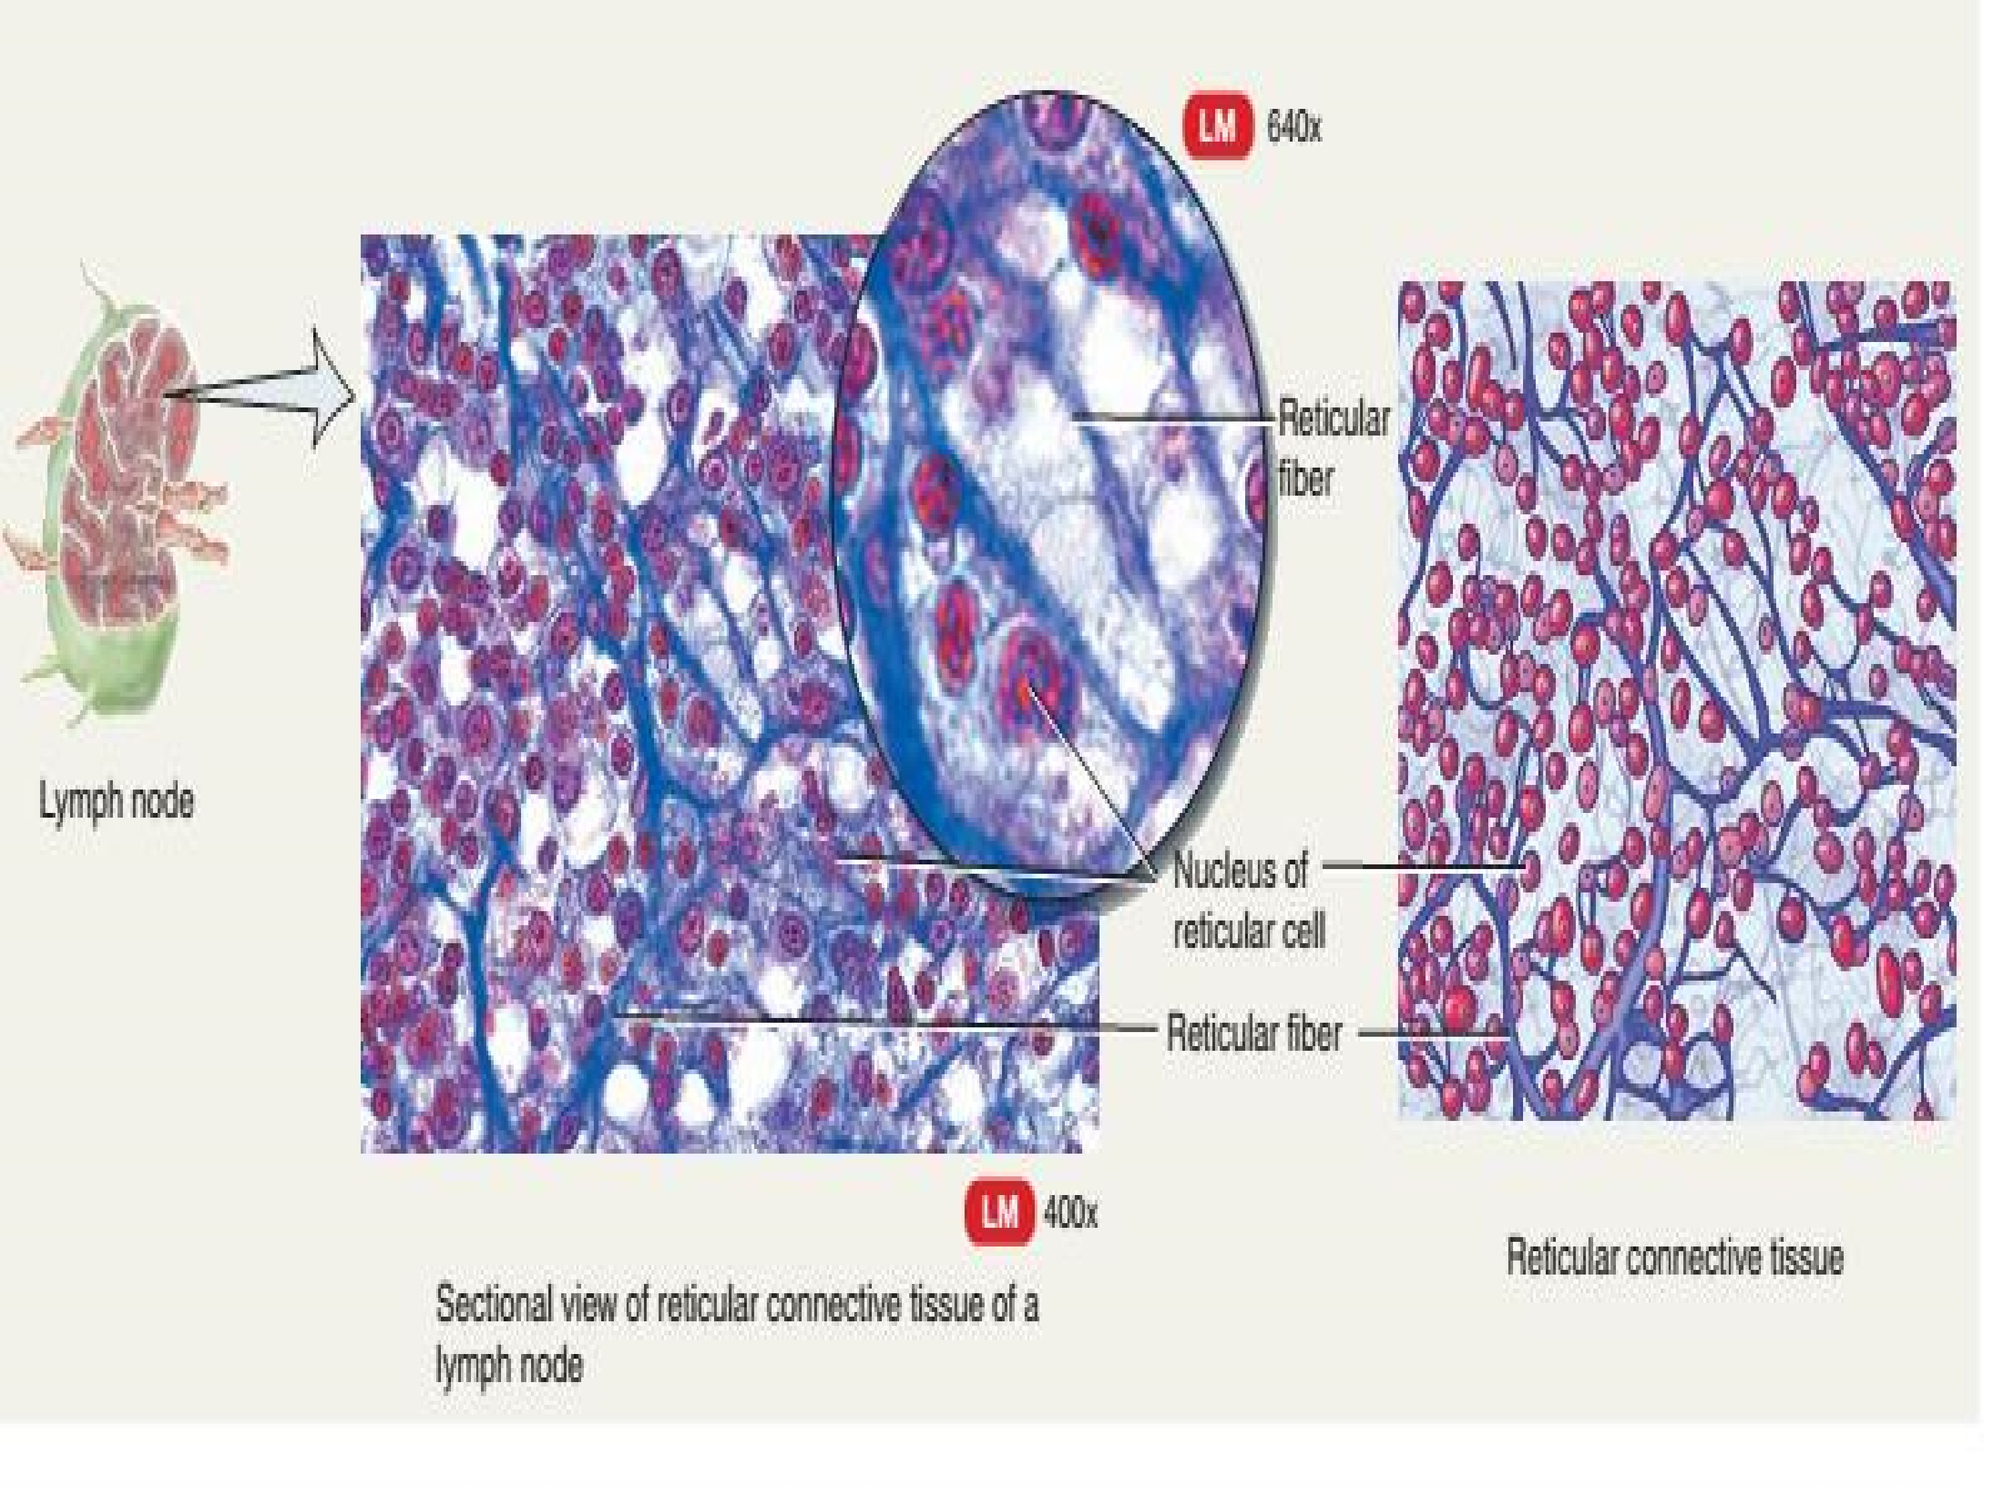

Slide 71
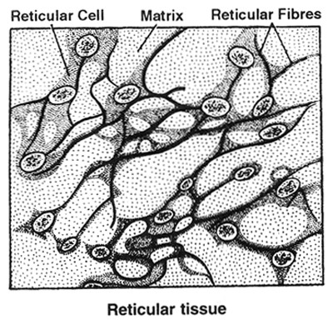

Slide 72
Supporting connective tissue
CARTILAGE
Outer most covering of cartilage is called Perichondrium which is composed of white fibres connective tissue.
Cartilage producing cells are arranged on periphery known as Chondrioblast.
These are active cell & divide to form chondriocytes, and synthesize the matrix of cartilage.
Mature cells of cartilage are called Chondriocytes.
They are found in vacuole like space in matrix called Lacuna. In which 2-3 Chondrocytes are present.
Maxtrix of cartilage is called Chondrin composed of Chondromucoprotein having Chondroitin-6sulphate and Mucopolysaccharide (Hyaluronic acid)
Matrix of cartilage provides rigidity & elasticity to cartilage.
Blood circulation is absent in the matrix. Hence, heals slowly after trauma and injury.

Slide 73
The collagen fibers give it strength.
Makes most of the embryonic skeleton and gradually replaced by bones during embryonic development and after birth

Slide 74
There are four types of cartilage:
  Hyaline cartilage.
  Elastic cartilage
  Fibrocartilage
  Calcified cartilage

Slide 75
Hyaline cartilage
Matrix is semi-transparent in nature. So named for its clear, glassy microscopic appearance, which contains usually invisible fine collagen fibers
Most abundant type of cartilage found in the body and flexible
Most of the part of embryonic skeleton is composed of this cartilage. Therefore, maximum bones of body are cartilaginous bones because they are developed from cartilage.
Outermost covering Perichondrium is present.

Slide 76
LOCATION: Tracheal rings, Embryonic skeleton, end of ribs and nose, larynx
FUNCTION:
Allows the growth of long bones
provides rigidity with some flexibility in the trachea, bronchi, ribs, and nose;
forms the embryonic skeleton

Slide 77
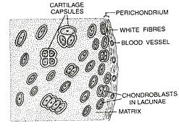

Slide 78
Elastic Cartilage
Chondrocytes embedded in extracellular matrix which contain elastic fibers
Perichondrium is present
In the matrix yellow fibres form network so it is highly flexible and elastic cartilage of body
Colour of matrix is pale yellow

Slide 79
LOCATION: Pinna, external auditory canal of ear, epiglottis, eustachian tubes and tip of nose
FUNCTION:
Provides rigidity with even more flexibility than hyaline cartilage
maintains shape of certain structures.

Slide 80
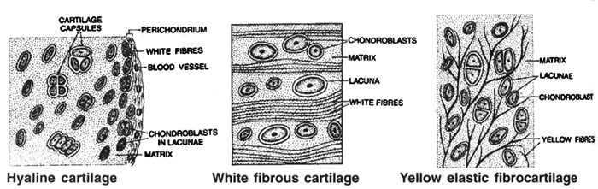

Slide 81
Fibro-Cartilage
  Have collagen fibers similar to those in hyaline cartilage which are arranged in thick bundles
  Lack perichondrium
  FUNCTION
  flexible and capable of withstanding considerable pressure (strongest of all cartilage)
  connects structures subjected to great pressure. Act as shock absorber
  LOCATION
  Intervertebral disks, symphysis pubis, articular disks (e.g., knee and temporomandibular joints)

Slide 82
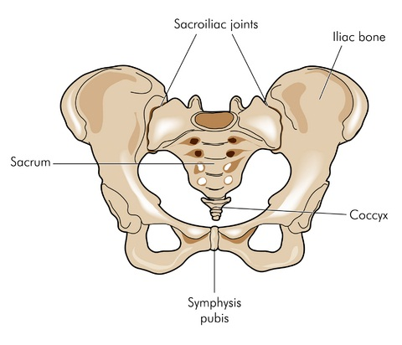

Slide 83
Calcified cartilage
It is modified hyaline cartilage but due to deposition of calcium salts(caco3) its matrix becomes hard like bones.
It is hardest cartilage of the body
LOCATION:
Pubis of frog's pelvic girdle.
Supra scapula of pectoral girdle
Head of Femur & Humerus
Vertebrae of sharks

Slide 84
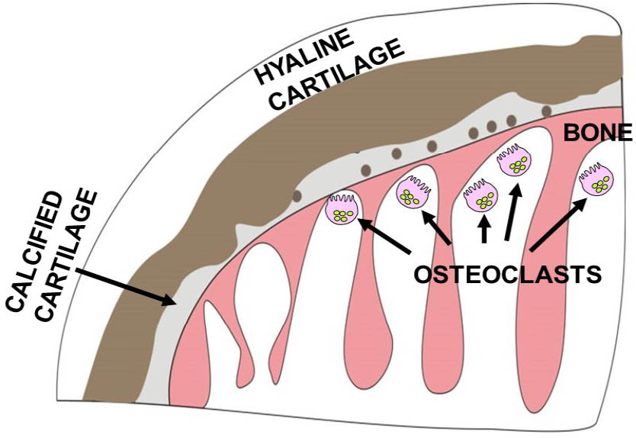

Slide 85
BONE
Study of Bone – Osteology
Process of bone formation – Ossification. Has two types:
Endochondral: Transformation of cartilage into bone
Intramembranous: Production of bones directly from connective tissue
Mesodermal origin
Hardest Tissue – Bones
(Softest Tissue – Blood.)
Hardest substance – Enamel. (It is not a group of cell but it is formed by the secretion of ameloblast cells of teeth.)
Outermost covering of bone is Periosteum composed of white fibrous connective tissue.
Bone producing cell called Osteoblast. They divide to form Osteocyte & synthesize organic part of matrix.

Slide 86
Mature cell of bone is called Osteocyte which is found in Lacuna. Only one osteocyte is found in lacuna.
It consist of two parts.
Inorganic Part – 65 – 68%
Ca₃(PO₄)₂ – 80% max. rest 20% CaCO₃, Mg₃(PO₄)₂, Fluorides.
Organic part – 32-35% Ossein in which bundle of collagen fibres suspended in sulphated mucopolysaccharide.

Slide 87
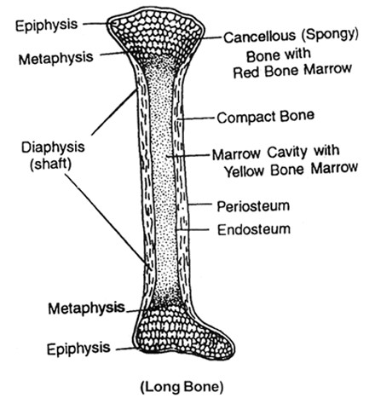
Structure of bone
Long bone has three region
Epiphysis
Diaphysis
Metaphysis

Slide 88
EPIPHYSIS:
Ends of long bone is called Epiphysis. Composed of spongy bone.
Cavity is present in the form of Trabeculae filled with red bone marrow.
It is composed of myeloid Tissue which produce blood corpuscles so epiphysis act as a Haemopoietic organ.

Slide 89
Diaphysis
Middle part of shaft of long bone is diaphysis which is composed of compact bone.
In this region hollow cavity is present called bone marrow cavity filled with yellow bone marrow composed of white fat. Function is storage of fat.
If required in anemic condition YBM is replaced by RBM.

Slide 90
Metaphysis
Lies in between epiphysis & Diaphysis.
In this region epiphyseal plate is present which is made up of osteoblast cells. They divide to form osteocyte and also synthesize matrix of bone, so epiphysial plate is responsible for elongation of bone.
After complete development of long bone this plate is destroyed. So a complete developed bone shows 2 regions while in a developing bone 3 regions are found.

Slide 91
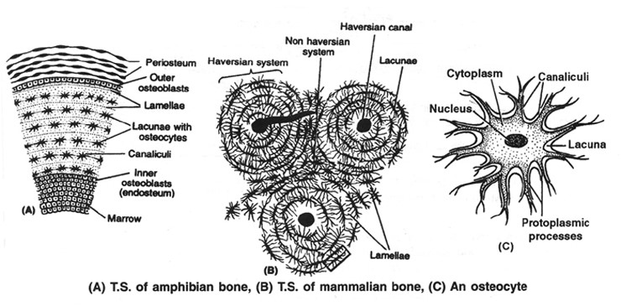
Internal structure of bone

Slide 92
PERIOSTEUM
Outermost covering consists of two layers.
Outer layer consists of White fibrous connective tissue in which blood circulation is present.
Inner layer – consists of single layer of osteoblast cells. These cells are cube like in shape in which oval shaped nucleus & basophilic granules are present in cytoplasm.
They divide to form osteocyte and secrete layer of matrix.

Slide 93
Matrix
It is composed of inorganic & organic compounds. Matrix of bone is synthesized in the form of layer called Lamellae. Between these lamellae layer of Osteocyte cells are also present. Osteocyte are present in the lacuna. Each Osteocyte is interconnected with adjacent Osteocytes by their cytoplasmic process called canaliculi.
In the matrix of bone 2 types of canals are present.
  1. Haversian canal 2. Volkmann's canal

Slide 94
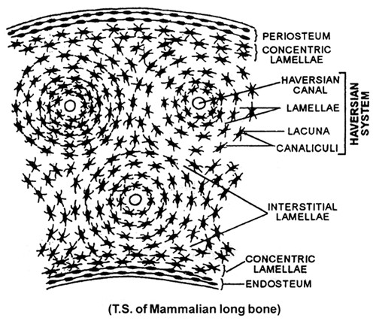

Slide 95
Haversian canals are central Longitudinal canals which are arranged parallel to long axis of bone. In this canals 1 or 2 blood capillaries and nerve fibres are present.
Where as Volkmann's canals are transverse/horizontal or oblique canals that interconnect the Haversian canals.
Haversian canal, Haversian lamellae & Osteocyte form Haversian system or Osteon.

Slide 96
Endosteum
consist of 2 layers.
a) Towards bone marrow cavity lined with layer of reticular fibrous connective tissue.
b) Towards matrix of bone line with layer of Osteoblast cell. They divide to form osteocyte & synthesize matrix. So growth of bone is bidirectional (Periphery and central region).

Slide 97
BONE MARROW CAVITY
– In the central region hollow cavity is present which is filled with Yellow bone marrow. It is composed of white fat & its function is collection of fats or storage of fats.

Slide 98
Types of bone
On the basis of matrix present
Spongy bone: Filled with the soft tissue called red bone marrow (synthesize RBC and WBC)which is present on the expanded ends of long bone
Lacks haversian system
Compact bone: Filled with fatty tissue called yellow bone marrow which is present on the shaft of long bone.
Have number of haversian systems

Slide 99
Fluid connective tissue
Contains both myeloid(form blood) and Lymphoid tissue(form lymph)
Matrix liquid and fibres free.

Slide 100
Blood cells
Plasma
Erythrocytes
Leukocytes
Blood platelets
Granulocytes
Agranulocytes
N
eutrophils
Eosinophils
Basophils
Monocytes
Lymphocytes

Slide 101
BLOOD
Study of Blood – Haematology
Process of blood formation Haemopoiesis.
Colour – Red
PH – 7.4 (Slightly alkaline)
By weight – 7 to 8% of body weight
By volume – 5 – 6 litres in male and 4-5 litres in female.
Blood is a false connective tissue because
a) Cells of blood have no power of division.
b)Fibres are completely absent in blood.
  c) Matrix of blood is produced and synthesized by liver and lymphoid organs.

Slide 102
COMPOSITION:
Contains blood plasma and blood corpuscles
Blood plasma:
        Forms 55% of total blood volume
        Water: 90 to 92%
        Blood plasma protein(goblin, albumin, prothrombin)-7%
        Organic matter: 1-2% (Amino acid , glucose, fatty acids, urea, ammonia)
        Inorganic matter: 1% (Na+, Ca++, P, Mg++, Cl-)
        Respiratory Gases: Oxygen and carbon dioxide
        Internal secretion like antibodies and various enzymes

Slide 103
Functions Of plasma:
Transportation of digested food, respiratory gases, excretory wastes, hormones etc.
Regulation of temperature
Maintenance of osmotic pressure of the blood by holding water(albumin)
Maintenance of blood pH. (plasma protein)

Slide 104
B) Blood Corpuscles:
Divided into
        Erythrocytes(RBC)
        Leucocytes(WBC)
        Thrombocytes(Blood Pletelets)

